Slide 1


REAL NUMBERS
PPT-3
SUBJECT : MATHEMATICS CHAPTER NUMBER: 01
CHAPTER NAME : REAL NUMBERS

Slide 2

PREVIOUS KNOWLEDGE TEST :
An algorithm is a series of well defined steps which gives a procedure for solving a type of problem
A lemma is a proven statement used for proving another statement.
Theorem 1.1 (Euclid’s Division Lemma) : Given positive integers a and b, there exist unique integers q and r
satisfying a = bq + r, 0 ≤ r < b.
To obtain the HCF of two positive integers, say c and d, with c > d, follow the steps below:
Step 1 : Apply Euclid’s division lemma, to c and d. So, we find whole numbers, q and r such that c = dq + r, 0
≤ r < d.
Step 2 : If r = 0, d is the HCF of c and d. If r ≠ 0, apply the division lemma to d and r.
Step 3 : Continue the process till the remainder is zero. The divisor at this stage will be the required HCF.

Slide 3

LEARNING OUTCOME
Students will be able to know and write the solutions and way of presenting the additional questions given to solve.
Students will be able to Explain Euclid’s division algorithm.

Slide 4

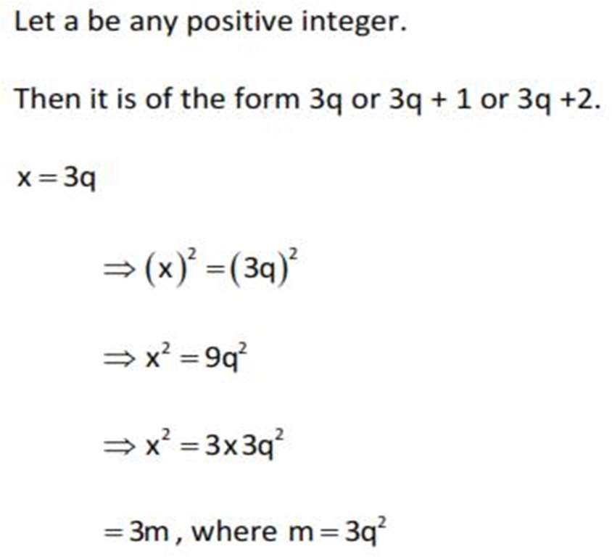
Show that square of any positive integer is of the form 3m or 3m +1 for some integer m.

Slide 5

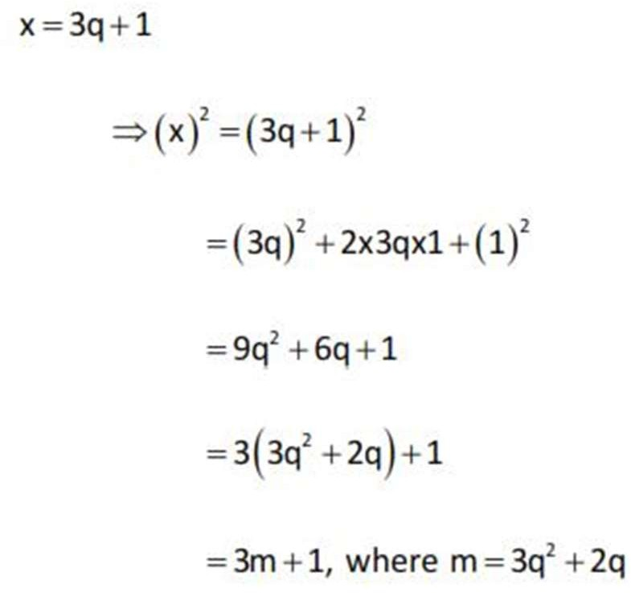

Slide 6

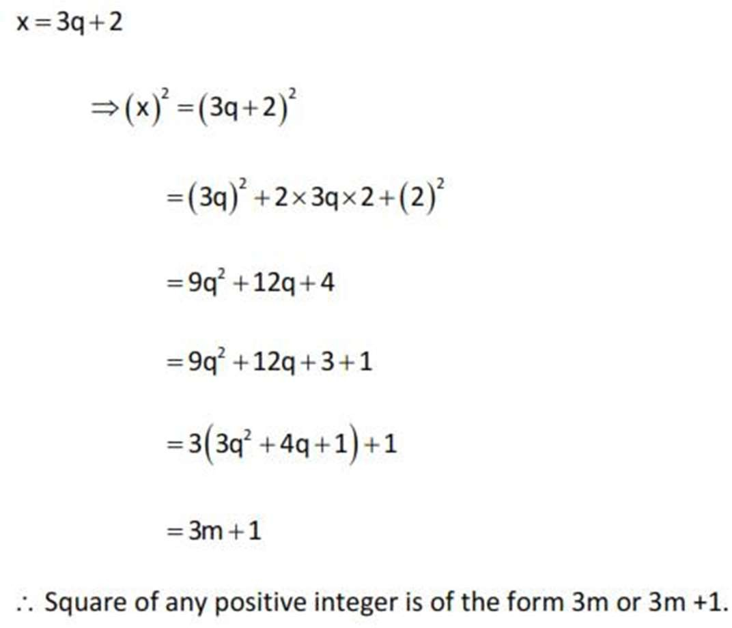

Slide 7

show that one and only one out of n,n+2,n+4 is divisible by 3
https://www.topperlearning.com/answer/show-that-one-and-only-one-out-of-n-n-2-and-n-4-is-divisible-
by-3-where-n-is-any-positive-integer/q0ltvo
n2-1 is divisible by 8 for an odd positive integer
https://www.toppr.com/ask/en-in/question/show-that-n2-1-is-divisible-by-8-if-n-is-an-odd-positive/

Slide 8

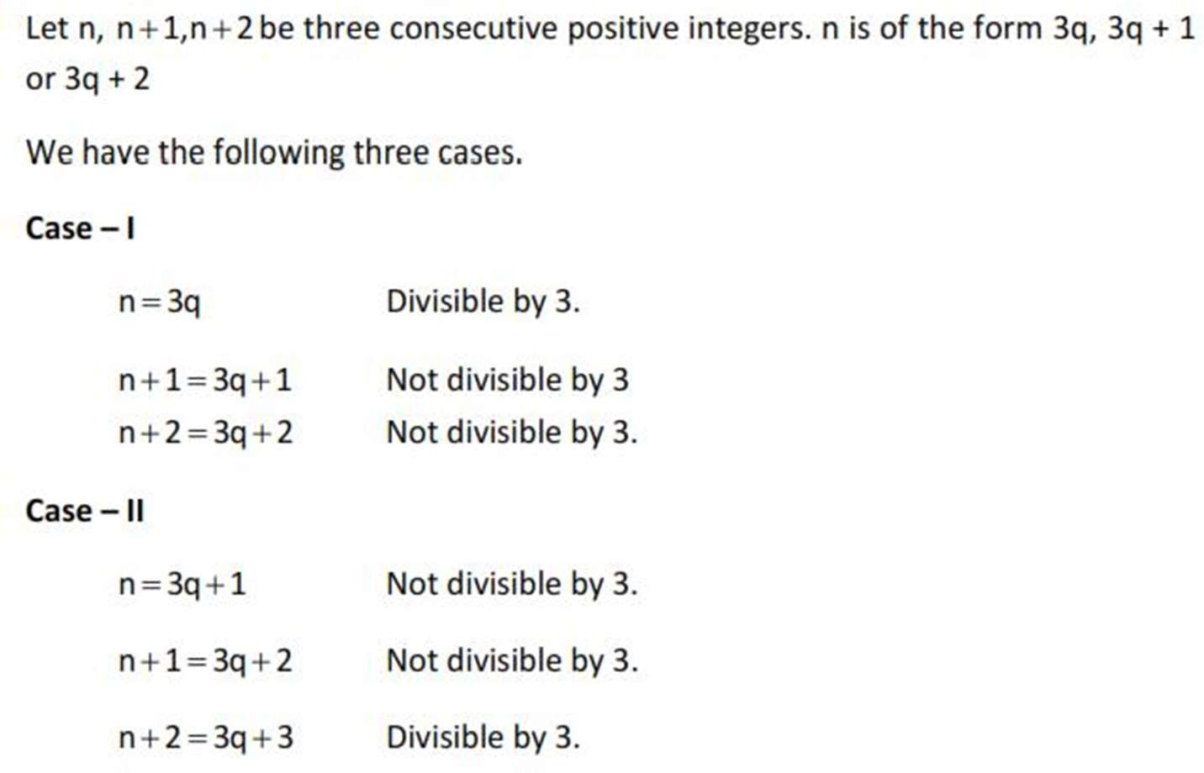
Prove that one of every three consecutive positive integers is divisible by 3.

Slide 9

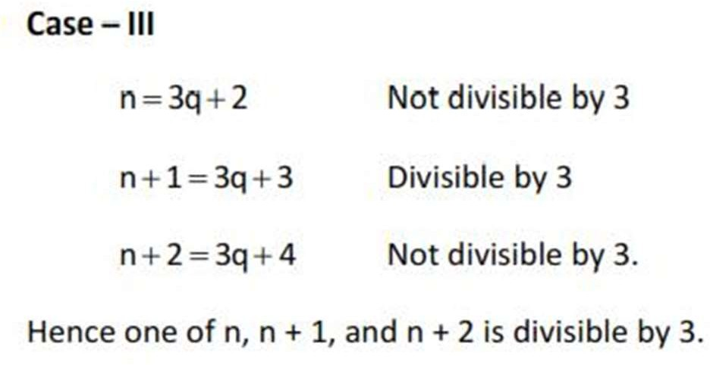

Slide 10

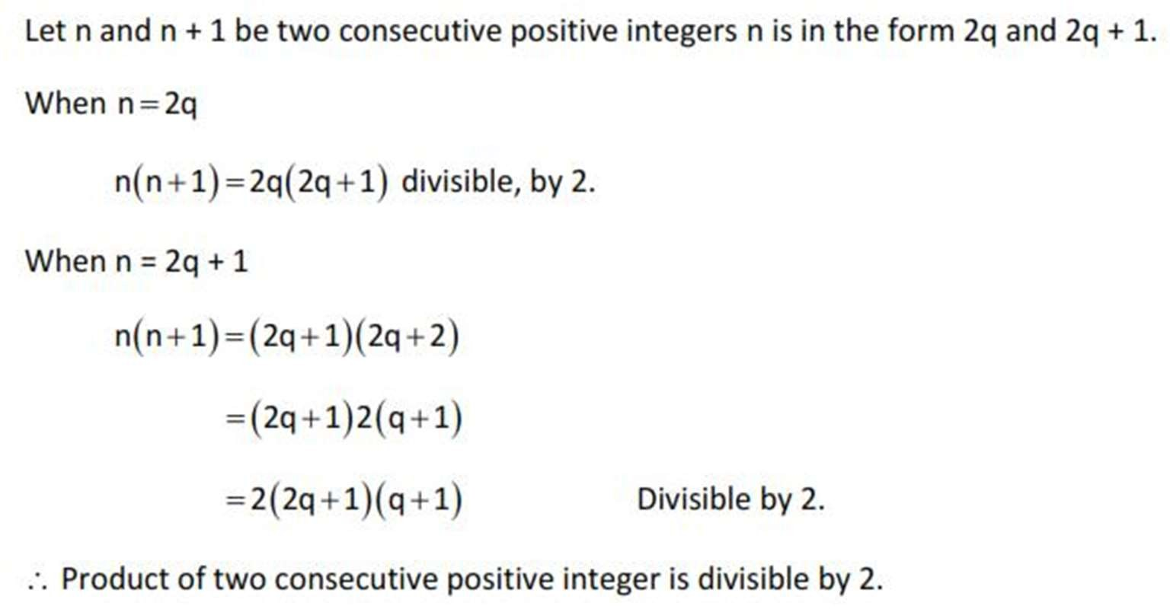
Prove that product of two consecutive positive integers is divisible by 2.

Slide 11

Home assignment
●
Ex. 1.1 Q. No 4 & 5

Slide 12

THANKING YOU
ODM EDUCATIONAL GROUP

