Slide 1

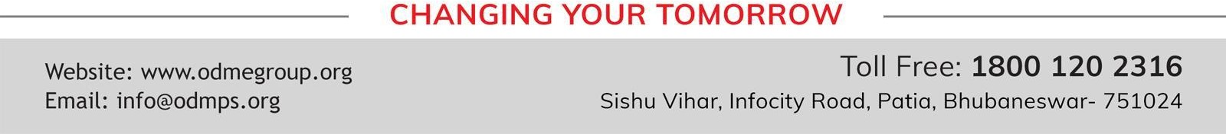
SESSION : 1
CLASS : 5
SUBJECT : SOCIAL SCIENCE CHAPTER NUMBER: 16
CHAPTER NAME : SOME PEOPLE NEVER DIE
SUBTOPIC : INTRODUCTION, ABRAHAM LINCOLN, MAHATMA GANDHI

Slide 2
LEARNING OBJECTIVES:
Enable the learner to know about:
The personality of great persons and their contribution to the society.
How people conduct their lives to determine ways to help improve lives.

Slide 3
CLASS WORK: New words:-
Slave
Convent
Charity
Satyagraha
Missionaries
Georgia
Negroes
LLLinois
Representatives

Slide 4
Introduction:
There are some men and women who, through their actions and words, have made a huge difference in the lives of people. They fought to end the suffering and pain of others and helped them lead a life of dignity and comfort. These great people live on forever in the hearts of the people whose lives they changed.

Slide 5
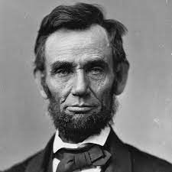
Abraham Lincoln
Born in USA in year 1809.
He was elected to the Illinois House of Representatives at the age of 25.
He was totally against the black slavery which happened in those times.
In 1860, he was the elected President of the USA.
He made various plans to make USA united and banned slavery in USA.
This led to American Civil War which was lasted for four years.
Before the war ended, Lincoln announced freedom of three million slaves in the USA.
He made plans to remove the differences between the northern and southern states but was shot dead by a supporter of the southern states.
Pronunciation of LLLinois - enonoi
Abraham Lincoln

Slide 6
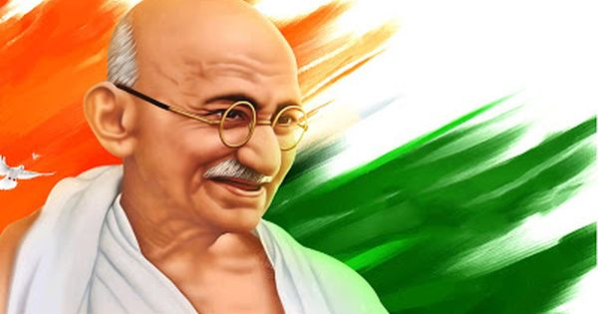
Mohandas Karamchand Gandhi
Born on 02 October 1869 at Porbandar in Gujarat.
He studied law in England.
He went to South Africa and became a successful lawyer.
He opposed injustice by using non-violent methods of protest called ‘Satyagraha’.
His methods were successful in South Africa and India.
He launched ‘Non-Cooperation Movement’ in India in 1920 to struggle against unjust British rule.
Gandhiji started many other movements against the British and forced the Britishers to bow before the might of non-violence and India became free on 15th August 1947.
Gandhiji was against the practice of untouchability in India.
He worked for Hindu-Muslim unity in India.
Gandhiji was shot dead on 30th January 1948 by Nathuram Godse.

Slide 7
SUMMARY:
Life style and achievements of Abraham Lincoln and Gandhiji

Slide 8
LET’S REVISE:
FILL IN THE BLANKS:
_______________ was elected to the LLLinois House of Representatives.
People from Africa, were kept as _______ by the white people.
The ______ backed by Lincoln, won the American Civil War.
___________________ went to South Africa and became a successful lawyer.
The Black of Africa and the Indians living in South Africa were badly treated by the ________
__________________ Movement was launched by Gandhiji in 1920.
____________________ decided to call Gandhiji ‘Mahatma’ or the ‘great soul’.
War between the northern and southern states of USA is called _________________.
Abraham Lincoln
slave
war
Mahatma Gandhi
British.
Non-Cooperation
Rabindranath Tagore
American Civil War

Slide 9
HOMEWORK:
Write difficult words in the notebook.

Slide 10
LEARNING OUTCOME:
By the end of the class, learners will be able to know:
The personality of great persons and their contribution to the society.
How people conduct their lives to determine ways to help improve lives.

Slide 11
THANKING YOU
ODM EDUCATIONAL GROUP

