Slide 1



SESSION NO.: 4
CLASS: 5
SUBJECT: SCIENCE
CHAPTER NUMBER: 14
CHAPTER NAME: NATURAL DISASTERS
SUB TOPIC: DROUGHT

Slide 2
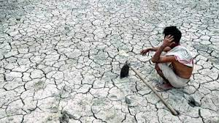
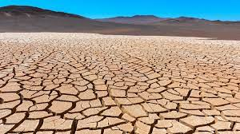
DROUGHT
  If a particular area receives no rain or less rain than normal for a long period, it is said to be affected by drought.
  However, it is not only the lack of rainfall that causes drought.

Slide 3
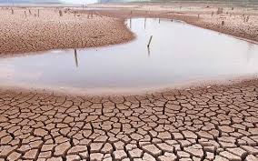
DROUGHT
  Hot dry winds, very high temperature and evaporation of moisture from the ground can result in conditions of drought.

Slide 4
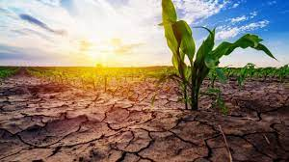
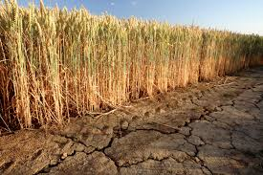
DROUGHT- AFFECTED AREAS
  People have to wait for help to come in the form of food, water and medicines from neighboring places or international agencies.
  India has faced three major droughts in the twentieth century-1904-05, 1965-66 and 1986-87.
  The 1987 drought was known as the drought of the century and had a major impact on one-third of the country.

Slide 5
SUMMARY
If a particular area receives no rain or less rain than normal for a long period, it is said to be affected by drought.
However, it is not only the lack of rainfall that causes drought.
India has faced three major droughts in the twentieth century-1904-05, 1965-66 and 1986-87.
The 1987 drought was known as the drought of the century and had a major impact on one-third of the country.

Slide 6


Slide 7
Q1. The drought of the century in the history of India occurred in ___year.
Ans: 1986-87

Slide 8
Q2.Write two causes of drought. .
Ans: Lack of rainfall
Hot Dry winds

Slide 9
HOMEWORK
We generally see the epidemics after any natural disaster.Why?

Slide 10
LEARNING OUTCOME
The learner will be able to:
know how drought occurs and what are its causes.

Slide 11
THANKING YOU
ODM EDUCATIONAL GROUP

