Slide 1



SESSION NO.: 3
CLASS: 5
SUBJECT: SCIENCE
CHAPTER NUMBER: 14
CHAPTER NAME: NATURAL DISASTERS
SUB TOPIC: TIDAL WAVES

Slide 2
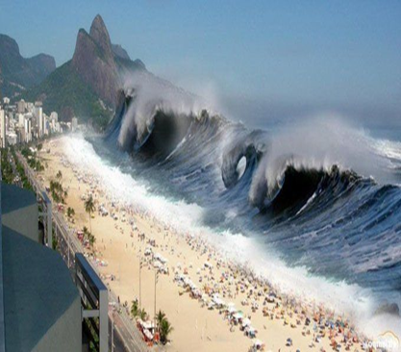
TIDAL WAVES
Tidal or storm waves are also known as tsunamis (pronounced su-nami).
A tsunami is caused by an undersea earthquake or by a severe hurricane or cyclone.

Slide 3
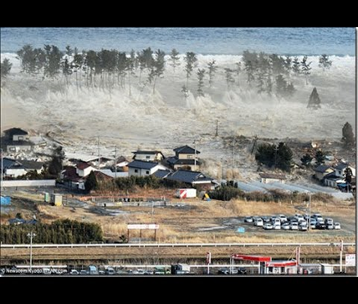
TIDAL WAVES
Storm waves from the sea come rolling towards the shore. They cause destruction on the seashore within seconds.
Tidal waves as high as 15 meters have been recorded. If there is already a high tide then storm waves hit the land.
They can cause severe damage. These giant waves travel at a speed of 800 km/h.
This results in destruction of life and property in the area.

Slide 4
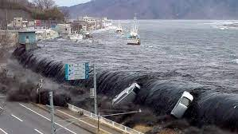
TIDAL WAVES
On 26 December 2004, an earthquake measuring 9.0 on the Richter Scale hit off the coast of Indonesia.
It triggered a massive tsunami that resulted in widespread death and destruction across South Asia.

Slide 5
SUMMARY
Tidal or storm waves are also known as tsunamis (pronounced su-nami).
A tsunami is caused by an undersea earthquake or by a severe hurricane or cyclone.
Tidal waves as high as 15 meters have been recorded. If there is already a high tide then storm waves hit the land.
They can cause severe damage. These giant waves travel at a speed of 800 km/h.

Slide 6


Slide 7
Q1. Tidal or storm waves are also known as ________.
Ans: Tsunami

Slide 8
Q2. A tsunami is caused by an undersea earthquake or by a severe ________ or _________.
Ans: hurricane or cyclone.

Slide 9
HOMEWORK
Do the Oral Q&A of page no. 129.

Slide 10
LEARNING OUTCOME
The learner will be able to:
know how tidal waves occurs and what are its causes.

Slide 11
THANKING YOU
ODM EDUCATIONAL GROUP

