Slide 1


SESSION NO.: 3
CLASS: 5
SUBJECT: SCIENCE
CHAPTER NUMBER: 12
CHAPTER NAME: OUR LIFE SUPPORT
TOPIC: COMPOSITION OF AIR, PROPERTIES OF AIR
Notes:
Water too supports life
Impurities in water
Removal of insoluble impurities
Empty bottles of mineral water should be crushed before throwing them into the dustbin. Why?
Removal of soluble impurities
Draw a labelled diagram of the process of distillation
Purification of drinking water
Draw the picture of purification of town water supply
Long Q & A
Learn the Q & A
Activity
Class test
Learn the Q & A

Slide 2
LEARNING OBJECTIVE
To enable the learner to:
know the composition of air.
list the uses of gases in real life.

Slide 3
LET’S RECAP
The blanket of air that surrounds the earth is called the atmosphere. It has five layers. Troposphere is the layer closest to the earth’s surface. Here, weather changes takes place. Stratosphere is the layer next to troposphere and it contains ozone layer in it. Ozone layer protects us from the harmful rays of the Sun. Next to stratosphere we have mesosphere. This is the layer that burns out meteors or small rocks that comes towards us. Thermosphere lies just above mesosphere. Space shuttles move in this layer. Exosphere is the outermost layer of the atmosphere.
Which layer is next to mesosphere?
Ans: Thermosphere

Slide 4
LET’S RECAP
The blanket of air that surrounds the earth is called the atmosphere. It has five layers. Troposphere is the layer closest to the earth’s surface. Here, weather changes takes place. Stratosphere is the layer next to troposphere and it contains ozone layer in it. Ozone layer protects us from the harmful rays of the Sun. Next to stratosphere we have mesosphere. This is the layer that burns out meteors or small rocks that comes towards us. Thermosphere lies just above mesosphere. Space shuttles move in this layer. Exosphere is the outermost layer of the atmosphere.
2. The layer which is closest to the earth’s surface.
Ans: Troposphere

Slide 5
LET’S RECAP
The blanket of air that surrounds the earth is called the atmosphere. It has five layers. Troposphere is the layer closest to the earth’s surface. Here, weather changes takes place. Stratosphere is the layer next to troposphere and it contains ozone layer in it. Ozone layer protects us from the harmful rays of the Sun. Next to stratosphere we have mesosphere. This is the layer that burns out meteors or small rocks that comes towards us. Thermosphere lies just above mesosphere. Space shuttles move in this layer. Exosphere is the outermost layer of the atmosphere.
3. Describe one use of ozone.
Ans: Ozone layer protects us from the harmful ultraviolet rays of the Sun.

Slide 6
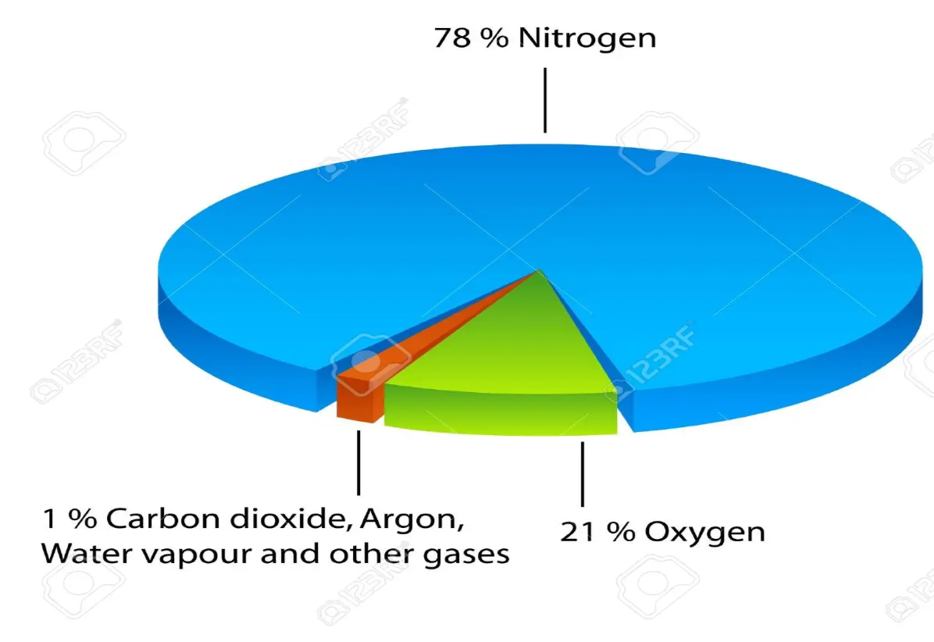
COMPOSITION OF AIR
The air we breathe contains various gases.
Air consists of 78% nitrogen, 21% oxygen and less than 1% of argon, carbon dioxide and other gases.
Air also contains water vapor, dust and smoke.

Slide 7

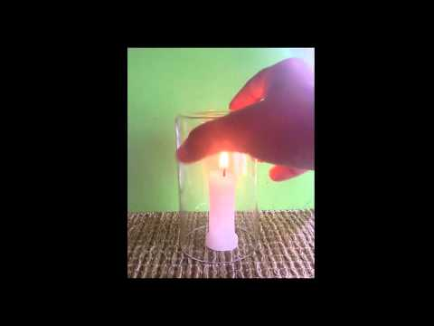
OXYGEN
It is the most important gas for the survival of living beings.
All living things need oxygen.
It is also needed for burning.

Slide 8

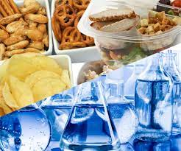
NITROGEN
Living things do not use nitrogen directly from the air.
Nitrogen is used by the plants with the help of bacteria in the soil.
Nitrogen is also added to the soil by using chemical fertilizers.
Animals get nitrogen from plants, meat and fish.

Slide 9
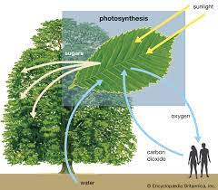
CARBON DIOXIDE
Carbon dioxide is very important for plants.
Plants prepare their food with the help of carbon dioxide water and sunlight by the process called photosynthesis.

Slide 10


OTHER GASES
Other gases such as hydrogen, ozone, helium, neon, argon and krypton are also present in the air.
Neon and argon are used in electric lights to produce the colorful glow in the glass tube.

Slide 11
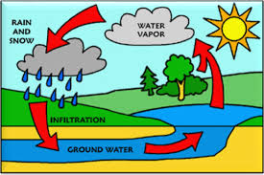
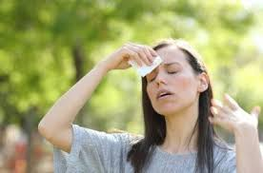
WATER VAPOUR
Water vapour is also a part of air.
Water vapour is formed because of the evaporation of water from the surface of water bodies.
Water vapour in the air can cause changes in the weather.
It condenses to form clouds, rain, fog and snow.
The amount of water vapor present in the air is called humidity.
High humidity makes us feel uncomfortable as our sweat does not evaporate easily.

Slide 12
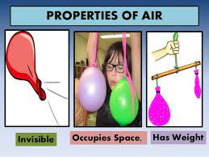
PROPERTIES OF AIR
Air is invisible.
Air has weight.
Air takes up space.
Air exerts pressure.

Slide 13
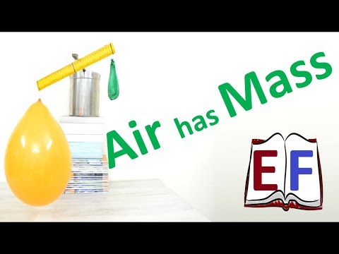
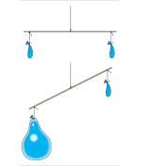
AIR HAS WEIGHT

Slide 14
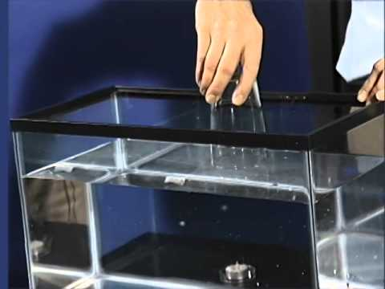
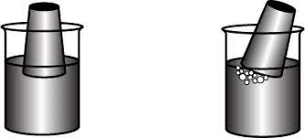
AIR OCCUPIES SPACE

Slide 15
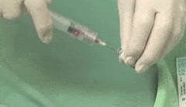
AIR EXERTS PRESSURE

Slide 16
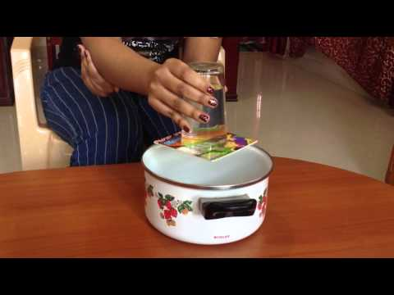
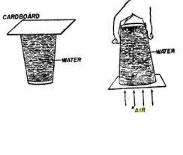
AIR EXERTS PRESSURE IN UPWARD DIRECTION

Slide 17
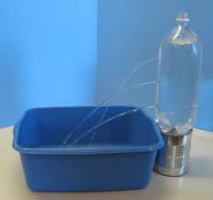
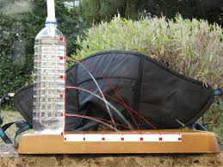
AIR EXERTS PRESSURE IN DOWNWARD DIRECTION

Slide 18
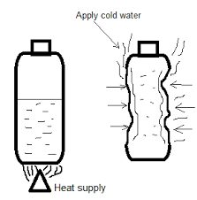
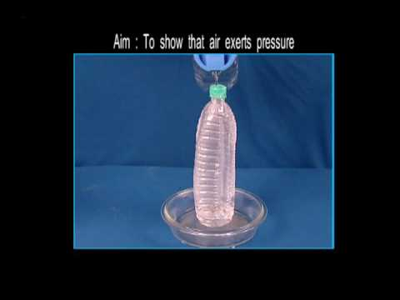
AIR EXERTS PRESSURE

Slide 19
SUMMARY
Air consists of 78% nitrogen, 21% oxygen and less than 1% of argon, carbon dioxide and other gases.
Air also contains water vapor, dust and smoke.
Properties of air:
  Air is invisible.
  Air has weight.
  Air takes up space.
  Air exerts pressure.

Slide 20


Slide 21
Assertion(A): Exhaled air is warmer than inhaled air.
Reason(R): Gaseous exchange takes place in nose.
Both A and R are true and R is correct explanation of A.
Both A and R are true but R is not the correct explanation of A.
A is true and R is false.
A is false and R is true.
Both A and R are false.
Ans: c. A is true and R is false.

Slide 22
Assertion(A): Argon is filled in glass tubes.
Reason(R): Argon produces a colourful glow in glass tubes.
Both A and R are true and R is correct explanation of A.
Both A and R are true but R is not the correct explanation of A.
A is true and R is false.
A is false and R is true.
Both A and R are false.
Ans: a. Both A and R are true and R is correct explanation of A.

Slide 23
Assertion(A): Animals need oxygen to breathe.
Reason(R): Oxygen is needed for survival.
Both A and R are true and R is correct explanation of A.
Both A and R are true but R is not the correct explanation of A.
A is true and R is false.
A is false and R is true.
Both A and R are false.
Ans: a. Both A and R are true and R is correct explanation of A.

Slide 24
HOMEWORK
Do the oral Q & A of page no. 113.

Slide 25
LEARNING OUTCOME
The learner will be able to:
know the composition of air.
list the uses of gases in real life.

Slide 26
THANKING YOU
ODM EDUCATIONAL GROUP

