Slide 1


SESSION NO.: 1
CLASS: 5
SUBJECT: SCIENCE
CHAPTER NUMBER: 12
CHAPTER NAME: OUR LIFE SUPPORT
TOPIC: INTRODUCTION, AIR AROUND US- AIR IS NEEDED FOR BREATHING, AIR IS NEEDED FOR BURNING
Notes:
Layers of atmosphere
Composition of air, cont...
Draw a picture to show the composition of air
Do questions A & B in your notebook
Composition of air
Properties of air
Do the oral Q& A of page no. 113
Water too supports life
Impurities in water
Removal of insoluble impurities
Empty bottles of mineral water should be crushed before throwing them into the dustbin. Why?
Removal of soluble impurities
Draw a labelled diagram of the process of distillation
Purification of drinking water
Draw the picture of purification of town water supply
Long Q & A
Learn the Q & A
Activity
Class test
Learn the Q & A

Slide 2
LEARNING OBJECTIVE
To enable the learner to:
define air and atmosphere.
understand the importance of air and atmosphere.
list the uses of air in our real life.

Slide 3
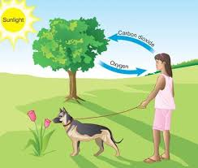
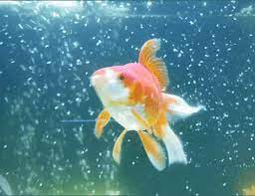
INTRODUCTION-AIR
Living things cannot live without air.
All living things need air to breathe.

Slide 4

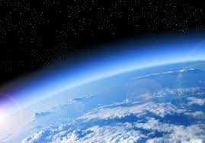
ATMOSPHERE
The thick blanket of air that surrounds our planet is called atmosphere
The atmosphere is held around the earth by the it’s gravity.
Atmosphere is a mixture of gases, water vapour and dust.

Slide 5
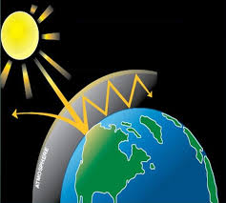
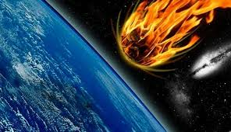
IMPORTANCE OF ATMOSPHERE
It retains heat and blocks out the harmful rays of the sun.
Atmosphere also prevents meteors from hitting the surface of the earth.
The oxygen present in the atmosphere supports life.
Air also contains carbon dioxide which is used by the plants to prepare food.

Slide 6
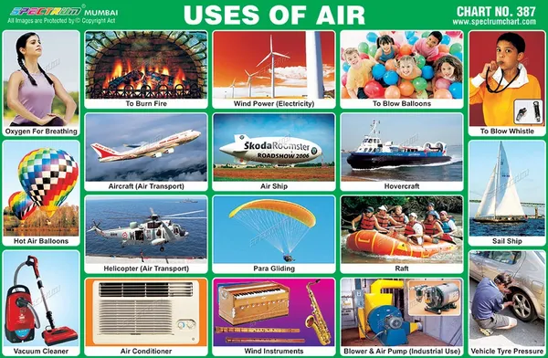
USES OF AIR
Air is used:
for breathing
for burning
to move parachutes, gliders and kites
to inflate footballs and tubes of vehicles
to push sailboats
to turn the blades of windmills
to draw water or generate electricity

Slide 7
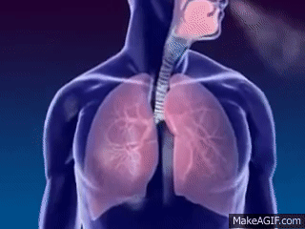
AIR IS NEEDED FOR BREATHING
The fresh air we breathe in is called inhaled or inspired air.
The air we breathe out is called exhaled or expired air.
Our lungs take in the oxygen from the inhale air and mixes it with the blood and takes out carbon dioxide from the blood.
Exhaled air is warmer than inhaled air.

Slide 8
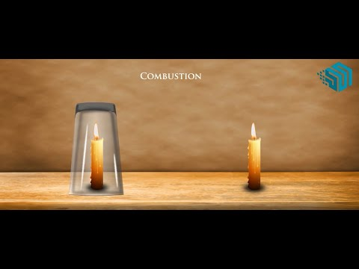
AIR IS NEEDED FOR BURNING
Air contains oxygen which is needed for burning.

Slide 9
SUMMARY
All living things need air to breathe.
The thick blanket of air that surrounds our planet is called atmosphere.
The atmosphere is held around the earth by the it’s gravity.
Air is used for breathing, for burning, to move parachutes, gliders and kites, to inflate footballs and tubes of vehicles, to push sailboats, to turn the blades of windmills, to draw water or generate electricity.

Slide 10


Slide 11
Assertion(A): Air is needed for breathing.
Reason(R): Air contains oxygen.
Both A and R are true and R is correct explanation of A.
Both A and R are true but R is not the correct explanation of A.
A is true and R is false.
A is false and R is true.
Both A and R are false.
Ans: a. Both A and R are true and R is correct explanation of A.

Slide 12
Assertion(A): The atmosphere is a blanket of air surrounding the earth.
Reason(R):The atmosphere is held in place by the Sun’s gravity.
Both A and R are true and R is correct explanation of A.
Both A and R are true but R is not the correct explanation of A.
A is true and R is false.
A is false and R is true.
Both A and R are false.
Ans: c. A is true and R is false.

Slide 13
Assertion(A): Air contains only water vapour.
Reason(R): Moving air is used to generate electricity.
Both A and R are true and R is correct explanation of A.
Both A and R are true but R is not the correct explanation of A.
A is true and R is false.
A is false and R is true.
Both A and R are false.
Ans: d. A is false and R is true.

Slide 14
HOMEWORK
Write the difficult words in your notebook.

Slide 15
LEARNING OUTCOME
The learner will be able to:
define air and atmosphere.
understand the importance of air and atmosphere.
list the uses of air in our real life.

Slide 16
THANKING YOU
ODM EDUCATIONAL GROUP

