Slide 1


SESSION NO.: 4
CLASS: 5
SUBJECT: SCIENCE
CHAPTER NUMBER: 12
CHAPTER NAME: OUR LIFE SUPPORT
TOPIC: WATER TOO SUPPORTS LIFE, IMPURITIES IN WATER, REMOVAL OF INSOLUBLE IMPURITIES
Notes:
Removal of soluble impurities
Draw a labelled diagram of the process of distillation
Purification of drinking water
Draw the picture of purification of town water supply
Long Q & A
Learn the Q & A
Activity
Class test
Learn the Q & A

Slide 2
LEARNING OBJECTIVE
To enable the learner to:
understand the importance of water.
know the types of impurities.
learn the ways to remove the impurities.
list the uses of water in our real life.

Slide 3
LET’S RECAP
Rahul has put one inverted glass in a beaker containing water. When he tilted the glass he observed that bubbles started to come out. What do you think from where this bubbles came? Explain your answer.
How is a doctor able to fill in liquid medicine in a syringe?
Why do the water coming out from the lowest hole in a bottle goes to a longer distance?

Slide 4
WATER TOO SUPPORTS LIFE
Water is as important as air for survival.
We need water to drink.
All living things need water to survive.
We also need water for cooking, bathing, working and construction work.
Rain water is the purest form of water.

Slide 5
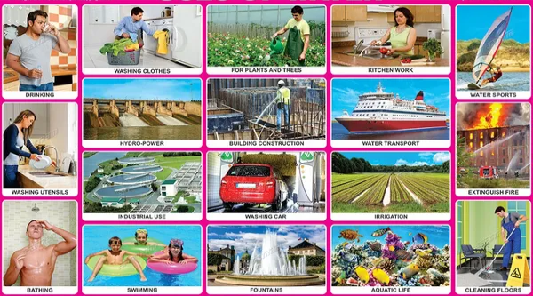
USES OF WATER

Slide 6
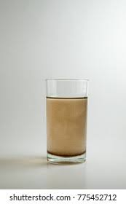
IMPURITIES IN WATER
When some unwanted substances mix in water, then the water becomes impure.
There are many types of impurities:
  Insoluble impurities
  Soluble impurities
  Disease-causing germs

Slide 7
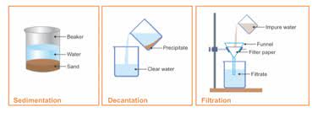
REMOVAL OF INSOLUBLE IMPURITIES
When the impurities are not soluble in water, they are said to be insoluble impurities.
Insoluble impurities can be removed by
  sedimentation,
  decantation and
  filtration.

Slide 8
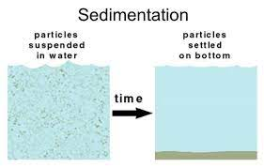
SEDIMENTATION
The process of settling down of heavy particles present in water is called sedimentation.
The impurities that settles down are called sediment.

Slide 9
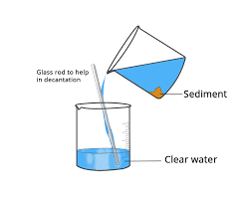
DECANTATION
The process of separation of clear liquid into another container is called decantation.

Slide 10
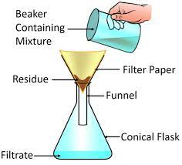
FILTRATION
The process in which solid particles in a liquid are removed by the use of a filter is called filtration.

Slide 11
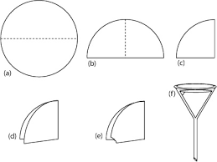
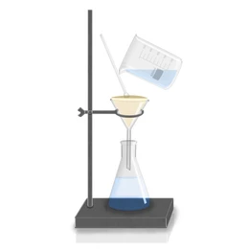
ACTIVITY TO PERFORM FILTRATION
A circular piece of filter paper is taken and a cone is made out of it.
The cone is placed inside a funnel.
The funnel is placed on the mouth of a conical beaker.
The mixture of soil and water is poured over the filter paper by using a glass rod.
Drops of clear water will trickle into the beaker and gets collected as filtrate.
Soil particles will be left on the filter paper.

Slide 12
SUMMARY
Water is as important as air for survival.
Rain water is the purest form of water.
When some unwanted substances mix in water, then the water becomes impure.
There are many types of impurities:
  Insoluble impurities
  Soluble impurities
  Disease-causing germs
When the impurities are not soluble in water, they are said to be insoluble impurities.
Insoluble impurities can be removed by sedimentation, decantation and filtration.

Slide 13


Slide 14
Assertion(A): Argon is filled in glass tubes.
Reason(R): Argon produces a colourful glow in glass tubes.
Both A and R are true and R is correct explanation of A.
Both A and R are true but R is not the correct explanation of A.
A is true and R is false.
A is false and R is true.
Both A and R are false.
Ans: a. Both A and R are true and R is correct explanation of A.

Slide 15
Assertion(A): Air exerts pressure in all direction.
Reason(R): Air is everywhere.
Both A and R are true and R is correct explanation of A.
Both A and R are true but R is not the correct explanation of A.
A is true and R is false.
A is false and R is true.
Both A and R are false.
Ans: b. Both A and R are true but R is not the correct explanation of A.

Slide 16
HOMEWORK
Empty bottles of mineral water should be crushed before throwing them into the dustbin. Why?

Slide 17
LEARNING OUTCOME
The learner will be able to:
understand the importance of water.
know the types of impurities.
learn the ways to remove the impurities.
list the uses of water in our real life.

Slide 18
THANKING YOU
ODM EDUCATIONAL GROUP

