Slide 1


SESSION : 2
CLASS : IV
SUBJECT : ENGLISH
CHAPTER NUMBER : 7
CHAPTER NAME : Whittington and his cat
SUBTOPIC : Explanation , new words and new words

Slide 2
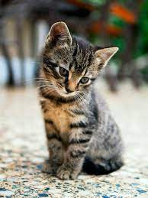
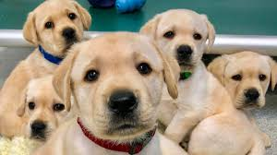
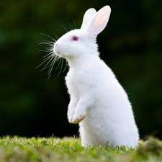
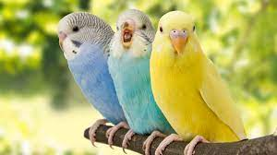
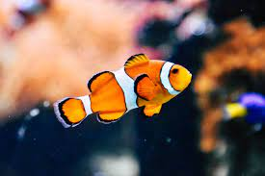
PETS

Slide 3
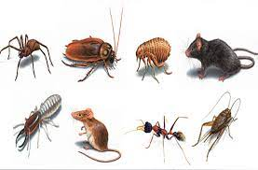

Pests Are there pests in your house? What do you do to keep your house free of pests? Do you think pets are useful to us? Lets enjoy a video on a pet.

Slide 4
LEARNING OUTCOME
Knowledge of new words and their uses .
Application of some phreses.

Slide 5

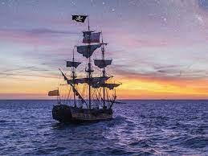
After some days, Mr Fitwarren’s ship was ready to sail and he called for his servants. It was the custom that everybody gave something they owned or made to be sold to foreign lands. The captain would return with the money for it. Poor Wittington had nothing but the cat.he gave his cat to the captain. The ship sailed along.

Slide 6
Soon, sailers were facing a menace. The ship was full of rats! They nibbled the food and tore the clothes. The sailors were irritated. The captain set Whittington’s cat out of it’s room hoping that it would kill a few rats. But Whittington’s cat killed all the rats. The captain and the soldiers were very happy. After a long journey, the ship reached the cost of Barbary. The captain sent patterns of the best things that he had to the king of the country. Soon, the king invited the captain to his palace for dinner. Just as they were about to sit down to dinner, a large number of mice rushed in and started nibbling the meat.

Slide 7
The captain was shocked and asked, “ How do you tolerate these pests? “We are helpless!” the king said, “I have offered a huge reward to anyone who will help us get rid of them. But nobody has been able to do anything”! The captain remembered Whittington’s cat and said “Do not worry, your Majesty! I have the perfect solution for your problem”. The king said sadly, “you do not understand. These pests are in thousands. We have tried everything.” the captain reassured the king, I promise you all will be fine and your country will be free of these pests. Soon, he returned with the cat. As soon as the cat saw the rats,

Slide 8
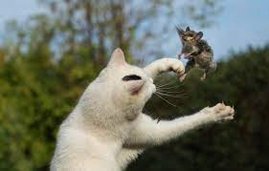
She jumped out of the captain’s arms. In a few minutes, half the mice lay dead at her feet. The rest scampered away in terror. The king was so happy that he ordered the ship to be loaded with all the treasure it would carry.

Slide 9
New words custom- a tradition followed by a society menace- a threat or danger scampered- ran away quickly

Slide 10


