Slide 1


SESSION : 1
CLASS : IV
SUBJECT : ENGLISH
CHAPTER NUMBER : 7
CHAPTER NAME : Whittington and his cat
SUBTOPIC : Introduction with a video, explanation and new words

Slide 2
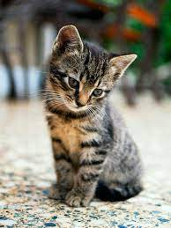
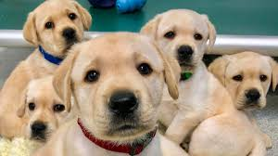
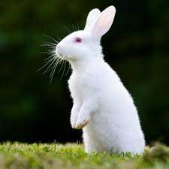
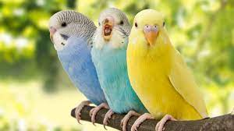
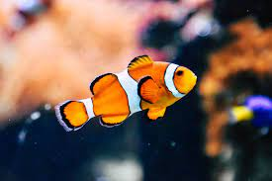
PETS

Slide 3
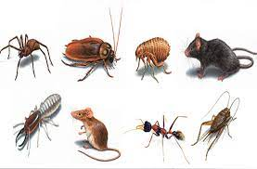

Pests Are there pests in your house? What do you do to keep your house free of pests? Do you think pets are useful to us? Lets enjoy a video on a pet.

Slide 4
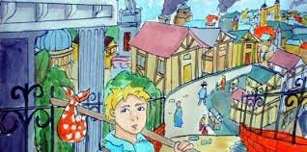
Lets read the story about a little boy and his cat A long time ago, a young boy named Richard Whittington hitchhiked to London to try his fortune. He did odd jobs here and there and slapt on the pavement. One day he was spotted by a merchant,

Slide 5
Mr Fitzwarren, who gave him work at his house. His job was to help the cook and in return, he received food and lodging. Whittington enjoyed work but he faced a big problem. There were rats in the attic where he slept. They would keep him awake most of the night. He would be tired and weary the next morning. Whittington decided to get a cat. As luck would have it, the next day, he came across a girl with a cat. He bought the cat for a penny. Whittington slept soundly from then on. The cat became his only friend.

Slide 6
Whittington also loved to daydream. He would think of faraway lands where he would go on expeditions with his faithful cat. He imagined himself as a knight who rid the world of rats! He saw people cheering him and kings sending envoys with treasures in gratitude. But all these would come to a sudden end when he would hear the cook shout, “Whittington! I want you to clean the pots. Where are you , you idle boy? What have you been doing?” Whittington would stop his daydreaming and get back to work. He believed that some day things would be different.

Slide 7

WHITTINGTON AND HIS CAT
New words
Hitchhiked – travelled by asking for free rides in other people’s vehicles
Fortune- luck
Pavement- footpath
Weary- extreme tiredness
Expedition- adventurous trips
Envoys- messengers
Treasure – precious gems and valuable objects

Slide 8
LEARNING OUTCOME
Knowledge of new words and their uses .
Application of some phreses.

Slide 9


