Slide 1


WELCOME TO THE ONLINE CLASS
SESSION NO.: 2
CLASS: 4
SUBJECT: SCIENCE
CHAPTER NUMBER: 9
CHAPTER NAME: ANIMALS: LIVING AND SURVIVING
SUB TOPIC: ADAPTATIONS TO ENVIRONMENT-TERRESTRIAL ANIMALS: POLAR BEARS AND ARCTIC FOXES

Slide 2
LEARNING OBJECTIVE
To enable the learner to:
understand the importance of adaptations among animals.
classify animals according to their habitats and feeding habits.

Slide 3
RECAPITULATION
The process of changing to suit the environment is known as ______________.
A snake crawls with the help of its _____________.
How do camels protect themselves from heat?
Why some animals like lizards and frogs sleep for several months in winter?

Slide 4
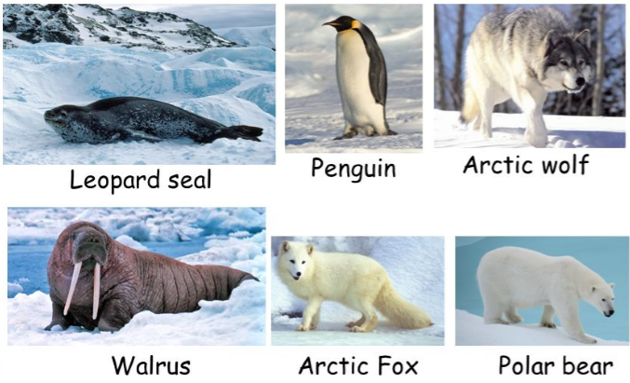
ANIMALS IN ARCTIC AREAS HAS SEVERAL FEATURES
They have a white appearance.
They have thick layers of fat and fur - for insulation against the cold.
Have small ears - helps to maintain the warmness of the body.
Broad and large paws - helps them to walk in the snow.

Slide 5
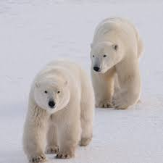
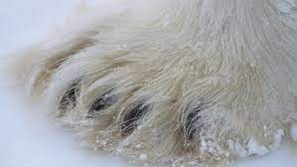
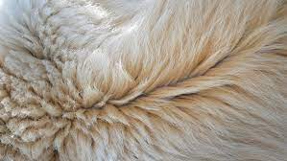
ADAPTATIONS TO THE ENVIRONMENT BY POLAR BEARS
A polar bear lives in the cold and snowy Arctic lands.
They are the largest land carnivores.
Their white fur helps them to blend in with the snow and ice.
The wide and large paws help a polar bear to walk in the snow.
They have fat under the skin which is used as food in winter.

Slide 6
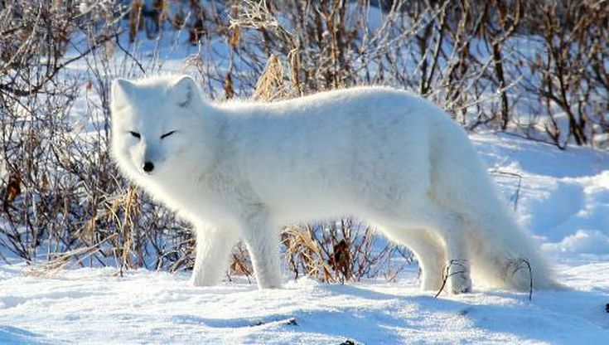
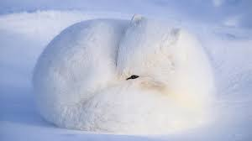
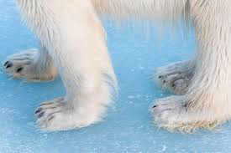
ADAPTATIONS TO THE ENVIRONMENT BY ARCTIC FOXES
Arctic Foxes have white, thick, fur and fluffy tail which help them to survive in harsh habitat.
These Foxes have small pointy ears that helps them to hear their prey moving underground.
Their round, compact bodies minimize surface area that is exposed to the cold air.
Their muzzle, ears, and legs are short, which also conserves heat.
Arctic foxes also have thick fur on their paws, which allows them to walk on both snow and ice.

Slide 7
SUMMARY
Animals in Arctic region has white appearance.
They have thick layer of fur and fat in their body to protect themselves from extreme cold.
Polar Bears are largest land carnivores.
Arctic foxes and Polar bears have thick fur on their paws, which allows them to walk on both snow and ice.

Slide 8


Slide 9
Q1. Name two animals who live in Arctic lands.
Ans: Polar bears and Arctic foxes

Slide 10
Q2. A polar bear lives in the ____ and ________ Arctic lands.
Ans: cold and snowy

Slide 11
Q3. Why do Arctic animals have short ears and legs?
Ans: to conserve the heat

Slide 12
HOMEWORK
Do the questions A, B & C in your notebook.

Slide 13
LEARNING OUTCOME
The learner will be able to:
understand the importance of adaptations among animals.
classify animals according to their habitats and feeding habits.

Slide 14
THANKING YOU
ODM EDUCATIONAL GROUP

