Slide 1


WELCOME TO THE ONLINE CLASS
SESSION NO.: 1
CLASS: 4
SUBJECT: SCIENCE
CHAPTER NUMBER: 9
CHAPTER NAME: ANIMALS: LIVING AND SURVIVING
SUB TOPIC: INTRODUCTION, ADAPTATIONS TO ENVIRONMENT-TERRESTRIAL ANIMALS: SNAKE AND CAMEL

Slide 2
LEARNING OBJECTIVE
To enable the learner to:
understand the importance of adaptations among animals.
classify animals according to their habitats and feeding habits.

Slide 3
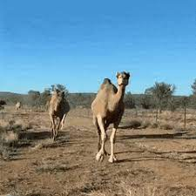
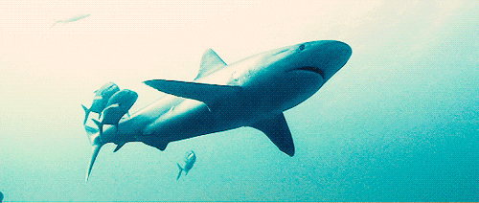
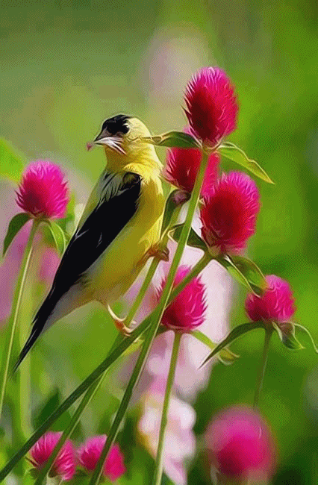
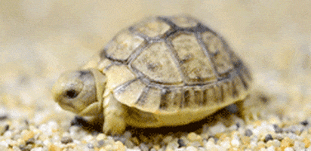
ANIMALS ADAPT THEMSELVES IN DIFFERENT SURROUNDINGS
We live in…...
IN THE WATER
MAINLY IN DESERT
ON THE TREE
BOTH ON LAND AND WATER

Slide 4
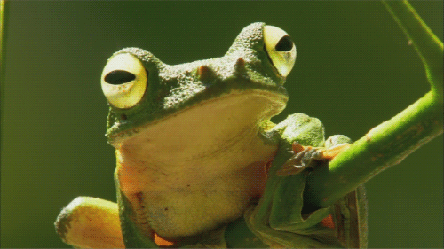
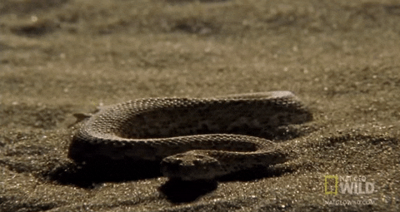
ADAPTATION
In the natural world, a plant or an animal adapts or changes itself to suit its surroundings, this process of changing to suit the surroundings is called adaptation.
Living things that are able to adapt themselves to their surroundings can survive.

Slide 5
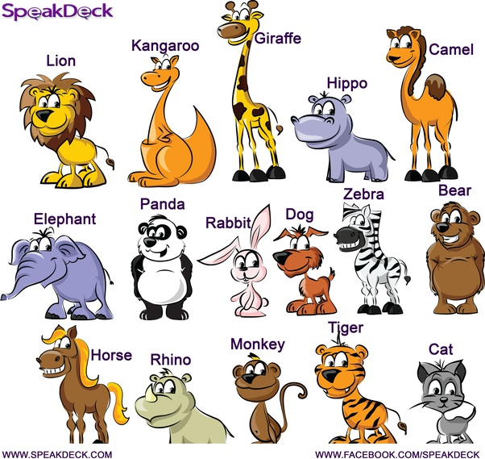
ADAPTATIONS TO ENVIRONMENT
The natural home of an animal is called its habitat.
TERRESTRIAL ANIMALS
Animals who live on land are called terrestrial animals.
These animals have developed specific features that help them to survive and live on land.
Examples of terrestrial animals are cats, ants, dogs, spiders, kangaroos, tigers, lions, mice, bats, bulls, oxen, leopards, elephants and many more.

Slide 6
FEATURES OF TERRESTRIAL ANIMALS
Most of these animals have legs, which help them to run fast.
They have lungs to breathe .
They have well- developed sense organs and nervous system.
These organs helps them to sense the changes in their surroundings.

Slide 7
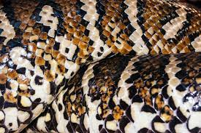
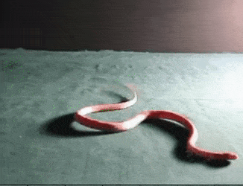
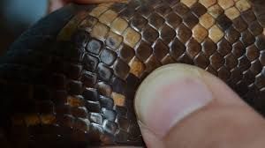
ADAPTATIONS TO THE ENVIRONMENT BY SNAKES
Animals like snakes do not have legs.
They have plates or scales that help them to crawl on the land.

Slide 8
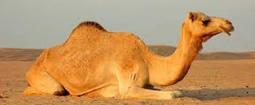
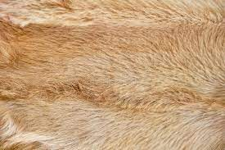
ADAPTATIONS TO THE ENVIRONMENT BY CAMEL
Camel lives in desert area.
They have thick skin.
Their body is not very hairy.
Thick skin of camels protect them from the heat of the sun.

Slide 9
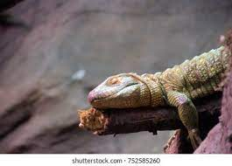
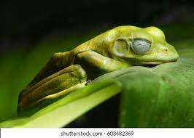
HIBERNATION
Some animals like lizards and frogs sleep for several months to protect themselves from the cold. This process is called hibernation.

Slide 10
SUMMARY
The process of changing to suit the environment is known as adaptation.
Habitat is known as the natural environment of the animals.
In the natural world, a plant or an animal adapts or changes itself to suit its environment.
Terrestrial animals are animals that live on the land.

Slide 11


Slide 12
Q1. The process of changing to suit the environment.
Ans: Adaptation

Slide 13
Q2. Animals like frogs and_______sleep for several months to protect themselves from cold.
Ans: lizards

Slide 14
Q3. Snakes are __________ animals.
Ans: terrestrial

Slide 15
HOMEWORK
Write the difficult words in your notebook.

Slide 16
LEARNING OUTCOME
The learner will be able to:
understand the importance of adaptations among animals.
classify animals according to their habitats and feeding habits.

Slide 17
THANKING YOU
ODM EDUCATIONAL GROUP

