Slide 1


WELCOME TO THE ONLINE CLASS
SESSION NO.: 5
CLASS: 4
SUBJECT: SCIENCE
CHAPTER NUMBER: 8
CHAPTER NAME: ANIMALS: HOW LIFE GOES ON
SUB TOPIC: SHORT AND LONG Q/A

Slide 2
LEARNING OBJECTIVE
To enable the learner to:
write short and long Q/A

Slide 3
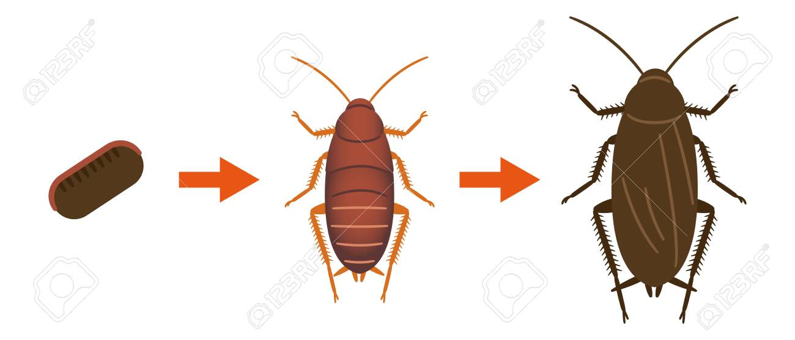
RECAPITULATION
COMPLETE THE LIFECYCLE OF A COCKROACH
EGG
NYMPH
ADULT
Why does fish lays thousands of eggs?
Shedding of old skin by animals is called______________

Slide 4
TICK THE CORRECT ANSWER
The process of producing young ones is called
reproduction ✅ b) digestion c) photosynthesis
2. The yellow portion inside an egg is the
yolk ✅ b) albumen c) lemon
3) The young one of a frog is called
tadpole ✅ b) larva c) maggot
4) Shedding of old skin by animals is called
moulting ✅ b) changing c) reproduction
5) Which of the following is the larva of a housefly
maggot ✅ b) nymph c) pupa

Slide 5
FILL IN THE BLANKS WITH THE CORRECT WORDS FROM BRACKETS.
Mammals ( Mammals/ Reptiles) take care of their babies for a long period of time.
Most birds build nests( nests/ holes) to lay eggs.
The larva of a butterfly is called caterpillar( maggot/ caterpillar).
Reptiles like lizards and snakes( snakes/fishes) lay their eggs in holes in the ground.

Slide 6
ANSWER THESE QUESTIONS
Q1. What are the different ways by which animals reproduce?
Ans: Animals reproduces in two ways:
by laying eggs
by giving birth to their young ones
Q2. How do mammals take care of their young ones?
Ans: Mammals take care of their young ones in many ways usually by mothers as
they feed their babies
clean them and keep them warm
protect them from enemies
teach them to find food for their survival
Q3. Why does a fish lay a large number of eggs at a time?
Ans: Fish lays thousands of eggs at a time in water because out of these only few hundred eggs grow into a baby fish, as many eggs and baby fish are eaten up by big fish.

Slide 7
SUMMARY
Animals reproduce in two different ways, by laying eggs and giving birth to young ones.
Animals which gives birth to young ones and give them their milk are called mammals.
Moulting is shedding of old skin or shell.
Some animals give more parental care to their young ones than others do.

Slide 8
WRITE SHORT ANSWERS
Q1. How do birds reproduce?
Ans: Birds reproduces by laying eggs.
Q2. What are nymphs?
Ans: Young ones of insects resembling the adults are known as nymphs.
Q3. What are the four stages in the life cycle of a butterfly?
Ans: The four stages of butterfly life cycle are:
Stage 1: Eggs
Stage 2: Caterpillar
Stage 3: Pupa
Stage 4: Adult
Q4: Name two insects which have three stages in their life cycle.
Ans: Some insects like grasshoppers and cockroaches have three stages in their life cycle.

Slide 9


Slide 10
Q1. _______are most developed among all animals.
Ans: mammals

Slide 11
Q2. Butterfly has ______stages of life cycle.
Ans: 4 stages

Slide 12
Q3. The young one that is different from the adult insect.
Ans: larva

Slide 13
HOMEWORK
Do the oral Q & A of page no. 70 and do the crossword puzzle given in page no. 73

Slide 14
LEARNING OUTCOME
The learner will be able to:
write short and long Q/A

Slide 15
THANKING YOU
ODM EDUCATIONAL GROUP

