Slide 1


WELCOME TO THE ONLINE CLASS
SESSION NO.: 4
CLASS: 4
SUBJECT: SCIENCE
CHAPTER NUMBER: 8
CHAPTER NAME: ANIMALS: HOW LIFE GOES ON
SUB TOPIC: LIFE CYCLE OF A COCKROACH AND A BUTTERFLY

Slide 2
LEARNING OBJECTIVE
To enable the learner to:
observe and understand the developmental changes in the life cycle of a cockroach and a butterfly

Slide 3
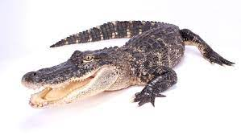
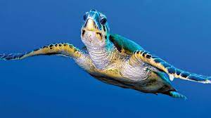
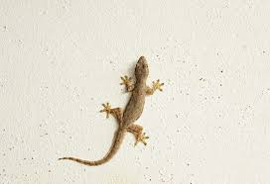
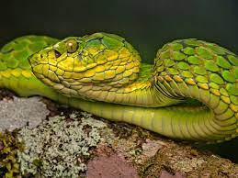
RECAPITULATION
The baby of a frog is known as _______.
Most birds build ______ to lay eggs.
Name these reptiles:

Slide 4
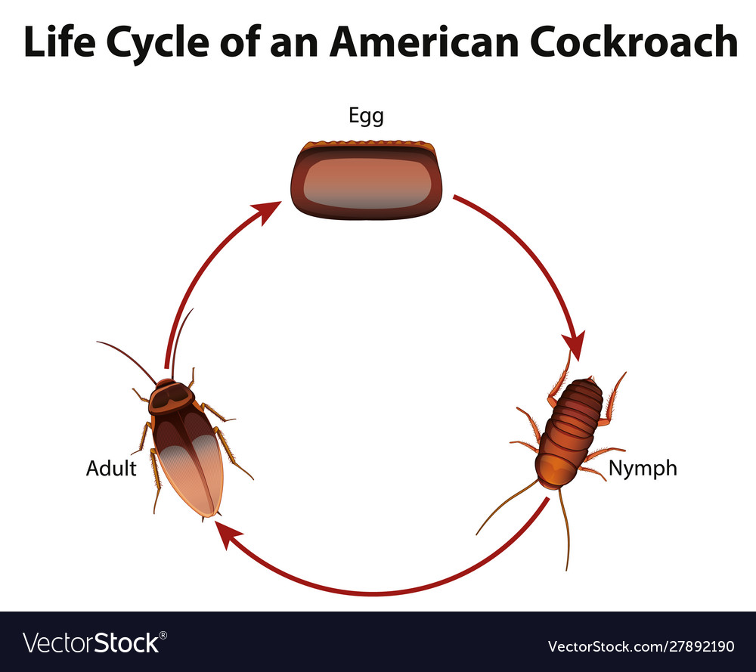
LIFE CYCLE OF A COCKROACH
Life cycle of a cockroach has three stages : the egg, nymph and the adult stage
The baby insect which comes out of the egg is called a nymph.
It is very similar to the parent.
After moulting many times, it changes into an adult.

Slide 5
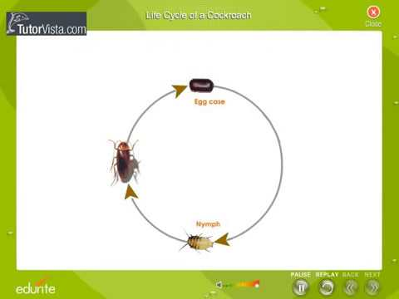

Slide 6
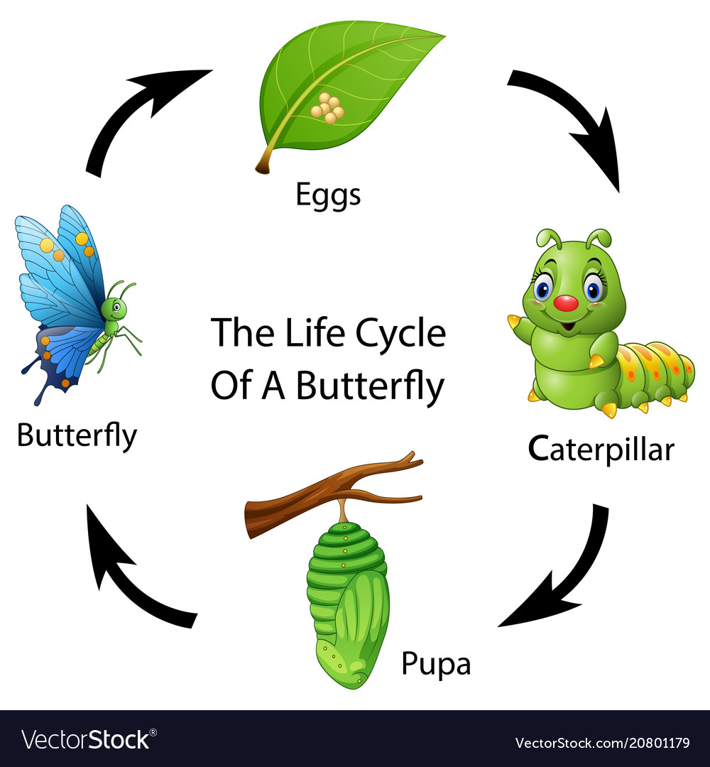
LIFE CYCLE OF A BUTTERFLY
Butterflies have four stages in their life cycle: the egg , caterpillar, pupa and the adult.
The young one that hatches from the egg of these insects is called a larva.
The larva of a butterfly is called a caterpillar.
The larva eats leaves and grows rapidly.
After some time it stops eating and forms a covering called as a pupa around itself.
Later the pupa bursts open and the butterfly comes out.

Slide 7
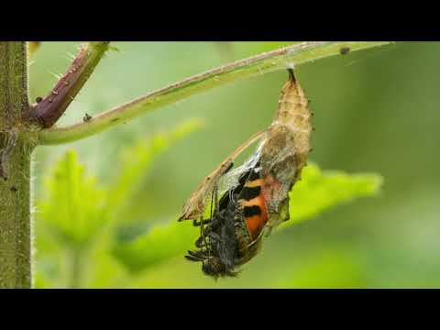

Slide 8
SUMMARY
Life cycle of some insects like cockroaches and grasshoppers has three stages.
The baby insect which comes out of the egg is called as nymph.
The young one that hatches from the egg of these insects is called as larva.
The larva of a butterfly is called as caterpillar.

Slide 9
WRITE SHORT ANSWERS
Q1. How do birds reproduce?
Ans: Birds reproduces by laying eggs.
Q2. What are nymphs?
Ans: Young ones of insects resembling the adults are known as nymphs.
Q3. What are the four stages in the life cycle of a butterfly?
Ans: The four stages of butterfly life cycle are:
Stage 1: Eggs
Stage 2: Caterpillar
Stage 3: Pupa
Stage 4: Adult
Q4: Name two insects which have three stages in their life cycle.
Ans: Some insects like grasshoppers and cockroaches have three stages in their life cycle.

Slide 10


Slide 11
Q1.How many stages do cockroach has in its life cycle?
Ans: three stages

Slide 12
Q2.The baby insect which comes out of an egg is called as __________.
Ans: nymph

Slide 13
Q3.The larva of a butterfly is called as __________ .
Ans: caterpillar

Slide 14
HOMEWORK
Draw the lifecycle of a cockroach and a butterfly in your project record.

Slide 15
LEARNING OUTCOME
The learner will be able to:
observe and understand the developmental changes in the life cycle of a cockroach and a butterfly

Slide 16
THANKING YOU
ODM EDUCATIONAL GROUP

