Slide 1


SESSION NO:7
CLASS :IV
SUBJECT : SOCIAL SCIENCE
CHAPTER NUMBER: 6
CHAPTER NAME : THE SOUTHERN PLATEAU
SUBTOPIC: LIFE IN THE SOUTHERN PLATEAU -ANDHRA PRADESH, TELENGANA, TAMIL NADU, MADHYA PRADESH, CHHATTISGARH

Slide 2
LEARNING OBJECTIVES:
Children will come to know -
About Andhra Pradesh, Telangana
Its crop
Festivals
Rivers

Slide 3
Warm up:
How many of you are vegetarian and Non-vegetarians?
Those who are non-vegetarian, What do you love to eat in non-veg ?
Do you know, from which state Odisha is importing fish?

Slide 4
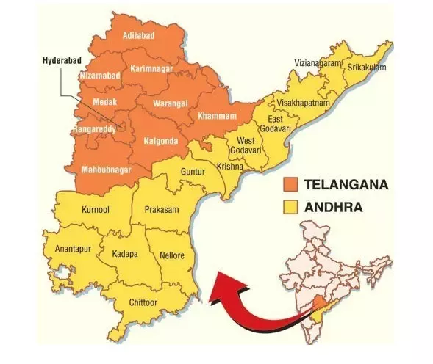

Slide 5
ANDHRA PRADESH

Slide 6
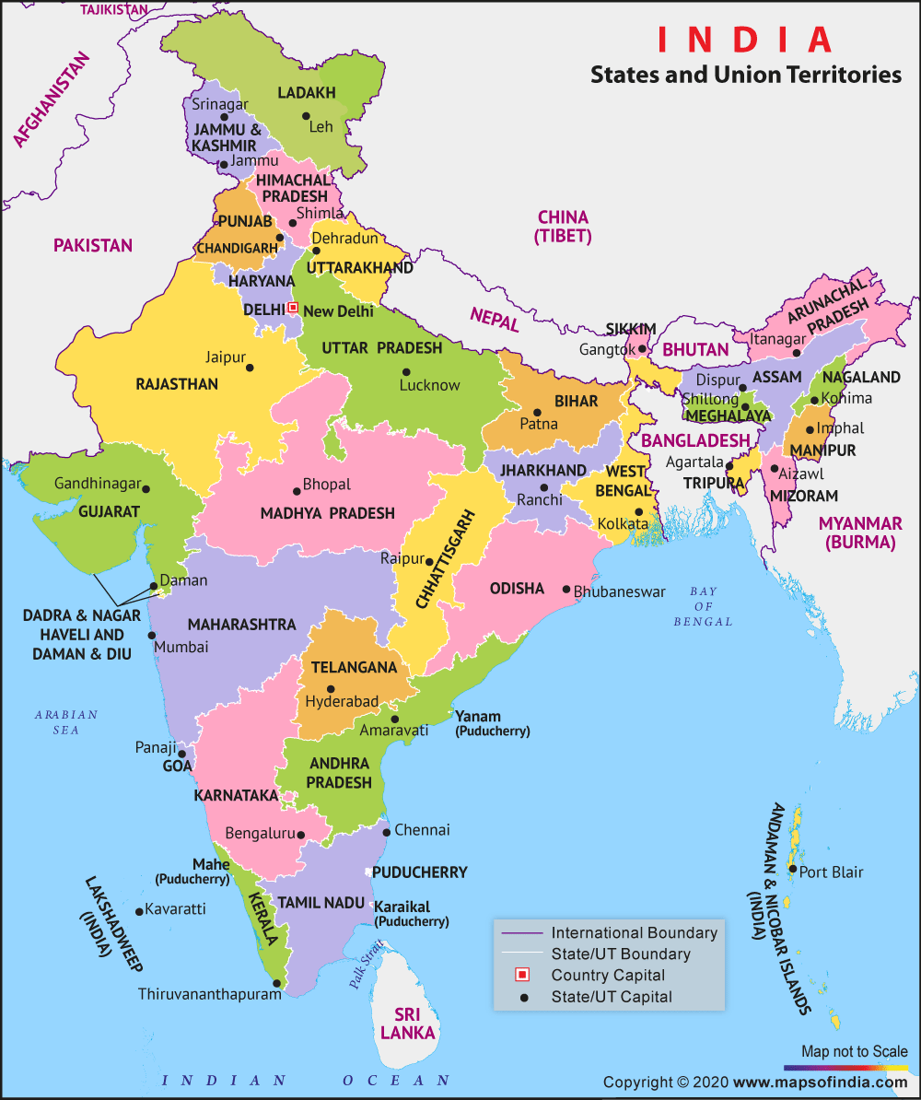
To the north-east of Karnataka is Andhra Pradesh.
Capital - Amaravati

Slide 7
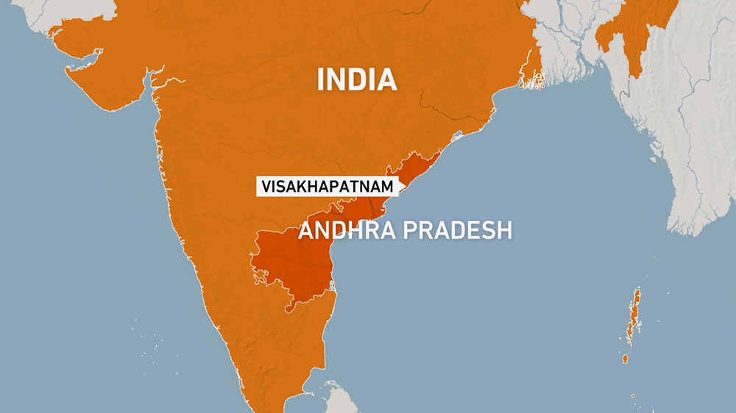
Other important city of Andhra Pradesh is
Visakhapatnam - one of the largest producers of
rice
red chilli
tobacco
Textiles and information technology ( IT-are important industries of the state).

Slide 8
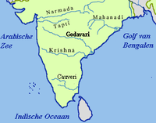
The rivers Krishna and Godavari flow through the state.

Slide 9
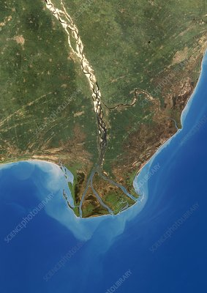
Their fertile deltas are ideal for the cultivation of rice.
This region is known as the 'rice bowl of India'.

Slide 10
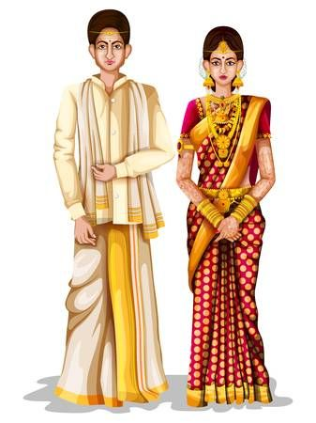
Language - Telugu.
The men wear traditionally dhoti and shirt.

Slide 11
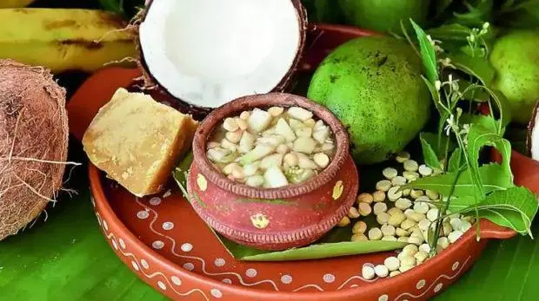



Important festivals:
Sankranti
Ugadi
Dussehra
Eid
Christmas

Slide 12
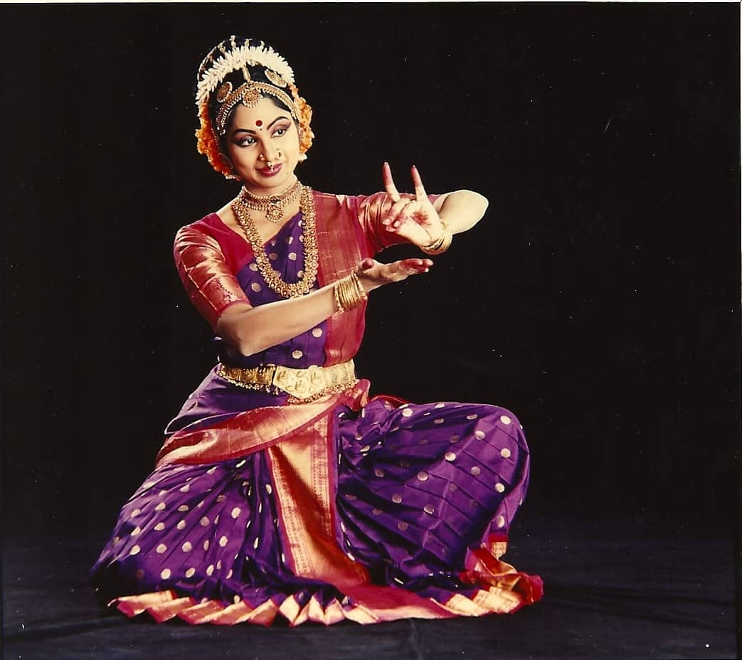
Famous dance form - Kuchipudi
Kuchipudi is one of the eight
major Indian classical dances.
It originated in a village named Kuchipudi in the
Indian state of Andhra Pradesh.

Slide 13
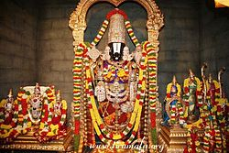
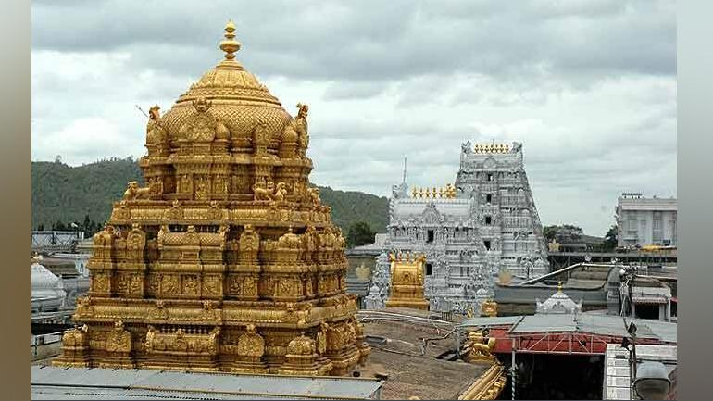
The Venkateshwara Temple in Tirupati is visited by lakhs of devotees every year.

Slide 14
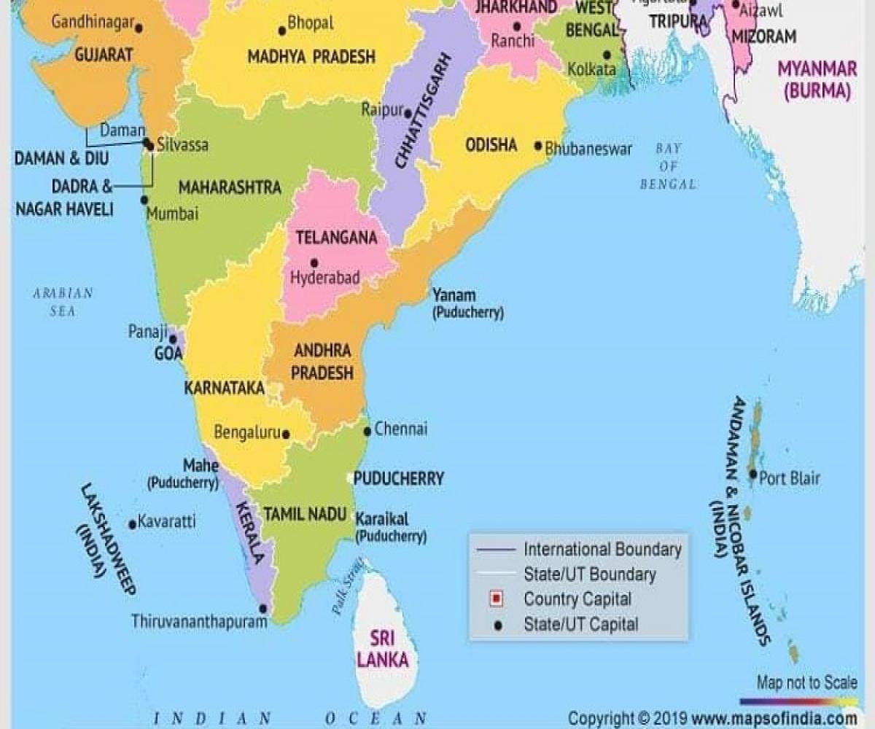
TELANGANA

Slide 15
The state of Telangana was formed in June 2014.
Capital - Hyderabad.
The other important cities of the state are:
Warangal
Karimnagar
Nizamabad
Khammam

Slide 16
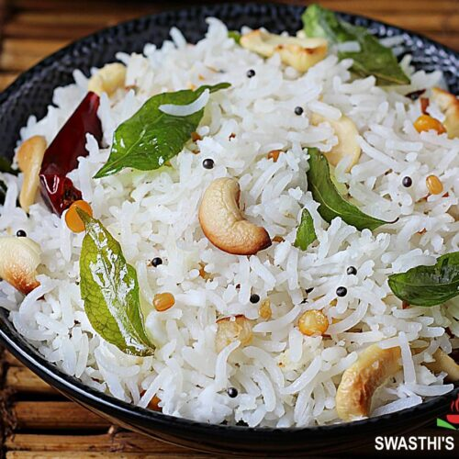
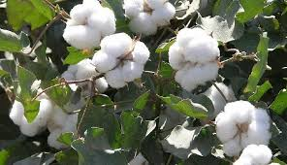
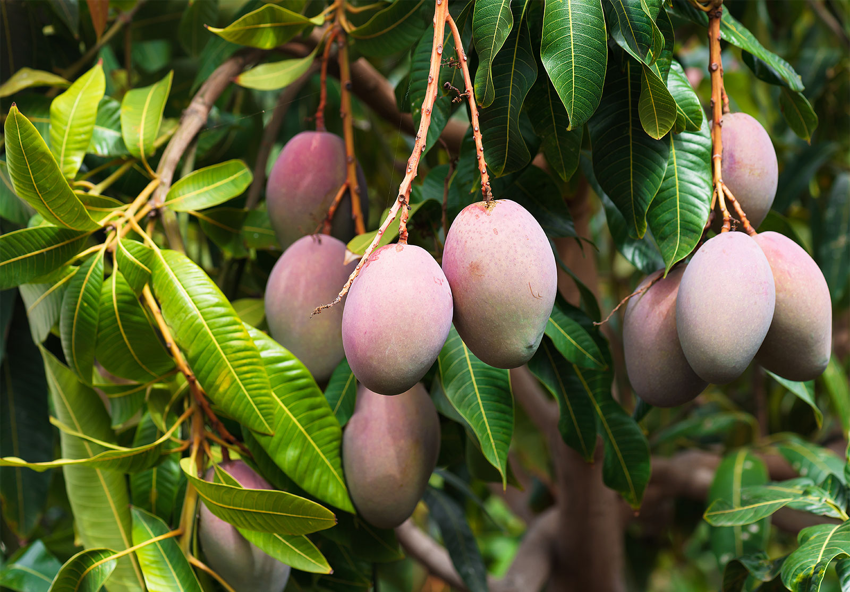
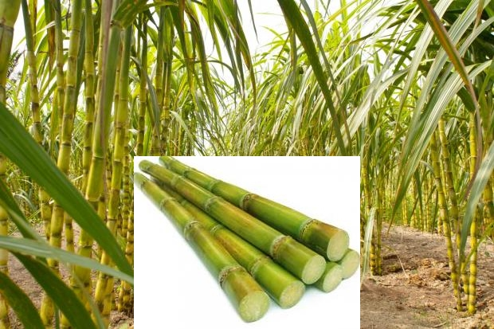
Two major rivers:
Godavari
Krishna
main occupation- Agriculture
main crops - Rice, cotton, sugar cane and mango

Slide 17
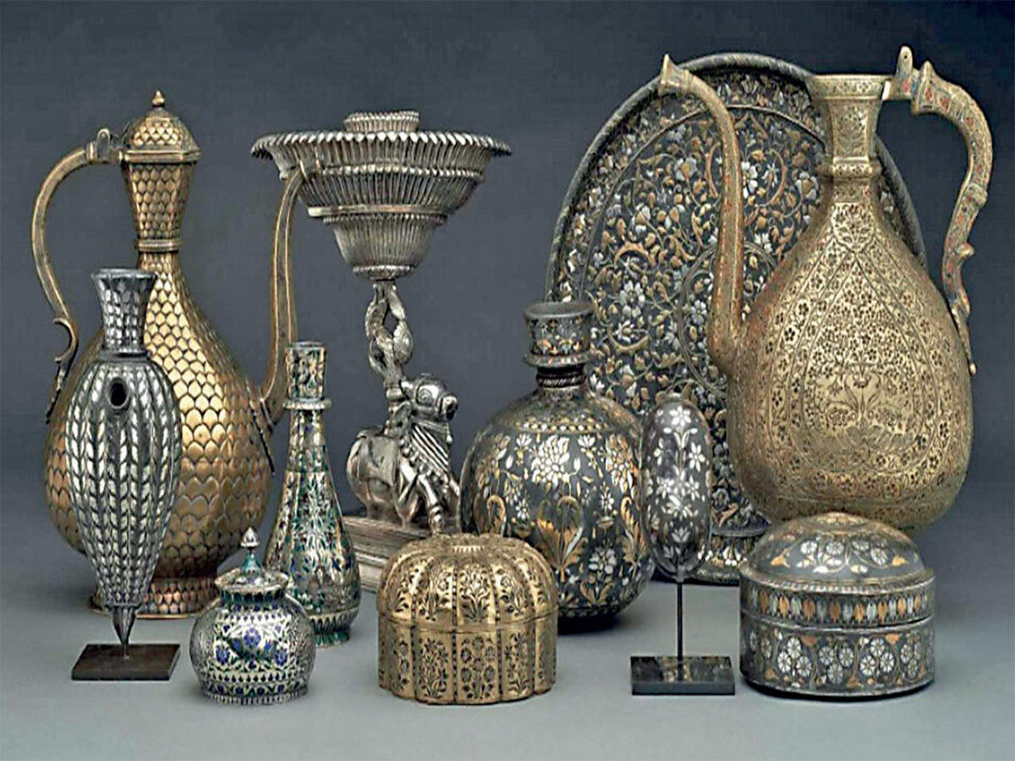
Bidriware - handicraft made here ( It is made from a mixture of zinc and copper with inlay work in silver).
main languages - Telugu and Urdu

Slide 18
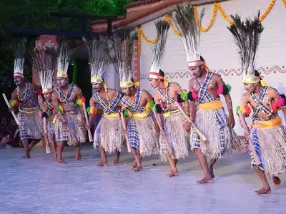
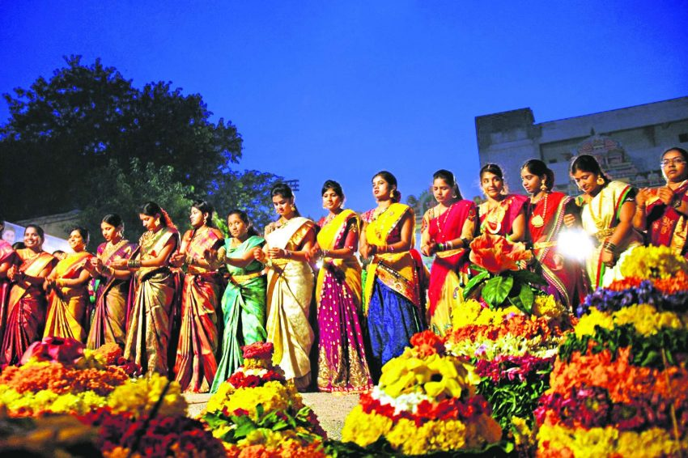
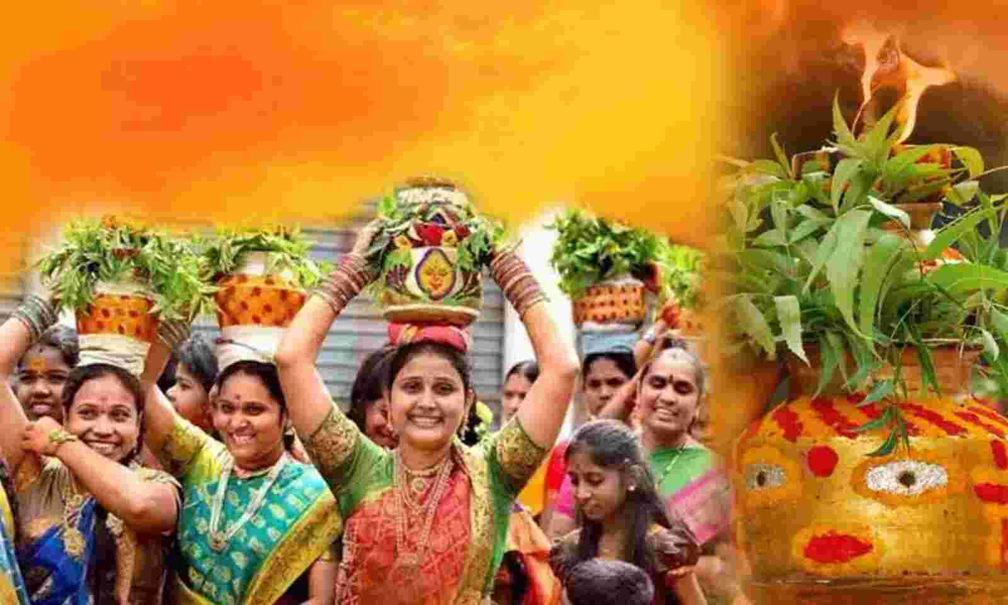
Popular folk dance- Gusadi
The main festivals- Bathukamma, Bonalu and Eid

Slide 19
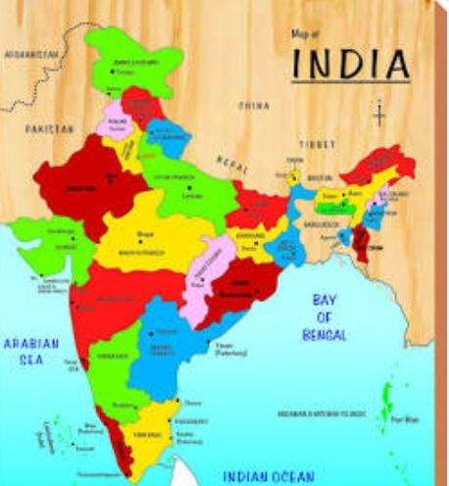

TAMILNADU
The state of Tamilnadu lies to the south of Andhra Pradesh
It’s capital is Chennai
Notes:
Tamil Nadu

Slide 20
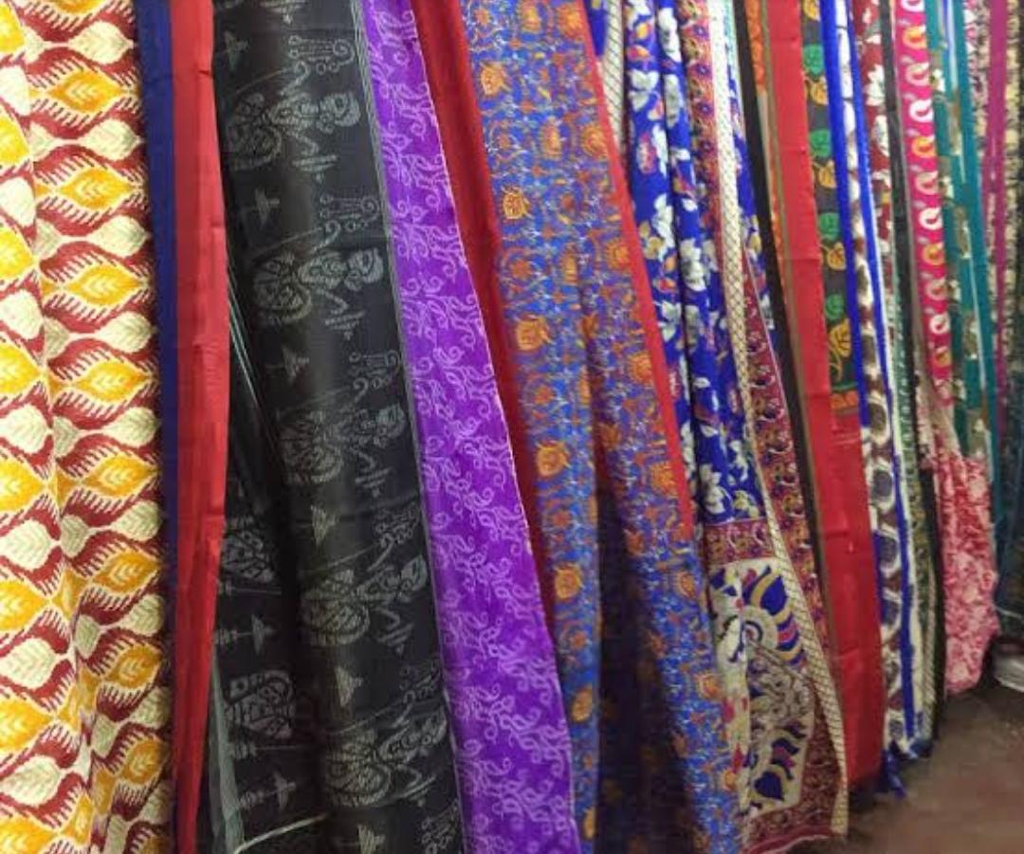
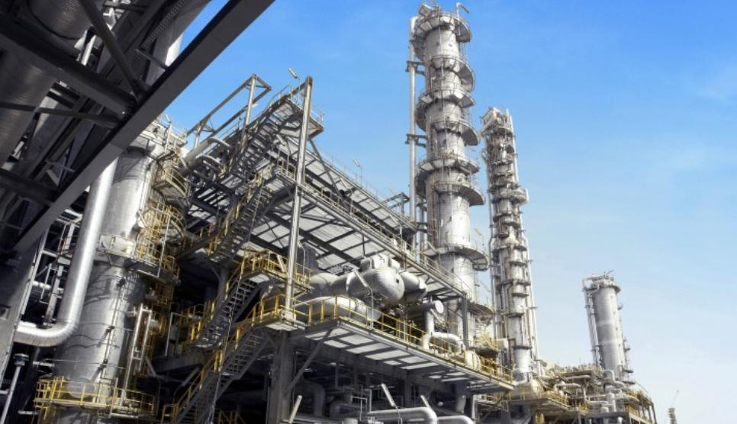
Heavy engineering, textiles and handlooms are some well developed industries in this state.

Slide 21
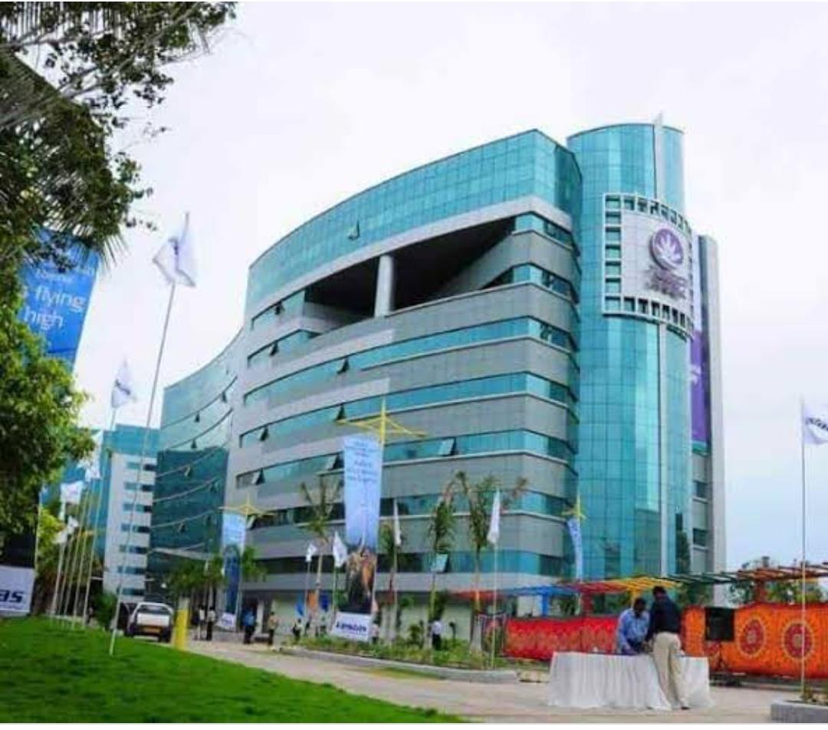
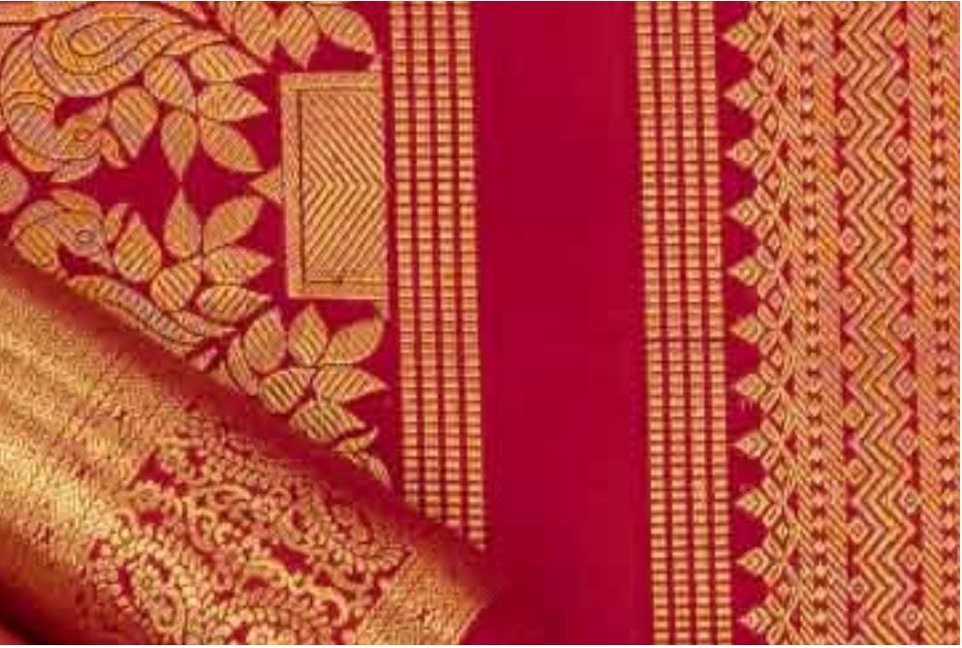
Chennai is an important software development centre.
The silk sarees of Kanchipuram are very famous.

Slide 22
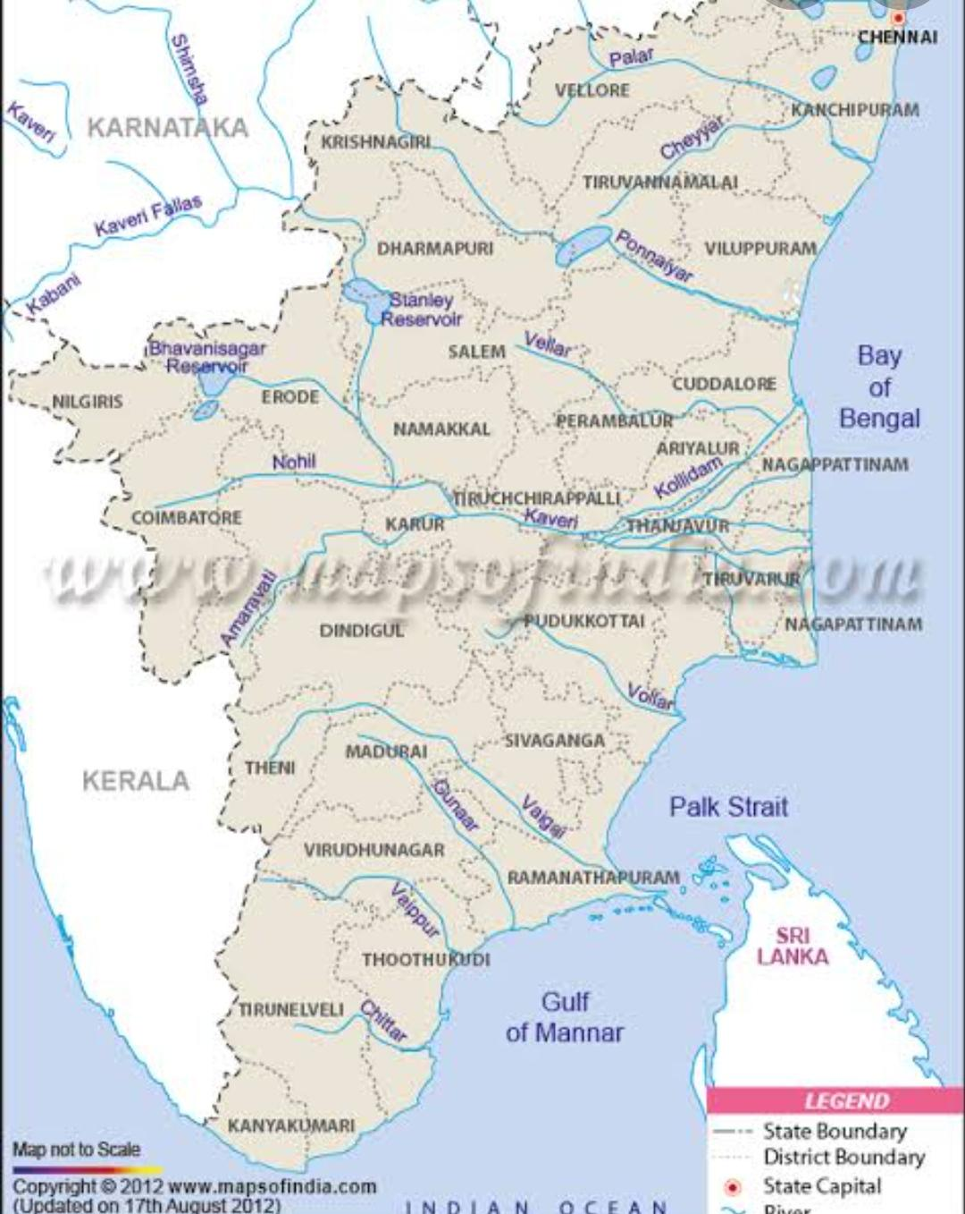
The rivers Kaveri, Vaigai and Palar flow through the state of Tamil Nadu.
Notes:
Most of the rivers flow from West to East.

Slide 23
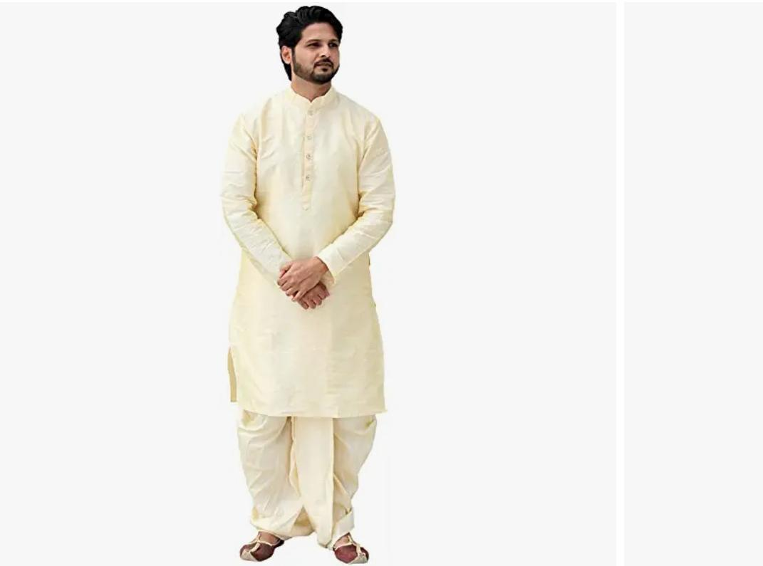
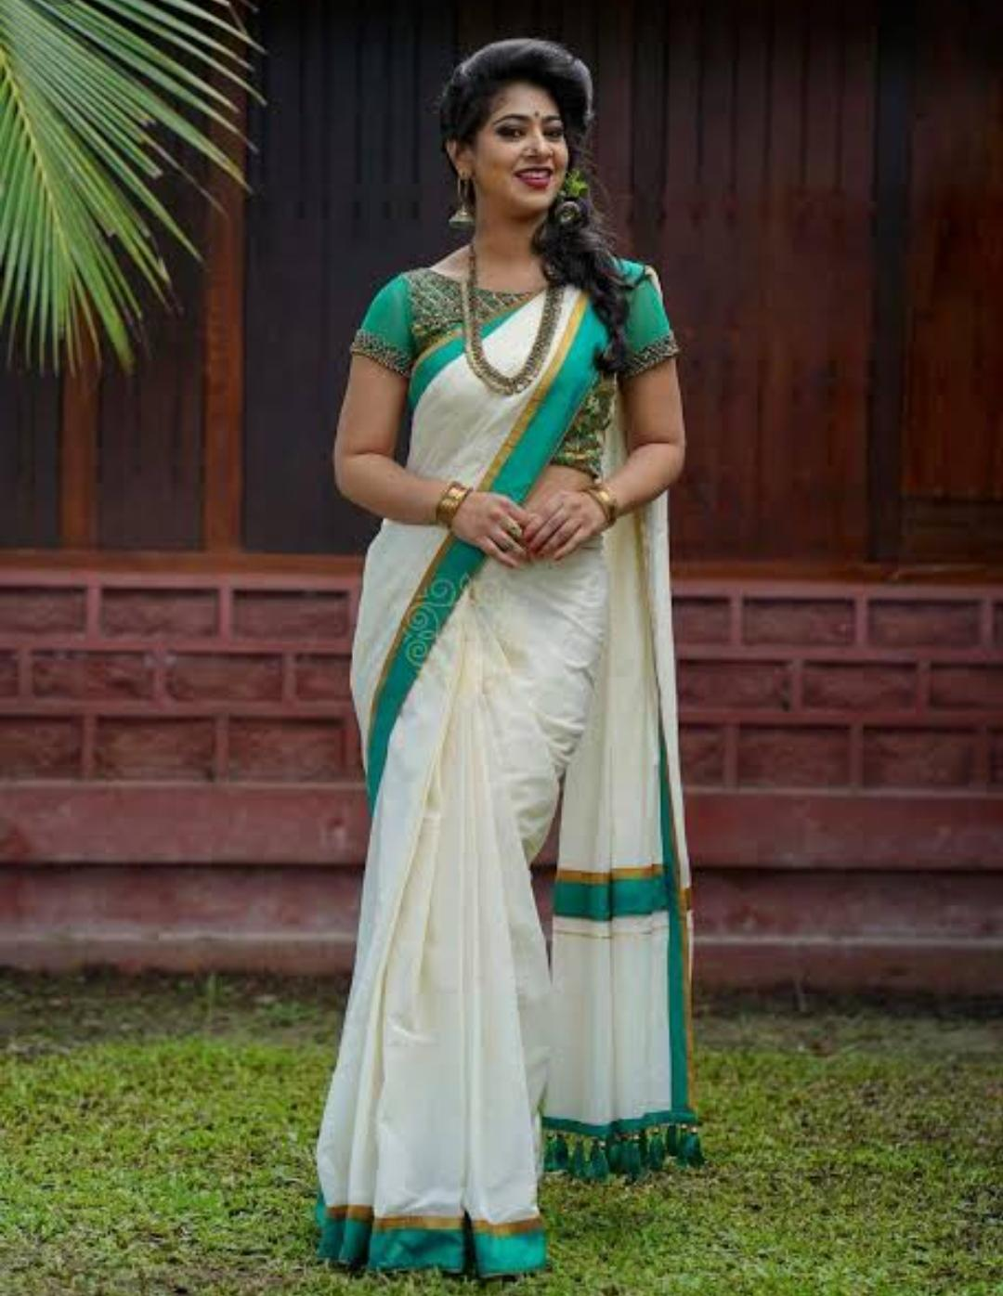
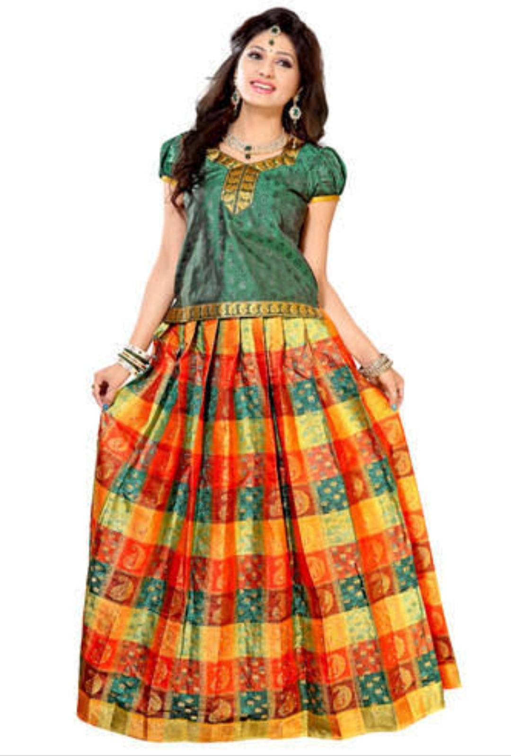
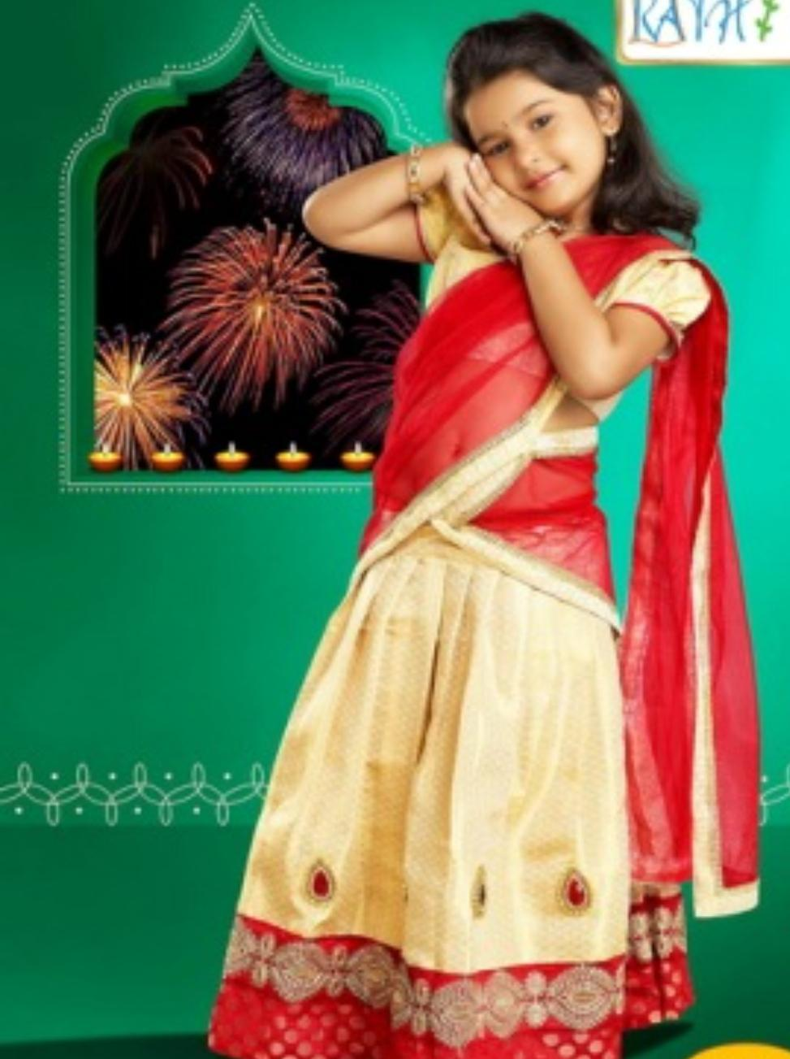
Language- Tamil
Traditional clothes of men- dhoti (or lungi) and shirt
Traditional clothes of women- Sarees
The traditional dress for small girls - Pavadai- blouse
Slightly older girls wear - half sarees.

Slide 24
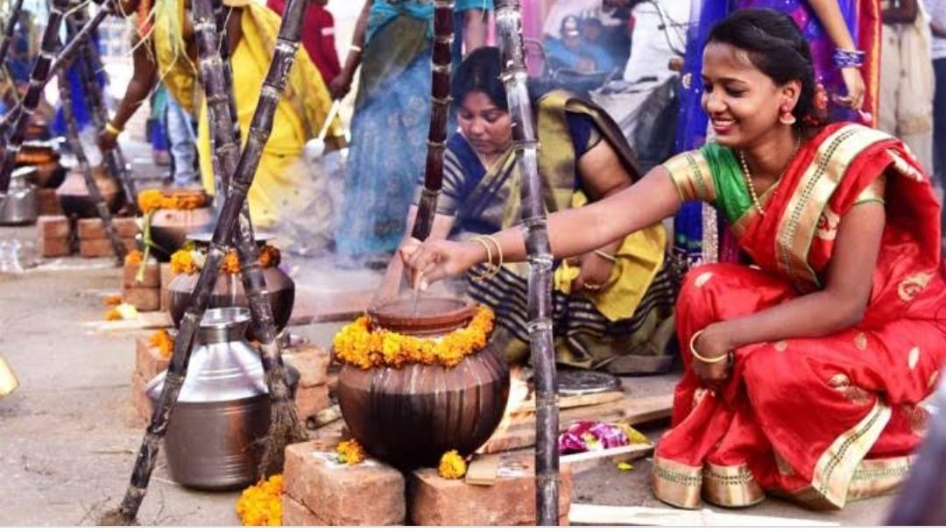
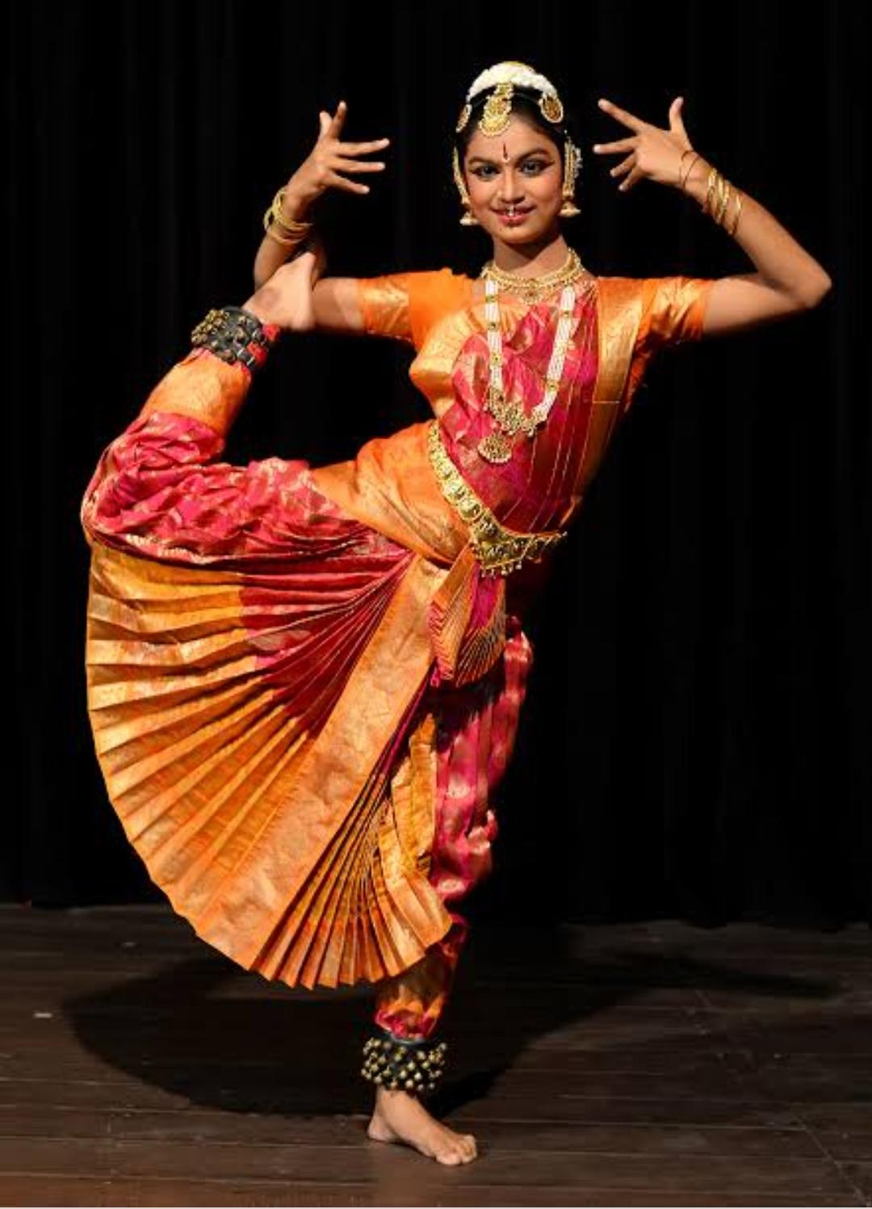
The main festival - Pongal
Most popular dance form- Bharatnatyam
.

Slide 25
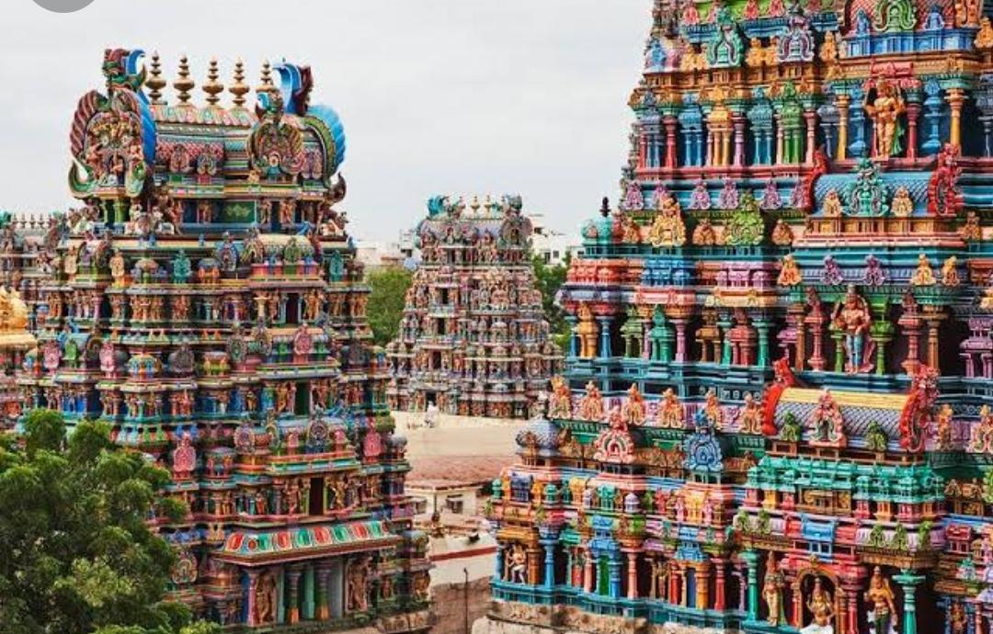
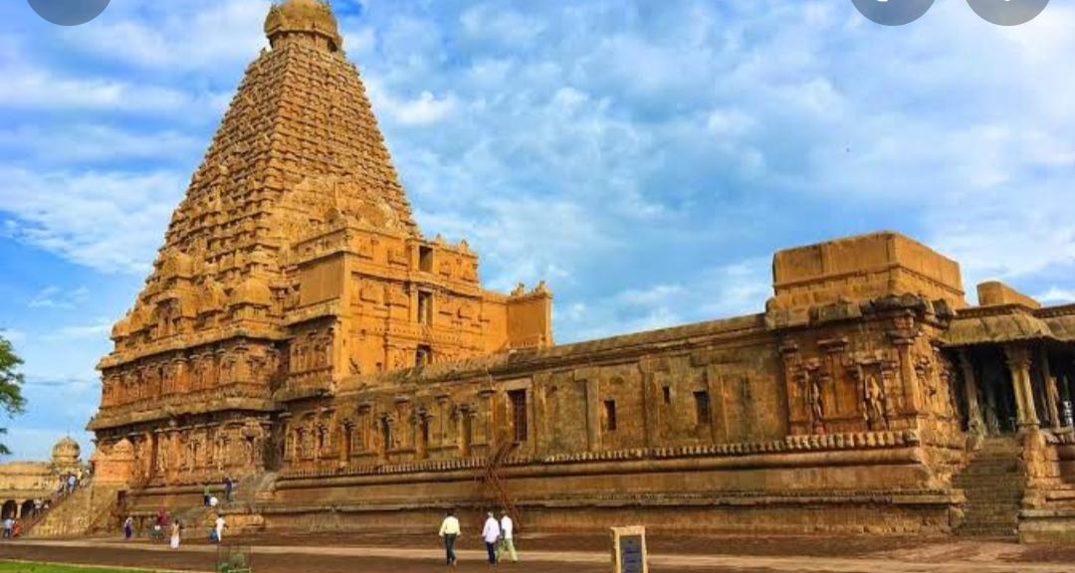
Temples- Madurai and Thanjavur

Slide 26
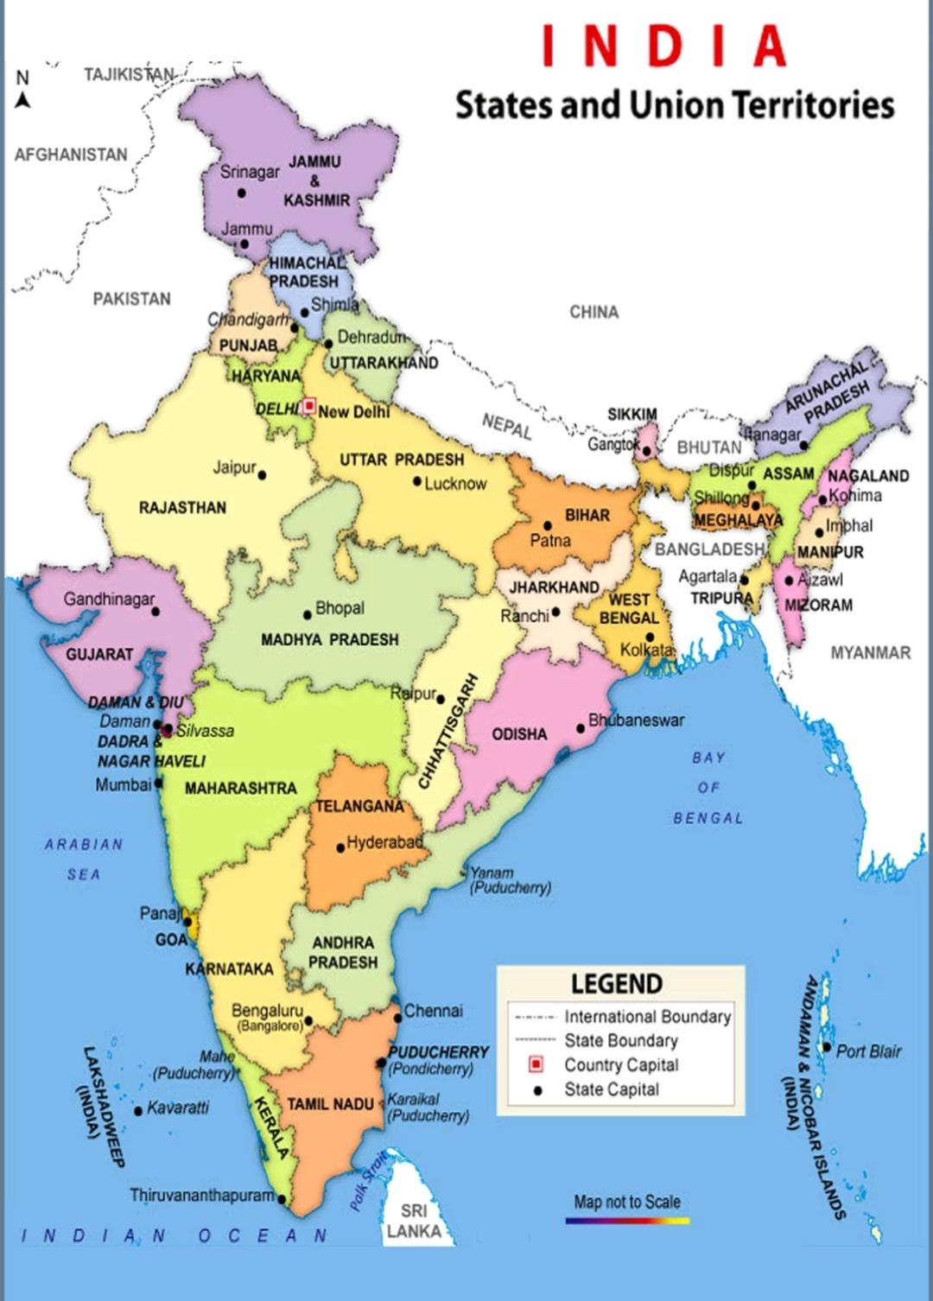
Madhya Pradesh
Capital- Bhopal
Large areas are covered with forest
Famous wildlife parks- Kanha and Bandhavgarh

Slide 27
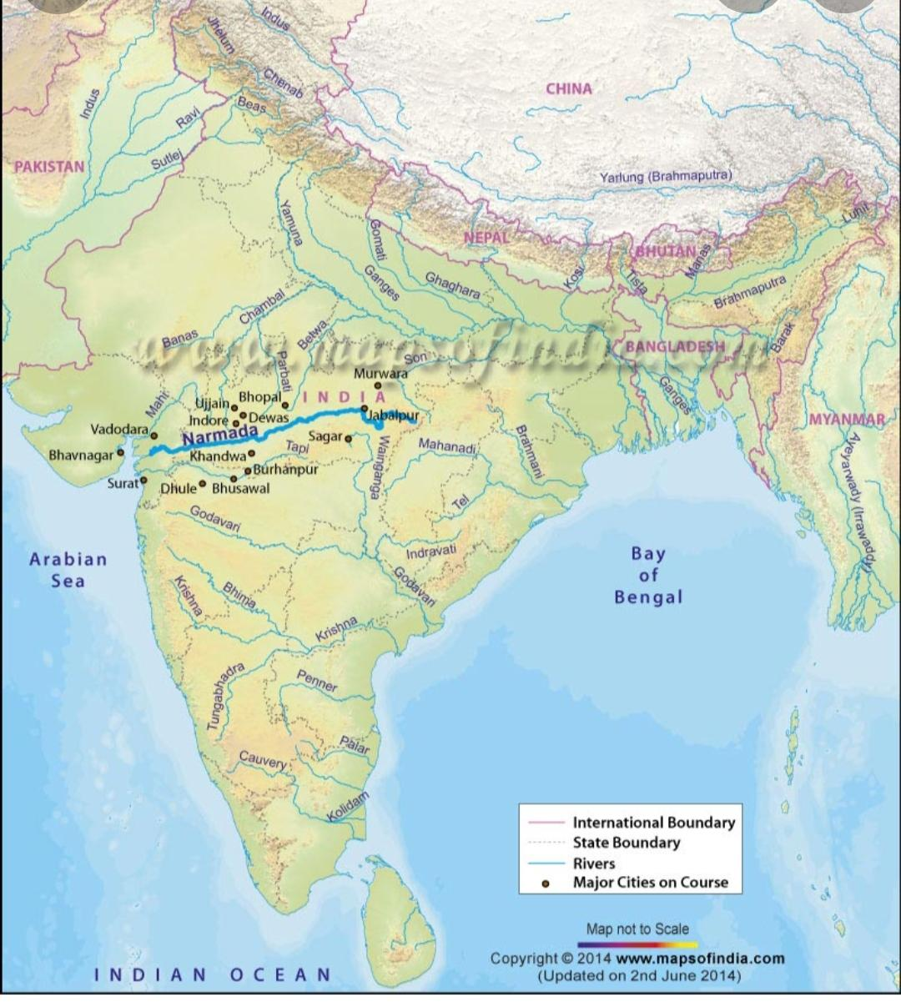
Rivers that originate in this state-
Tapi
Chambal
Narmada

Slide 28
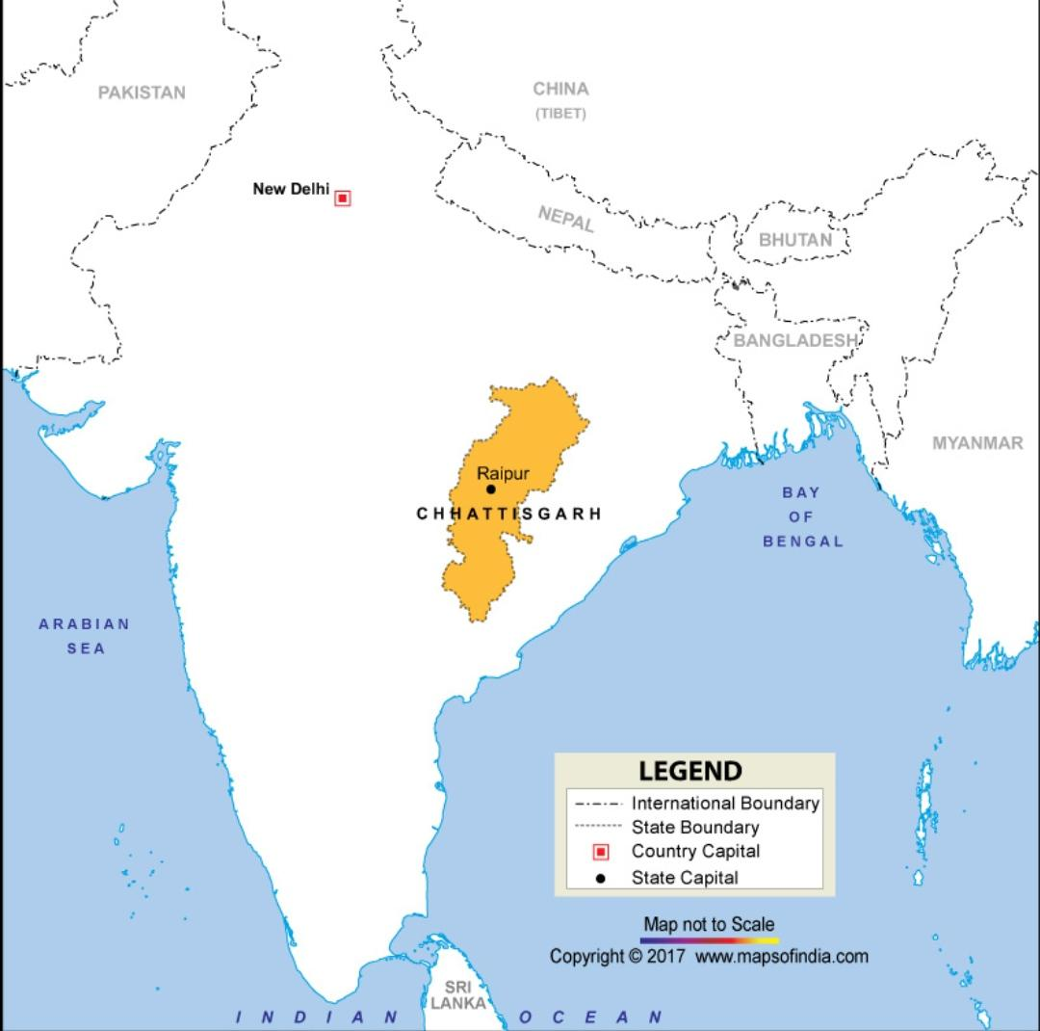
Chhattisgarh
Capital- Raipur
As Basin created by Mahanadi river
makes the land very fertile.
Rich in minerals- Coal, Iron Ore, Aluminium ore
and diamonds
Biggest steel plant- Bhilai
Widest waterfall of India - Chitrakote

Slide 29
Answer the following questions:
4. Name three minerals found in the Southern Plateau.
Ans. Three minerals found in Southern plateau are:
a) Iron
b) Coal
c) Mica
5. Why are cotton and sugarcane grown in large areas of the Deccan Plateau?
Ans. Cotton and Sugarcane are grown in large areas of the Deccan plateau because it covers a large part of black soil which is very suitable to grow cotton and sugarcane.

Slide 30
Answer the following questions
Q6..Why do most rivers in the Deccan plateau flow from West to East?
Ans. Most of the rivers from Deccan plateau flow from West to East because of the uneven land in the Deccan plateau slopes from West to East.
Q7. Many rivers in the Southern Plateau dry up during summers. Why?
Many rivers in the Deccan plateau dry up in summer because these rivers are fed by rain so they have little water and dry up in summer.
Q8. Name three plateaus which form the part of the Southern Plateau.
Ans. The three plateaus which form the part of the Southern Plateau are:-
1. Central Highlands
2. Deccan plateau
3. Chota Nagpur

Slide 31
Related video:
https://youtu.be/d8zge88FMrY

Slide 32

HOMEWORK
No Homework

Slide 33
LEARNING OUTCOME:
Children will be able to - - About Andhra Pradesh, Telangana Its crop Festivals Rivers

Slide 34
THANKING YOU
ODM EDUCATIONAL GROUP

