Slide 1


CLASS :IV
SUBJECT : SOCIAL SCIENCE
CHAPTER NUMBER: 6
CHAPTER NAME : THE SOUTHERN PLATEAU
SUBTOPIC: Central Highlands, The Deccan Plateau, Life in the Southern Plateau Maharashtra
Karnataka

Slide 2
LEARNING OBJECTIVES:
Children will come to know about
The division of the plateau region
states covering Deccan Plateau
Rivers of Deccan Plateau
Nagarjuna dam and its uses
The cities of the Maharashtra & Karnataka
The rivers of the Maharashtra & Karnataka
Important crops of Maharashtra & Karnataka

Slide 3
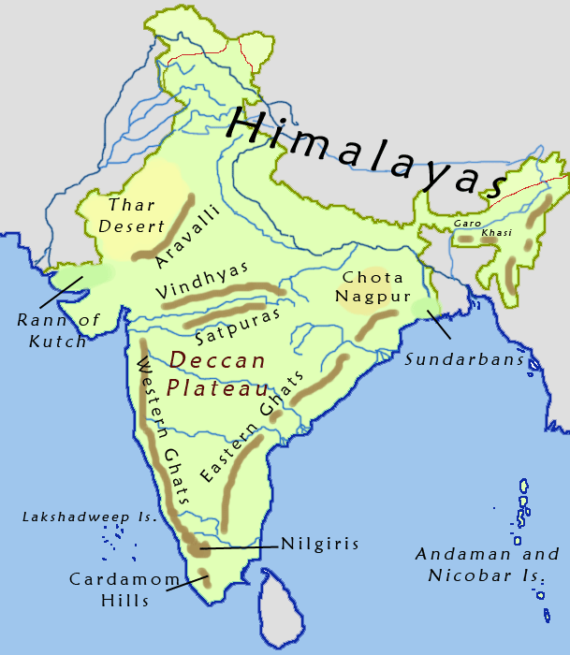
The Deccan Plateau
The large areas south of the Satpura mountains is the Deccan Plateau.
It is surrounded by the eastern and Western Ghats.
It covers the parts of:
Madhya Pradesh
Chhattisgarh
Orissa
Maharashtra
Karnataka
Andhra Pradesh
Tamil Nadu

Slide 4
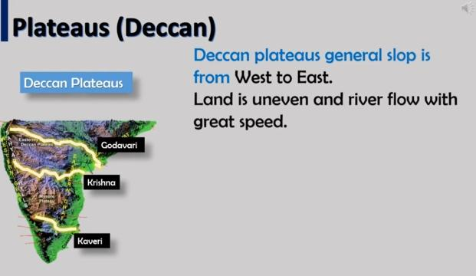
Rivers in the Deccan Plateau flows from West to east and falls into Bay of Bengal.
Mahanadi
Godavari
Krishna
Kaveri

Slide 5
Rivers of plateau region may dry up in summer.
Rivers like Godavari, Krishna and Kaveri form Delta as before flowing into the Bay of Bengal.
These areas are good for the rice cultivation.
large parts of Deccan Plateau have black soil hence cotton and sugarcane grows very well.

Slide 6
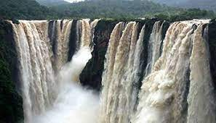
Water falls:
The land is uneven.
They form many waterfalls.
Jog Falls in the sharavathi river in Karnataka is the highest waterfalls in India.

Slide 7
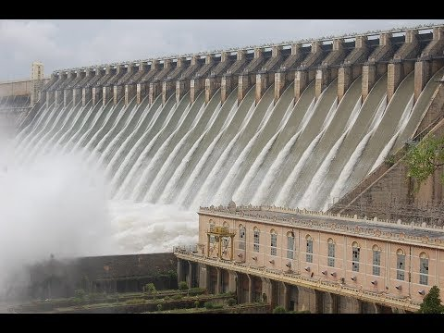
Dam:
Nagarjuna Dam have been built on the river Krishna.
Dam store water for irrigation and provide electricity.

Slide 8
Let's Warm Up by identifying the pictures:-

Slide 9
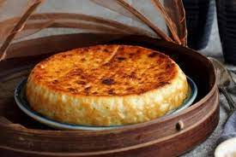
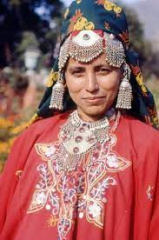
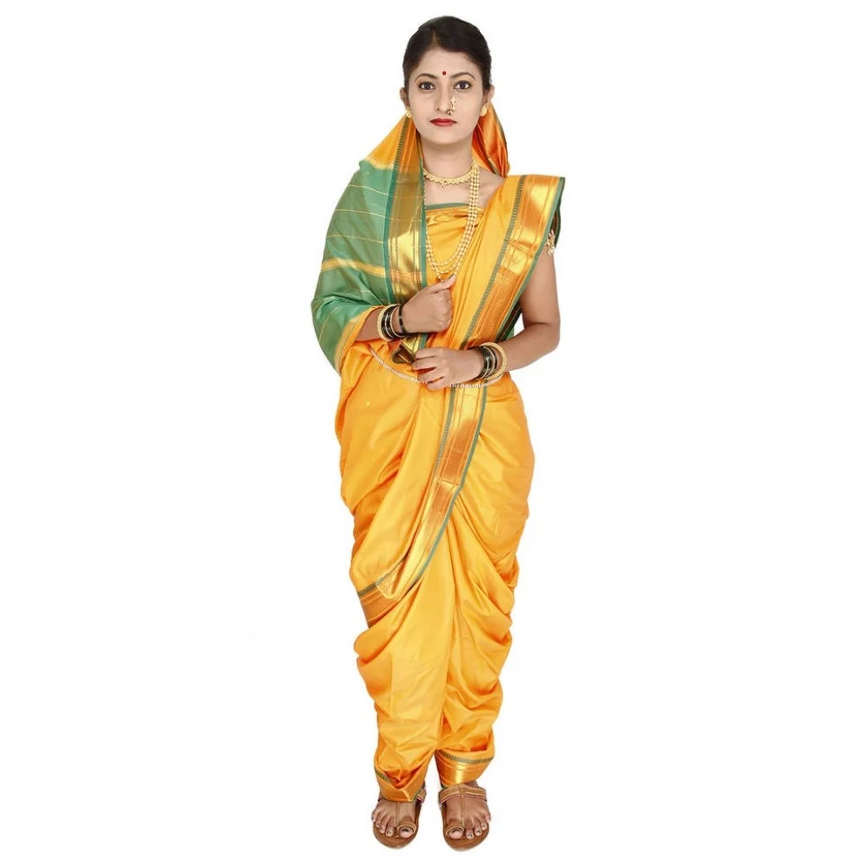
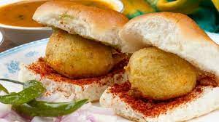
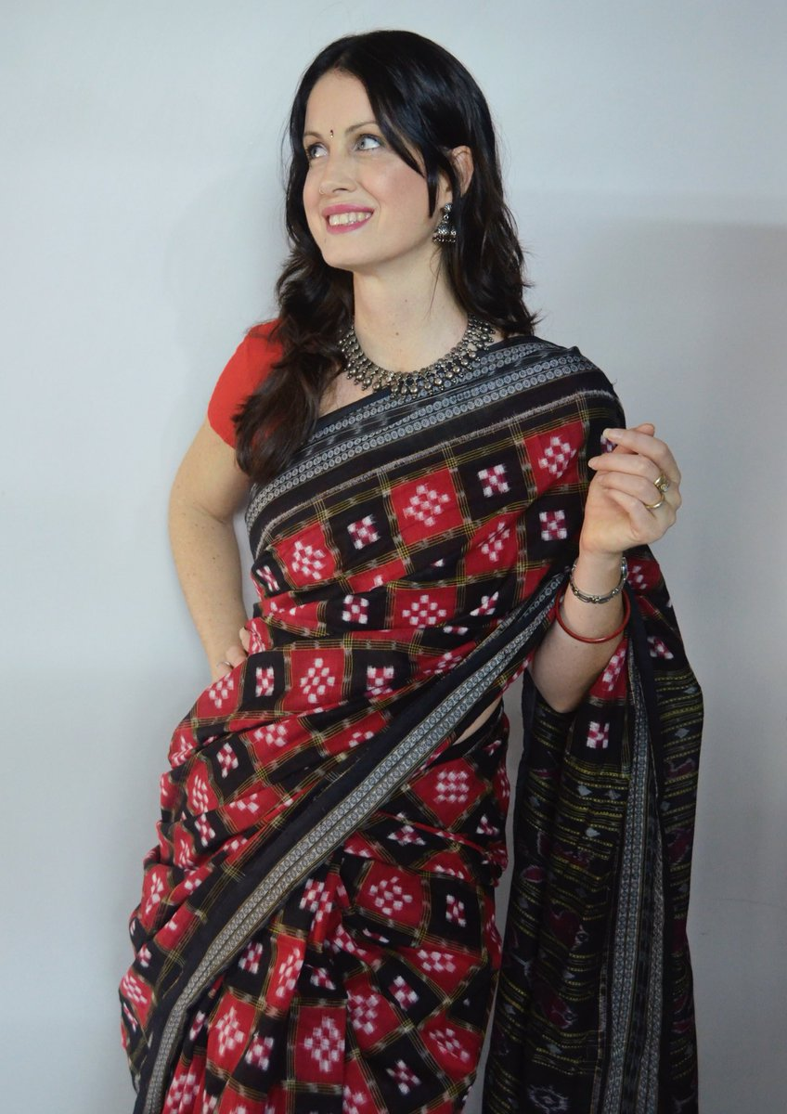
NAME THE CLOTHES
GUESS THE FOOD??
CHENNA PODA
PHIRAN
NAUWARI SAREE
SAMBALPURI SAREE
VADA PAO

Slide 10

MAHARASHTRA

Slide 11
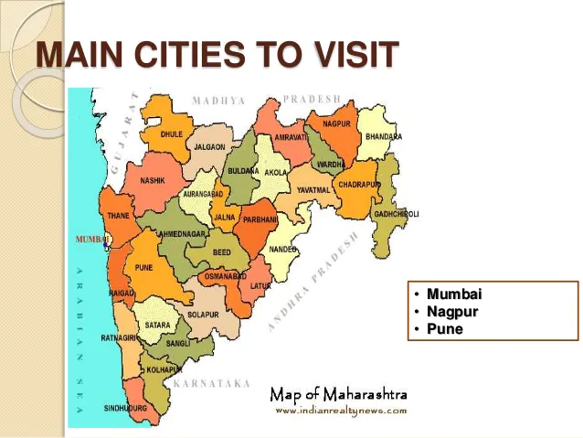
Its capital is Mumbai
Important cities of Maharashtra are:
Pune - second major IT hub of India
Nashik - Kumbh mela
Nagpur- trade centre of Oranges
Aurangabad - Ajanta and Ellora caves
Solapur - famous for handlooms

Slide 12
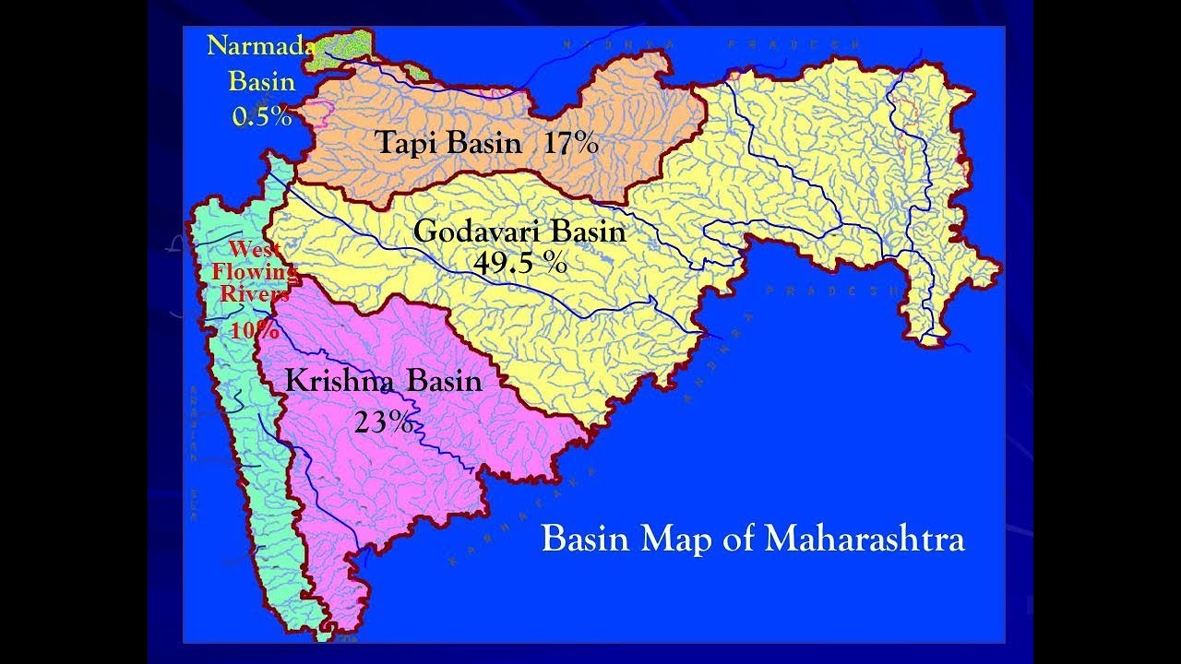
Two important rivers - Godavari and Krishna

Slide 13
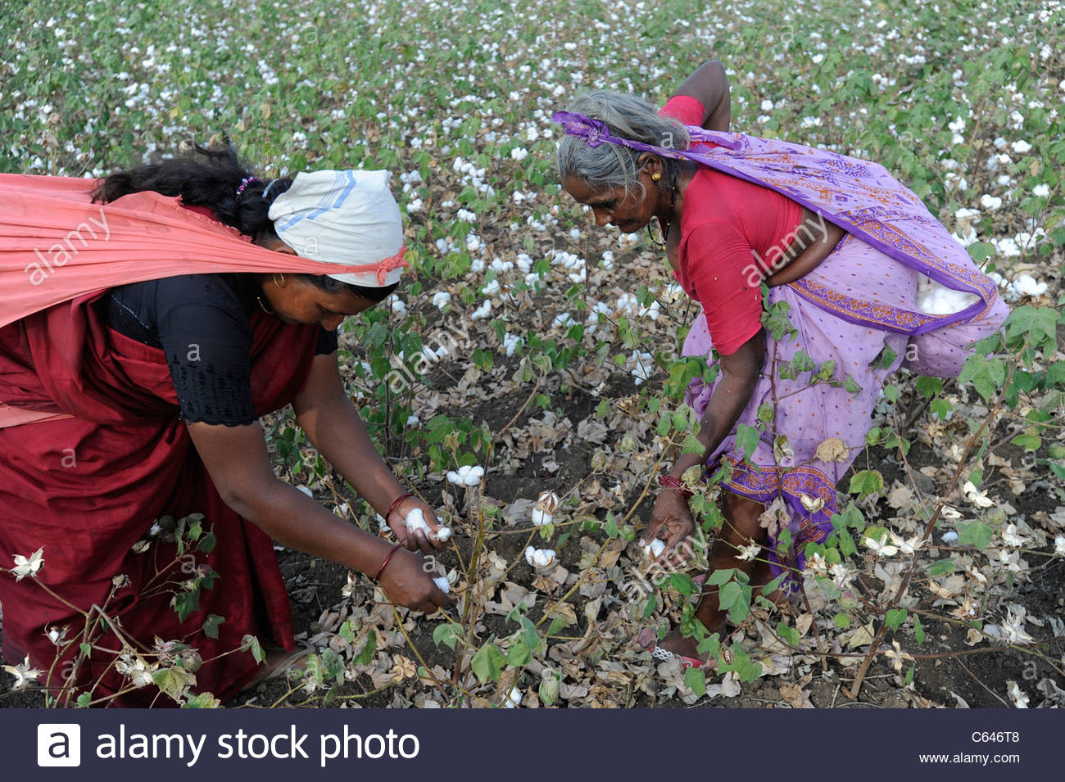
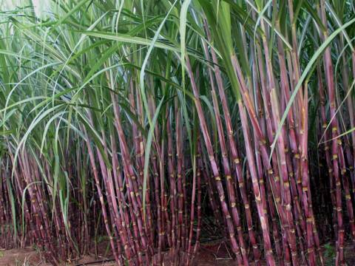
largest producer of - cotton
second largest producer of - sugarcane

Slide 14
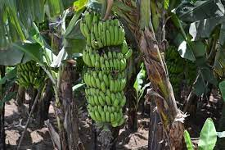
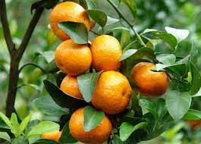
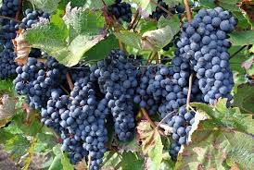
Fruits grown-
Bananas
oranges
grapes

Slide 15
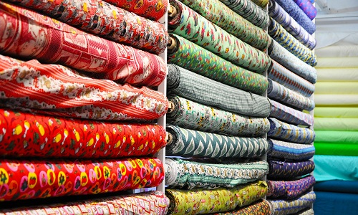
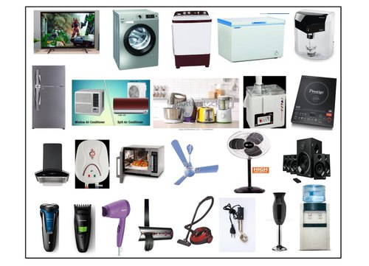
Important industries in Maharashtra -
textile automobiles
electronic

Slide 16
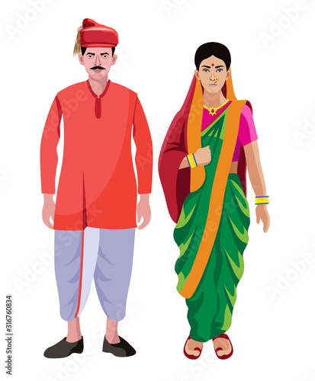
Traditional cloth of men are:
Dhoti and shirt with cap called a Gandhi topi.
women wear sarees.
common language - Marathi

Slide 17
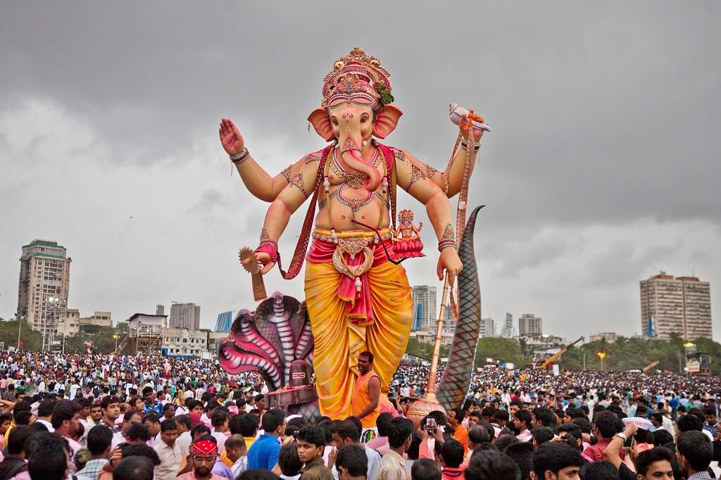
The most popular festival - Ganesh Chaturthi

Slide 18
KARNATAKA

Slide 19
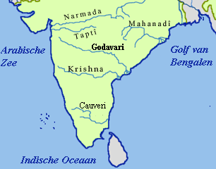
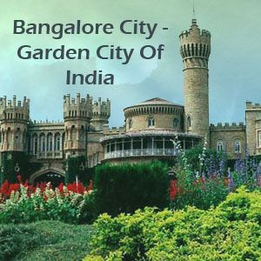
Capital is Bengaluru - it is called the garden city
The important cities: Karnataka - Mysore, Hubli
Two important rivers: Krishna and Kaveri
Coffee tea and Sandalwood are produced in this state.

Slide 20
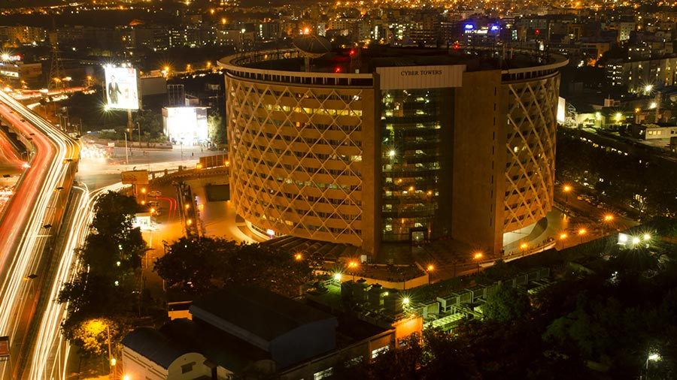
Bengaluru is the biggest software development centre in the India

Slide 21
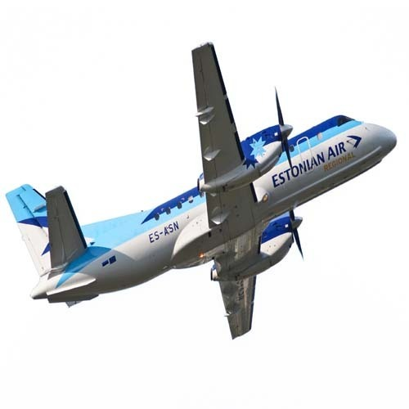
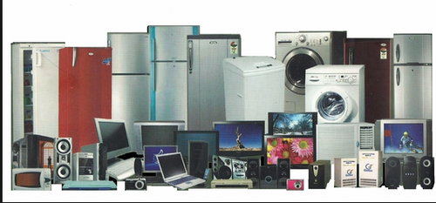
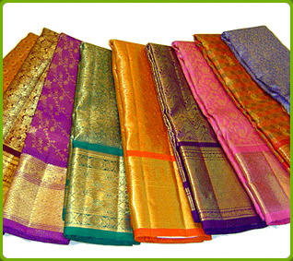
Other industries are:
aeroplane
electronic goods
Silk

Slide 22
Answer the following questions:
1. What is a plateau? What landforms border the Southern Plateau?
Ans. Large and flat area of land which is higher than the land around it and it looks like a table top.
The landforms which borders the southern plateau are:
a) The Aravali Range on the north-west.
b) The Rajmahal hills on the north-east.
c) The Western and Eastern Ghats.

Slide 23
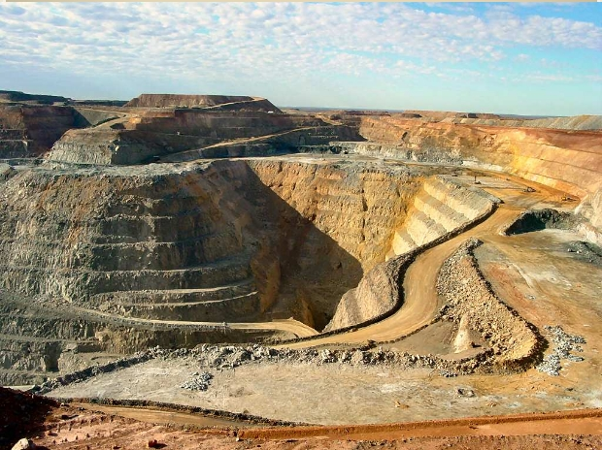
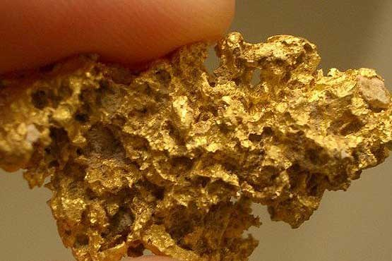
The Kolar Gold mines are also in this state.

Slide 24
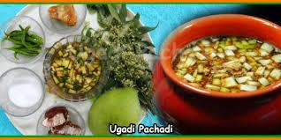
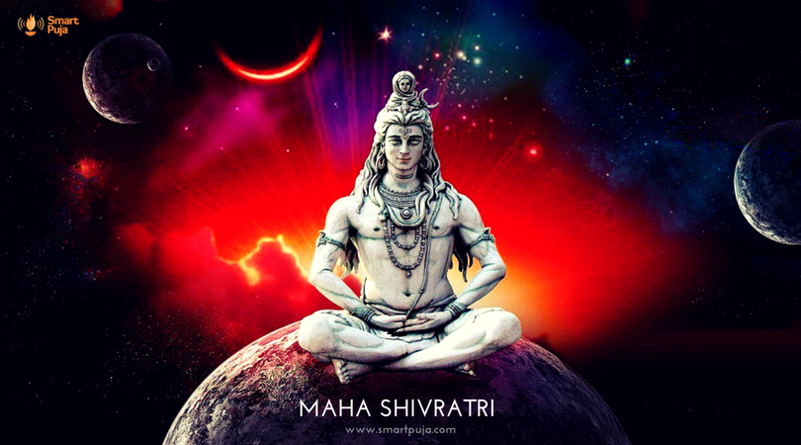
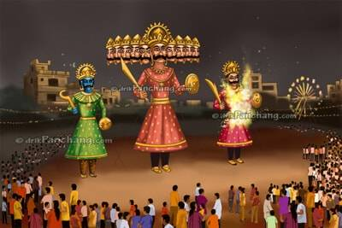
The people of Karnataka speak Kannada.
Important festivals Dussehra
Ugadi
Shivratri

Slide 25

HOMEWORK
List out five dams on Indian rivers in the notebook.

Slide 26
Related video:
https://youtu.be/7jR_24Dcev4

Slide 27
LEARNING OUTCOME:
Children will be able to - - know about the uses of the dam. - Waterfalls in Deccan Plateau - States of Deccan plateau

Slide 28
THANKING YOU
ODM EDUCATIONAL GROUP

