Slide 1


SESSION NO:10
CLASS :IV
SUBJECT : SOCIAL SCIENCE
CHAPTER NUMBER: 5
CHAPTER NAME : THE GREAT INDIAN DESERT
SUBTOPIC : Long Q & A- Answer the following questions

Slide 2
LEARNING OBJECTIVES:
Children will come to know about-
-the physical features of India.
- Desert as a type of landform.
-Life in the desert
-Water shortage in desert
-Less vegetation

Slide 3
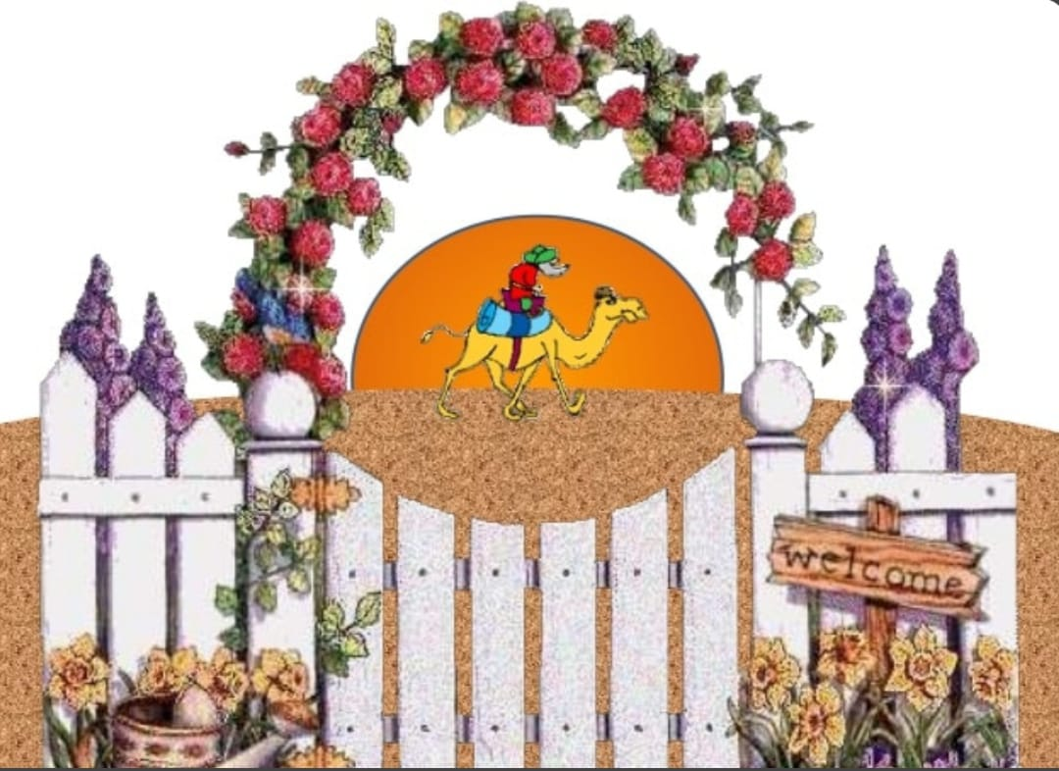

Slide 4
Answer the following questions:
4. What is an oasis?
Ans. 4. Oasis is an area in the desert with water and greenery is called an Oasis.
5. What has been the effect of the Indira Gandhi Canal on the Thar Desert?
Ans.a. Due to Indira Gandhi Canal which starts from Satluj river provides water to the part of Thar Desert. These areas have become green and farmers can grow variety of crops. b. These areas have become green and farmers can grow variety of crops.
6. Why is the camel still a very important means of transport in the desert?
7. Describe the traditional clothes of the people of Rajasthan.
8. Name a few tourist attractions of Rajasthan.

Slide 5
6. Why is the camel still a very important means of transport in the desert?
Ans.
a. Camel still a very important means of transport in the desert because it is used to carry loads, pull carts and plough fields.
b. Its milk and meat serve as food for the people.
7. Describe the traditional clothes of the people of Rajasthan.
Ans. The traditional clothes of people of Rajasthan is:
a. Women wear ghagra- choli with odhni to cover their head.
b. The men wear dhoti kurta and colourful turban.
8. Name a few tourist attractions of Rajasthan.

Slide 6
8. Name a few tourist attractions of Rajasthan.
Ans.The few tourist attraction are:
a. Desert Festival- The Desert festival is celebrated in Jaisalmer in Rajasthan.
b. Old forts - Amer Fort (Jaipur), Jaisalmer Fort etc.
c. historical monuments- Hawa Mahal, Jal Mahal

Slide 7
HOMEWORK
Practice questions and answers of ch - 5

Slide 8
LEARNING OUTCOME:
Children will be able to - - How people live in deserts. - know that water shortage leads to a difficult life. - know who are Banjaras

Slide 9
THANKING YOU
ODM EDUCATIONAL GROUP

