Slide 1


CLASS :IV
SUBJECT : SOCIAL SCIENCE
CHAPTER NUMBER: 5
CHAPTER NAME : THE GREAT INDIAN DESERT
SUBTOPIC : LIFE IN THE DESERT REGION OF RAJASTHAN-LANGUAGE AND FESTIVALS, TOURISM

Slide 2
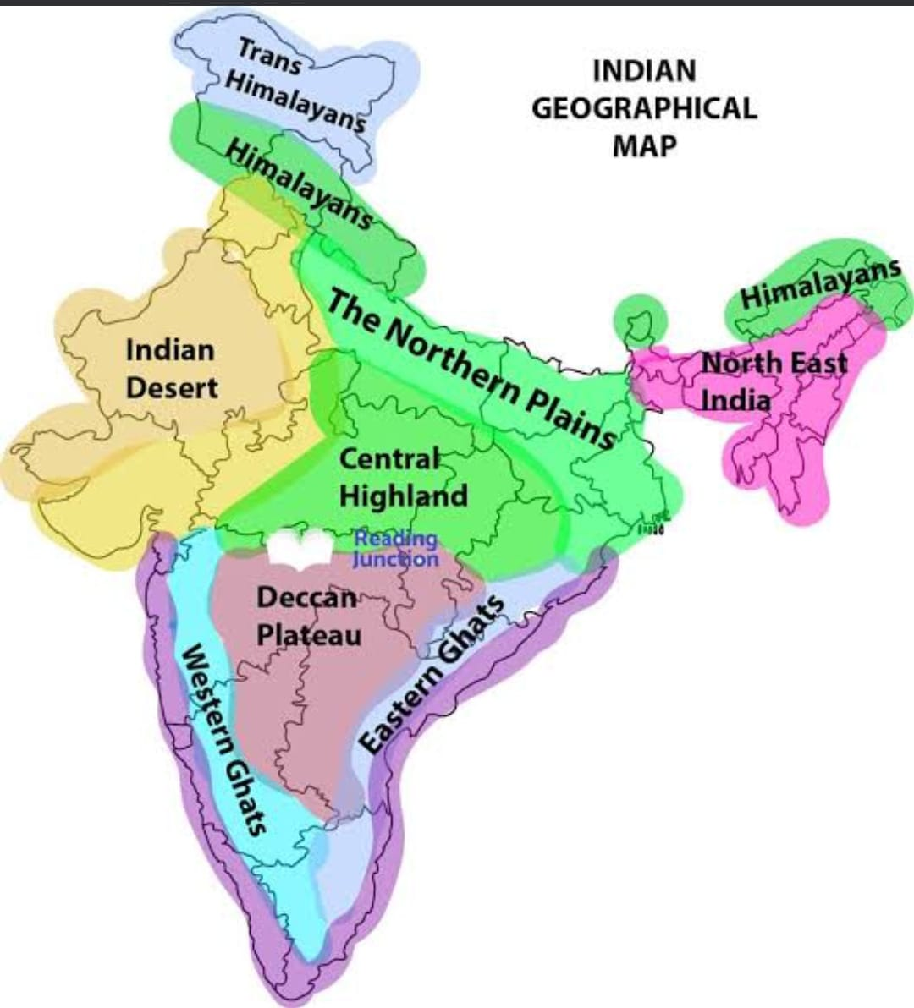

Slide 3
LEARNING OBJECTIVES:
To enable the learner to know about
the physical features of India.
desert as a type of landform.
life in the desert
water shortage in desert
less vegetation

Slide 4
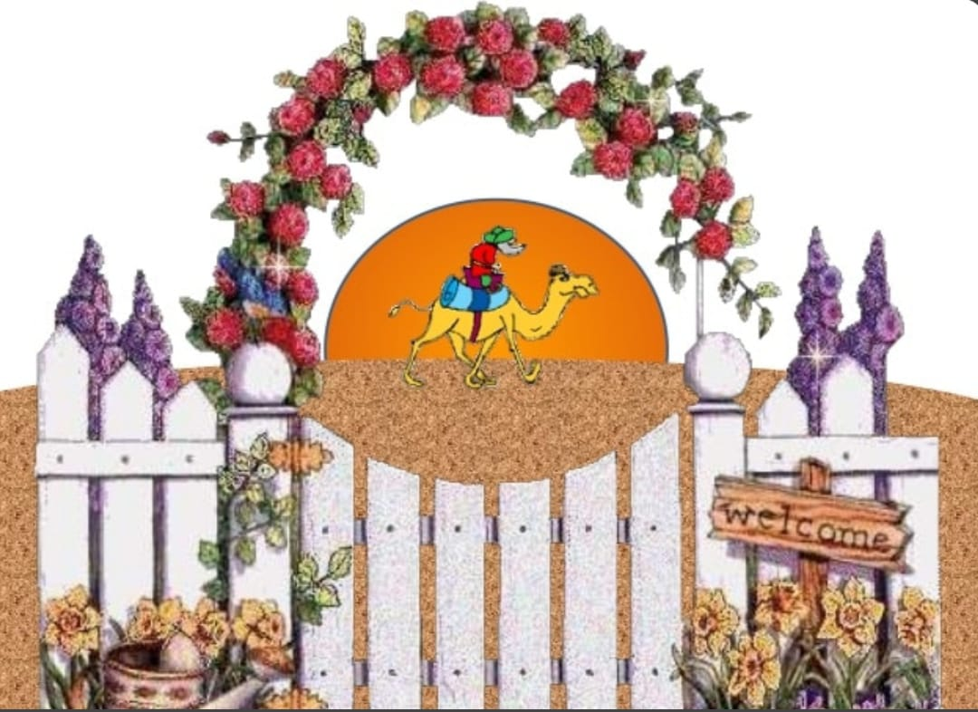

Slide 5
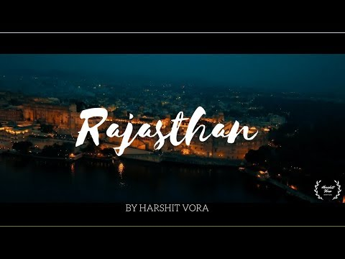

Slide 6
Recapitulation
The _____________ is the most useful animal in the desert.
The traditional dress of women is _______with Odhni to cover their head.
Desert has many small hills of sand called _____________.
An area in the desert, with water and greenery is called an __________.
Nomads of the Thar desert are called ________.
_________ canal which starts from Satluj river provides water to the parts of Thar Desert.

Slide 7
Language and Festivals:
Hindi and Rajasthani are the main languages.
• The main festivals celebrated in Rajasthan are:
➢ Holi
➢ Diwali
➢ Eid
➢ Dussehra
➢ Gangaur
➢ Teej

Slide 8
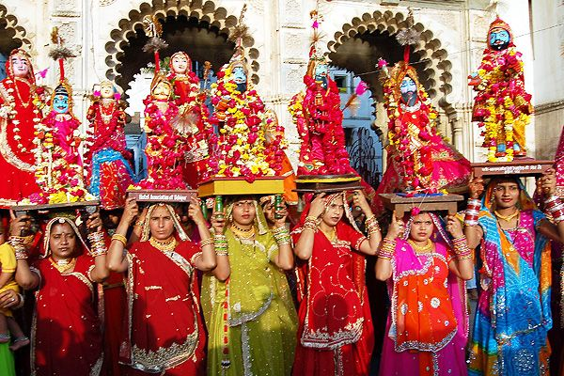
Gangaur
Gangaur is one of the most important and colour festivals of Rajasthan.
Married women worship Goddess Parvati for longevity and good health of their husbands.

Slide 9
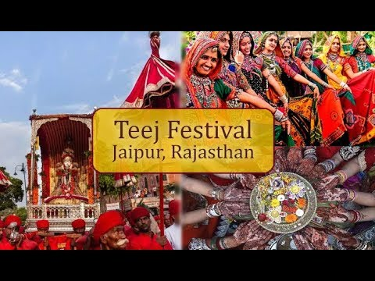
Teej
Teej is a festival when married women observe a
day-long fast and pray to Lord Shiva and
Goddess Parvati for long life and well-being
of their husband.
In India, three Teej festivals
are celebrated.

Slide 10
Tourism
Tourism is an important industry in the state.
People from all over the world come to Jaisalmer in Rajasthan during the Desert Festival.
Old forts and historical monuments in Rajasthan are a great attraction for tourists.

Slide 11
Desert Festival
The Desert festival is celebrated in Jaisalmer in Rajasthan.
enjoyable activities are:
the Marushri (Mr. Desert) competition, turban-tying competition
tug of war.
Indians compete with foreigners which adds to the fun of the festival.
An interesting event is the mustache competition.
In this competition the prize is awarded to the person possessing the longest mustache.

Slide 12
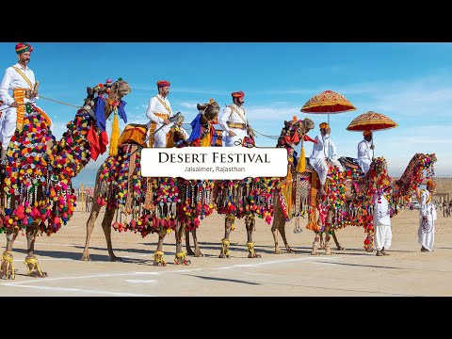

Slide 13
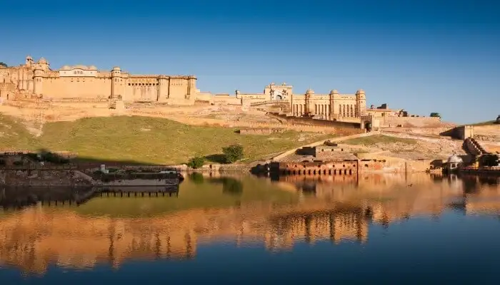
Amer Fort- Jaipur
Amer Fort is a fort cum palace mesmerizes you with its beauty.
Precision of carvings and embedment of stones prove that it is a finely-crafted marvel.
Being perched on a hillock of Aravali Range, Amer Fort has been regarded as a UNESCO World Heritage Site

Slide 14
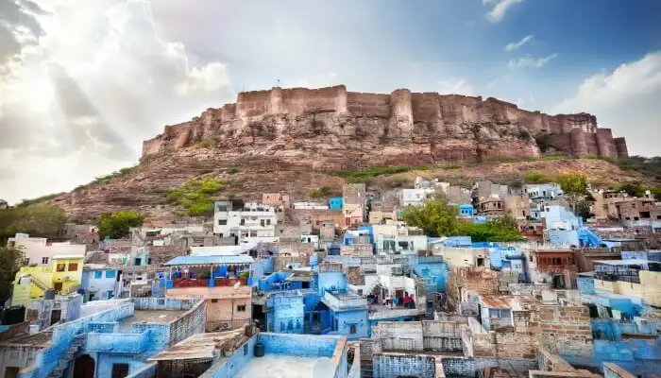
Mehrangarh Fort,Jodhpur
Overlooking the Blue City of Jodhpur from a height from 125 meters, Mehrangarh Fort.
The fort has many palaces.

Slide 15
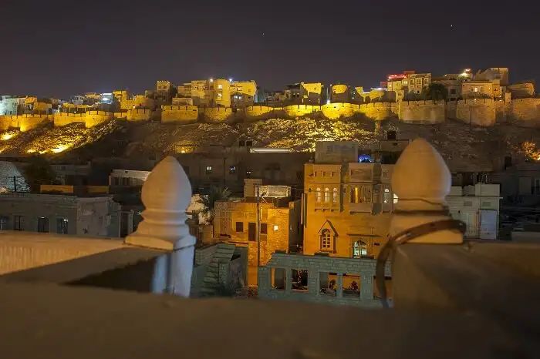
Jaisalmer Fort
One of the largest forts in India, Jaisalmer Fort was built in 1156 AD by King Rawal Jaisal.
Merging with the golden desertscape of Jaisalmer, it is often regarded as Sonar Quila or the Golden Fort.
The fort is nestled on a hill, 76 meters above the city and is located in the heart of Jodhpur.

Slide 16
Answer the following questions
. 1. What is a desert?
Ans. A flat area with sandy soil and very little rain and vegetation is called a desert.
2. Why are days hot and nights cool in the desert?
Ans.The days are hot and nights are cool in desert because the sun heats up quickly in the day and cools down fast at night.

Slide 17
Answer the following questions
Q 3. What is a sand dune? Why does it keep shifting?
Ans.
Sand dunes are small Hills of sand.
Sand dunes keep shifting because the strong winds move the dunes from one place to another.

Slide 18
HOMEWORK
Write and paste any 3 handicrafts of Rajasthan in the project record.

Slide 19
FACT FILE

Slide 20
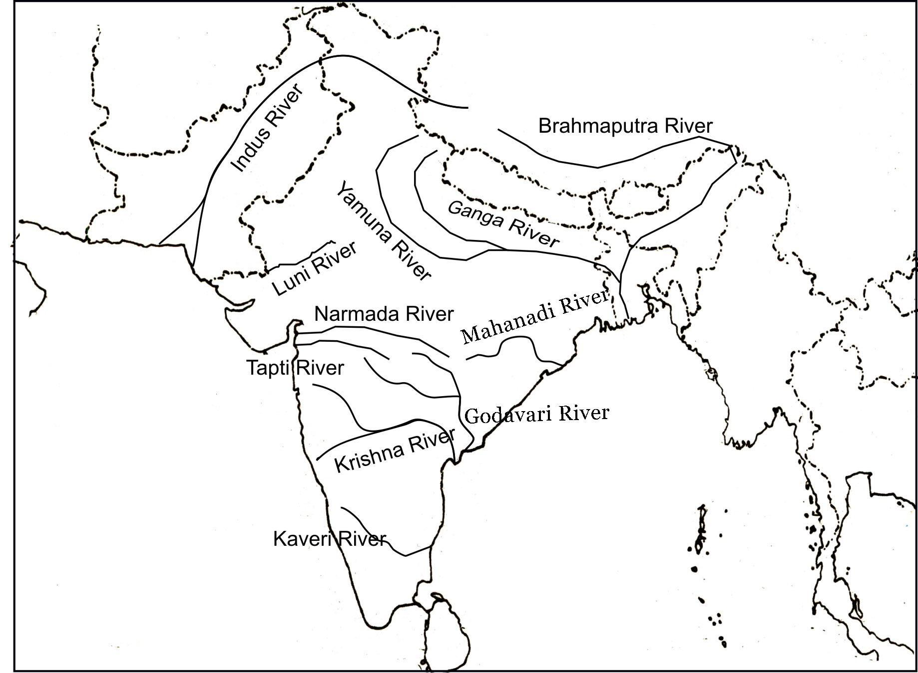
Luni river
Luni, the Indian river with saline water that doesn’t drain into any sea or ocean.
Luni originates from the Aravalli Range in Rajasthan.
Luni then flows into the Thar Desert and meets its end at the north-eastern part of the marsh called the Rann of Kutch in Gujarat, without flowing into any larger water body.

Slide 21
HOMEWORK

Slide 22
LEARNING OUTCOME
The learner will be able to
How people live in deserts.
know that water shortage leads to a difficult life.
know who are Banjaras

Slide 23
THANKING YOU
ODM EDUCATIONAL GROUP

