Slide 1

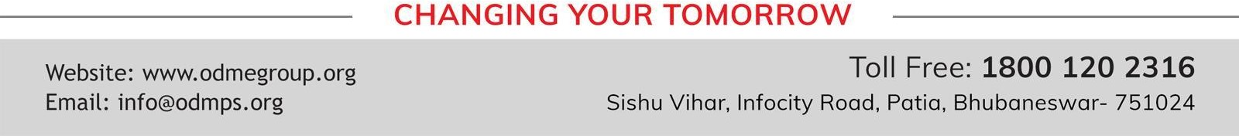
SESSION :2
CLASS : 4
SUBJECT : SOCIAL SCIENCE
CHAPTER NUMBER: 19
CHAPTER NAME :OUR RIGHTS AND DUTIES
SUBTOPIC : DEMOCRATIC, S0CIALIST, SECULAR, REPUBLIC

Slide 2

Recapitulation
https://wordwall.net/resource/25766237

Slide 3
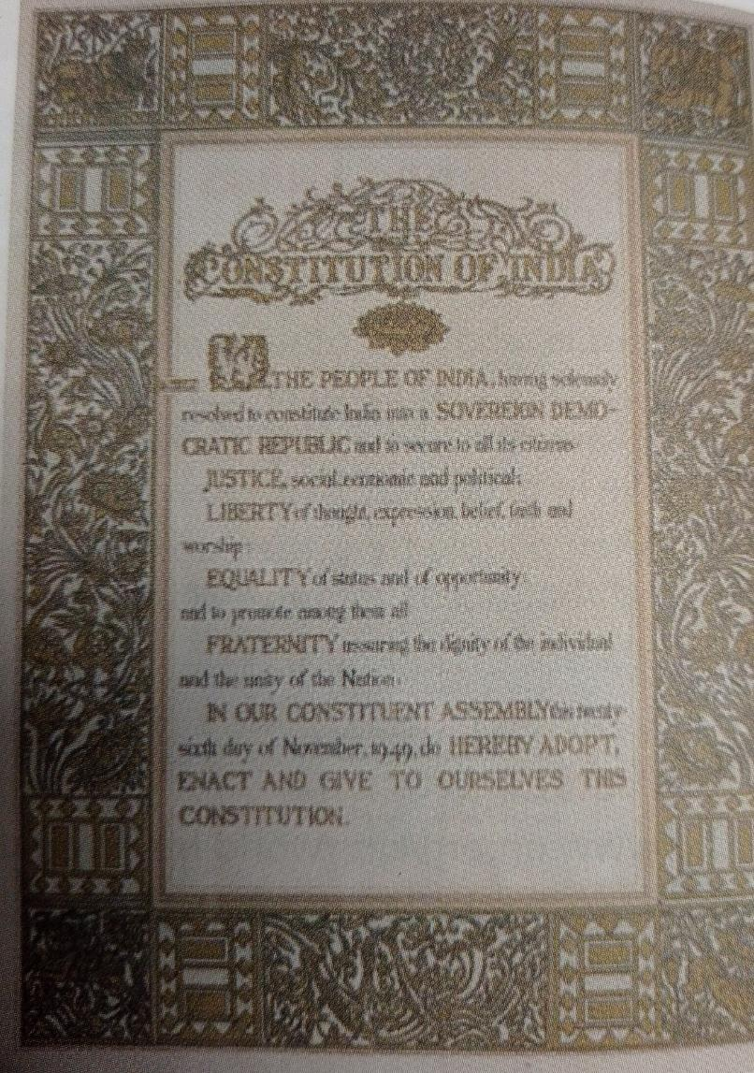
The Preamble, or introduction, to our Constitution describes India as a democratic, socialist, secular republic.

Slide 4
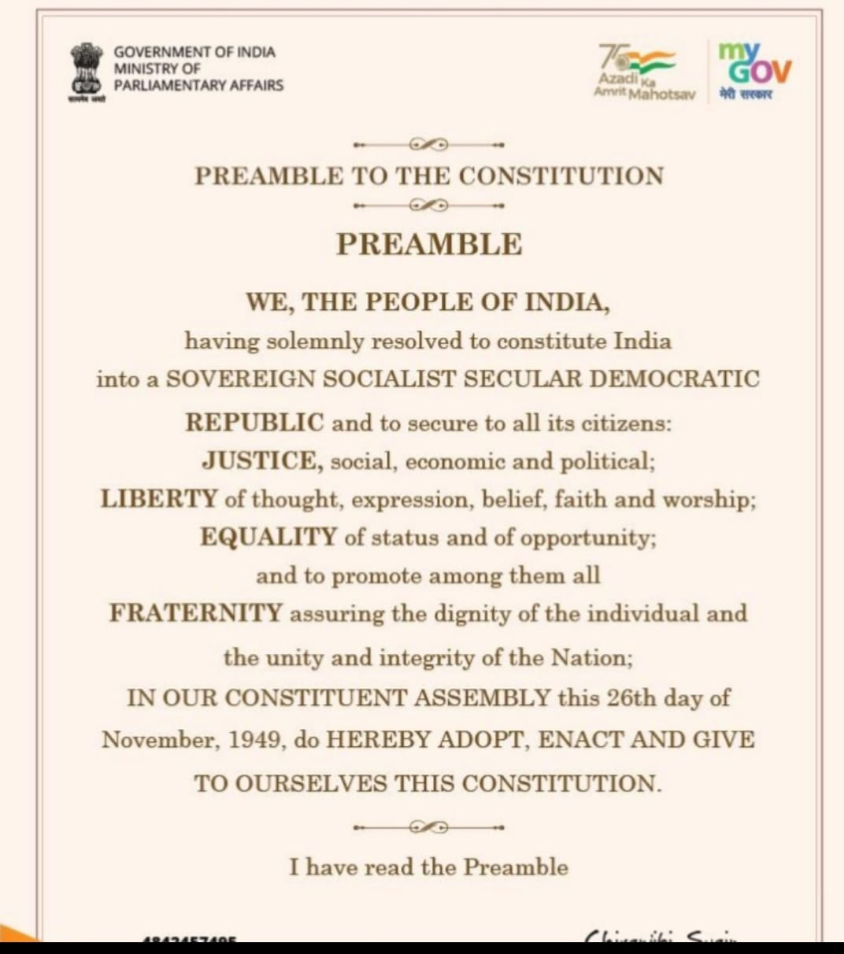

Slide 5
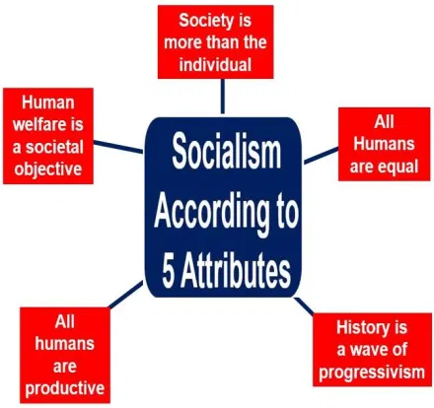
Socialist
This means that all the people in the
country will be treated as equals.
The government will not differentiate
between people on the basis of their
caste, religion or in any other way.
This is known as the principle of socialism.

Slide 6
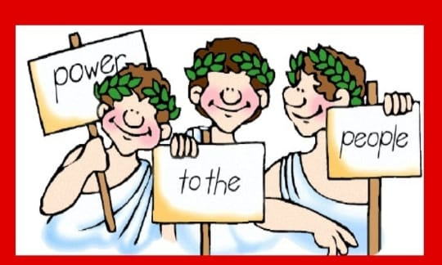
DEMOCRATIC
This means that all the people of the
country will choose or elect leaders
who would form the government.
This kind of government is known as
democracy.
Our country is no longer ruled by kings.
If the people are not happy with their
elected leaders, they can be removed
from their posts.

Slide 7
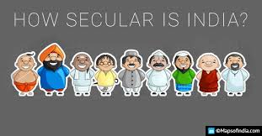
SECULAR
This means that all people in the country would be free to follow whatever religion they want. This is known as the principle of secularism.

Slide 8
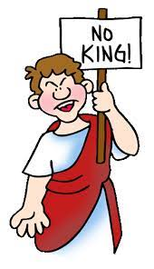
REPUBLIC
This means that our head of state is elected by the people.
India is headed by an elected president, unlike Britain whose head of state is a hereditary monarch.

Slide 9
Word Meanings
Sovereign - having the supreme power
Monarchy - form of government with a king at the head
Principles - the basic truth
Dictatorship - a ruler with total power over a country
Communism - system of social organization in which all property is owned by the community and each person contributes and receives according to their ability and needs.

Slide 10
A. Fill in the blanks.
1. The set of rules according to which our government runs is called our _____________.
Ans. constitution
2. Our Constitution was accepted on ___________. This day is called ___________ Day.
Ans. 26 January 1950, Republic Day
3. The _________ Principles give guidelines to the government for the welfare of the citizens.
Ans. Directive Principles
4. Every citizen of India has certain fundamental _______________.
Ans. rights

Slide 11
B. Match the columns.
1. 26 January a. Fundamental Right
2. Right to follow any religion b. Directive Principle
3. Protecting our national property c. Republic Day
4. Providing education to all children d. Our duty

Slide 12
B. Match the columns.
1. c. Republic Day
2. a. Fundamental Right
3. d. Our duty
4. b. Directive Principle

Slide 13
C. Identify the principle behind the following in our Constitution.
1. People of India are free to follow the religion of their choice: _____________
Ans. Secularism
2. All citizens of India will be treated as equals: _____________
Ans. Socialist
3. The people of India choose the leaders who form the Government: _____________
Ans.Democracy

Slide 14
E. Multiple choice questions.
1. Which of the following applies to India?
a. Democracy b. Socialism c. Secularism d. All of these
2. The set of written rules according to which our country is run, is called:
a. Constitution b. Directive principles c. Fundamental rights d. Duties
3. Which of the following is not a fundamental right?
a. right to be treated as equal b. right to follow any religion c. right to choose our profession d. right to proper living conditions
4. Which of these is a directive principle and not a right?
a. providing work for everyone b. providing education to all children
c. freedom to live anywhere in the country d. freedom to give your opinion

Slide 15
Answer the following questions:
Q1. What do you mean by constitution of our country?
Ans. The set of rules based on which the government would run. This set of rules is known as Constitution.

Slide 16
HOMEWORK
List out two differences between Monarchy and Democracy forms of government in project record.

Slide 17
LEARNING OUTCOME:
The learners will be able to know about
About some fundamental rights and duties as an individual.
Understand the making of the constitution.
More clarity about the topic.

Slide 18
THANKING YOU
ODM EDUCATIONAL GROUP

