Slide 1


SESSION : 17
CLASS : V
SUBJECT : MATHEMATICS
CHAPTER NUMBER: 8
CHAPTER NAME : FACTORS AND MULTIPLES
SUB-TOPIC : TEST OF DIVISIBILITY: RULES AND EXAMPLES

Slide 2
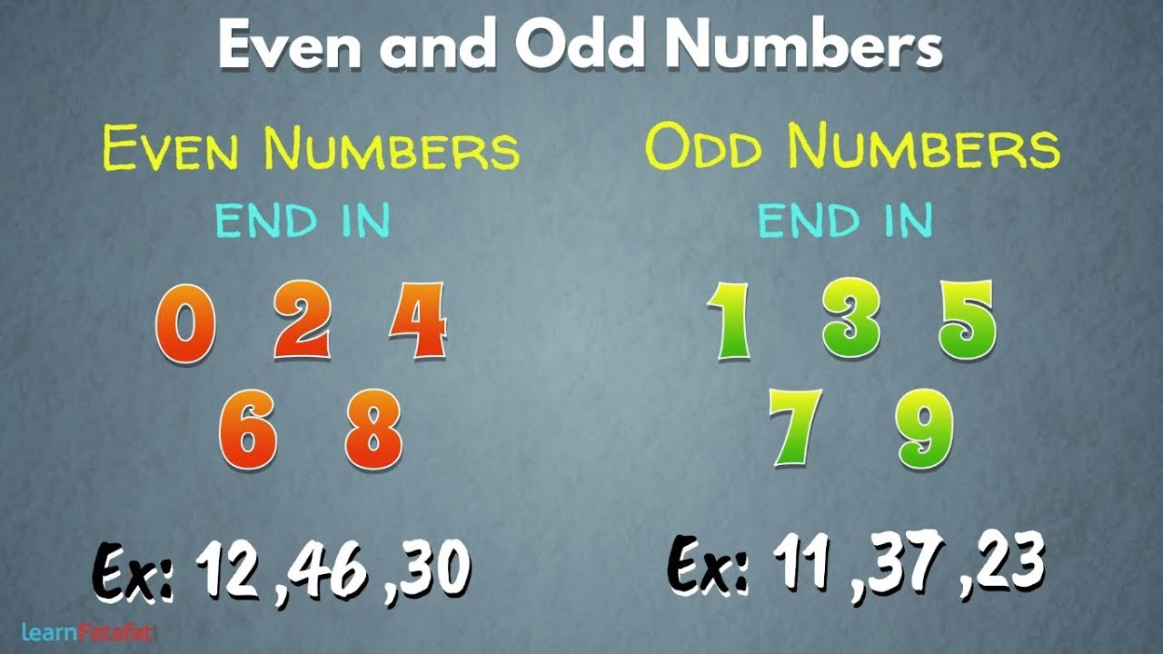

Let’s revise:
A. Numbers which are multiples of 2 are called even numbers.
Examples: 2, 4, 6, 8, 10, 12, 14, 16… etc.
B. Numbers which are not the multiples of 2 are odd numbers.
Examples: 1, 3, 5, 7, 9, 11, 13, 15… etc.

Slide 3

TEST OF DIVISIBILTY: 2
If its one’s digit is even or 0, then the number is divisible by 2
Examples: 0, 8, 36, 64, 1264… etc.

Slide 4


TEST OF DIVISIBILTY: 10
TEST OF DIVISIBILTY: 5
If its last [one’s ] digit is 0 or 5, then the number is divisible by 5.
Examples: 15, 55, 90, 345, 7910
If the one’s digit is 0, then the number is divisible by 10.
Examples: 20, 250, 500, 12540… etc.

Slide 5


TEST OF DIVISIBILTY: 3
If the sum of its digits is divisible by 3, then the number is divisible by 3.
Examples: 6, 12,21,18,111, 2163… etc.
TEST OF DIVISIBILTY: 9
If the sum of its digits is divisible by 9 then, the number is divisible by 9.
Example: 18, 45,72, 144, 3267… etc.

Slide 6


TEST OF DIVISIBILTY: 4
If the number formed by its last two digits are divisible by 4
or
If the last two digits are both 0, then the numbers is divisible by 4.
Examples: 124, 416, 5440, 9600
TEST OF DIVISIBILTY: 8
If the number formed by its last three digits are divisible by 8
or
If the last three digits are 0, then the numbers is divisible by 8.
Examples: 124, 416, 5440, 9600

Slide 7
WRAP UP
A number is Divisible by | If the last digit is
2 | 0, 2, 4, 6, 8
5 | 0, 5
10 | 0
A number is Divisible by | If the sum of its digit is divisible by
3 | 3
9 | 9
A number is Divisible by | If it is divisible by
6 | 2 and 3
12 | 3 and 4
15 | 3 and 5

Slide 8


TEST OF DIVISIBILTY: 6
If the number is divisible by both 2 and 3 , then it is divisible by 6.
Example: 72, 216, 3018, 21324… etc.
TEST OF DIVISIBILTY: 12
If it is divisible by both 3 and 4, then the number is divisible by 12
Example: 24, 60, 2700, 56100… etc.

Slide 9

TEST OF DIVISIBILTY: 15
If it is divisible by both 3 and 5, then the number is divisible by 15.
Example: 45, 90,450, 2700… etc.

Slide 10

TEST OF DIVISIBILTY: 11
If the difference between the sum of the digits in the odd places and the sum of the digits in the even places is either 0 or 11, then the number is divisible by 11
Examples: 308, 1331, 61809, 6556… etc.
Number | Sum of the digits (at odd places) From the right | Sum of the digits (at even places) From the right | Difference
308 | 8 + 3 = 11 | 0 | 11 - 0 = 11
1331 | 1 + 3 = 4 | 3 + 1 = 4 | 4 - 4 = 0
61809 | 9 + 8 + 6 = 23 | 0 + 1 = 1 | 23 - 1 = 22
6556 | 6 + 5 = 11 | 6 + 5 = 11 | 11 – 11 = 0

Slide 11
LEARNING OUTCOME :
Students are able to check the divisibility of a number by using the rules of tests of divisibility.

Slide 12
THANKING YOU
ODM EDUCATIONAL GROUP

