Slide 1


SESSION : 16
CLASS : V
SUBJECT : MATHEMATICS
CHAPTER NUMBER: 6
CHAPTER NAME : Rounding off- Estimation
SUBTOPIC : Doubt clearing and Class test

Slide 2
LEARNING OBJECTIVE :
Enable the students to recall the whole chapter of Estimation through this class test.

Slide 3
CLASS TEST
FULL MARK-15
A. Fill in the blanks. (1×5=5)
The half-way number between 19,000 and 20,000 is ____________.
2. 768 + 234 = ____________ [ 900, 1000, 800]
3. If we round off ₹456.80p to the nearest rupee we get _________.
4. If we round off 4 years 7 months to the nearest year we get ____________.
5. Round off to the nearest hour : 11: 45am=____________.

Slide 4
CLASS TEST
FULL MARK-15
B. Do as Directed. (2×2=4)
6.Estimate the sum.
2,65,893 + 2,541
7. Estimate the product.
a. 125 × 63

Slide 5
CLASS TEST
FULL MARK-15
C. Word Problem. (3×2=6)
8. Mohit had ₹ 9,876. He gave ₹ 897 to his sister for her school project. Estimate the money left with him.
9. A radio costs ₹1267. Find the approximate cost of 18 such radios?

Slide 6

ANSWER

Slide 7
CLASS TEST
FULL MARK-15
A. Fill in the blanks. (1×5=5)
19,500
The half way number between 19,000 and 20,000 is
2. 768 + 234 = [ 900, 1000, 800]
3. If we round off ₹456.80p to the nearest rupee we get
4. If we round off 4 years 7 months to the nearest year we get
5. Round off to the nearest hour : 11: 45 am=
1000
₹ 457
5 years
12 pm

Slide 8
CLASS TEST
FULL MARK-15
B. Do as Directed. (2×2=4)
6.Estimate the sum
2,65,893 + 2,541
Rounding off 2,65,893 and 2,541 to the nearest 1000 and add:
2,66,000 + 3000 = 2,69,000
7. Estimate the product
a. 125 × 63
Rounding off 125 and 63 to their greatest place value and multiply:
100 × 60 = 6000

Slide 9
CLASS TEST
FULL MARK-15
C. Word Problem. (3×2=6)
8. Mohit had ₹ 9876. He gave ₹ 897 to his sister for her school project. Estimate the money left with him.
Solution:
After rounding off 9876 and 897 to the nearest 100, we get
9876
9900
897
900
Money left with him =
9900 – 900 = ₹ 9000
So, Mohit is left with about ₹ 9000.

Slide 10
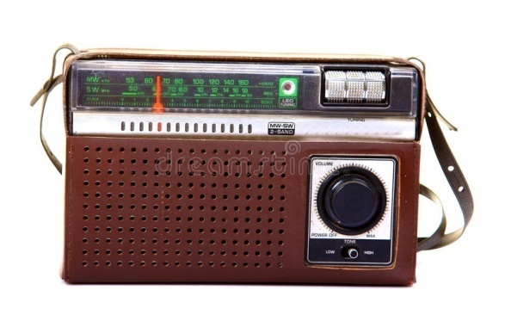
CLASS TEST
FULL MARK-15
9. A radio costs ₹1267. Find the approximate cost of 18 such radios?
Solution:
Cost of a radio = ₹1267
After rounding off 1267 and 18 to their greatest place value, we get
1267
1000
18
20
Approximate cost of 18 radios =
1000 × 20 = ₹20,000
So the approximate cost of 18 radios is ₹20,000

Slide 11
THANKING YOU
ODM EDUCATIONAL GROUP

