Slide 1


SESSION : 13
CLASS : V
SUBJECT : MATHEMATICS
CHAPTER NUMBER: 6
CHAPTER NAME : Rounding off- Estimation
SUBTOPIC : Estimation (Story sums)
Discussion of Examples

Slide 2
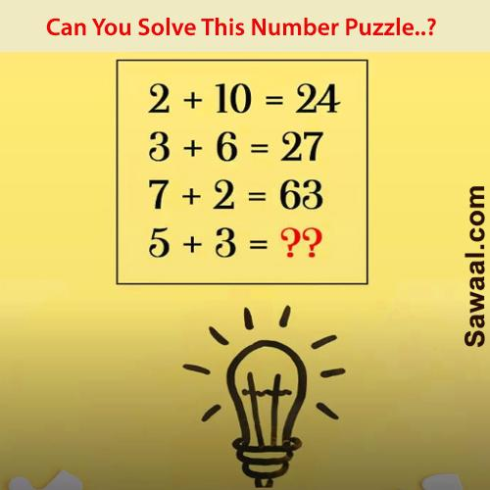
Solve this number puzzle?
A) 40 | B) 44
C) 60 | D) 56

Slide 3
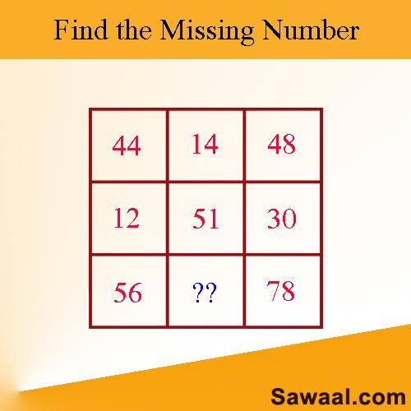
Solve the missing number puzzle?
A) 58 | B) 63
C) 78 | D) 65

Slide 4
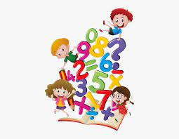
6.3 ESTIMATION – STORY SUMS
RULE – In case rounding off place value is not specified, we add or subtract numbers having different digits by rounding off all the numbers to the greatest place of the number having the least number of digits.
An estimation is the answer close to the actual answer.

Slide 5
ESTIMATION – STORY SUMS
EXAMPLE 1
Mr. Singh has 193 Pepsi, 187 Coca Cola and 95 Fanta bottles in his shop. Estimate about how many bottles he has in stock by rounding off each number to the nearest tens.
Solution :
Round off 193, 187 and 95 to the nearest tens
193
187
95
190
190
+
100
480
So, about 480 bottles are in the stock.

Slide 6
ESTIMATION – STORY SUMS
EXAMPLE 2
A shopkeeper’s monthly income by sale was Rs.27,650 and his expenditure was Rs. 15,275. Estimate his profit by rounding off to the nearest thousands .
Solution :
Round off each number to its greatest place value and subtract.
Round off 27,650 and 15,275 to the nearest thousands
27,650
15,270
28,000
-
15,000
13,000
So, his profit was about Rs. 13,000

Slide 7
ESTIMATION – STORY SUMS
EXAMPLE 3
Sahil bought a mobile phone for Rs. 6,325 and mobile cover for Rs.189. Find out about how much money he spent ?
Solution :
Out of the two given numbers, 189 is the smaller number (3-digit number). So, we shall round off both the numbers to the greatest place of 3-digit number, i.e. to the nearest hundreds.
6,325
189
6,300
+
200
6,500
So, he spent around Rs.6,500

Slide 8
ESTIMATION – STORY SUMS
EXAMPLE 4
A stadium has 28 rows and each row has 437 seats. About how many persons can be accommodated in the stadium ?
Rule - When finding the product of numbers, we round off each factor to its greatest place and multiply the rounded off factors.
Solution :
Round off the numbers to their greatest place value and multiply.
28
437
30
400
Number of seats = 30 400 =
12,000
×
So, the stadium can accommodate about 12,000 people

Slide 9
LEARNING OUTCOME:
Students are able
      To understand the need of rounding off
      To apply it in day to day life
      To get a general idea about situations involving addition, subtraction, multiplication or division.

Slide 10
HOME WORK-
Practice examples

Slide 11
THANKING YOU
ODM EDUCATIONAL GROUP

