Slide 1


SESSION : 3
CLASS : V
SUBJECT : MATHEMATICS
CHAPTER NUMBER : 5
CHAPTER NAME : OPERATIONS ON LARGER NUMBERS
SUBTOPIC : WORD PROBLEMS
Exercise - 5 C Q.No 3 TO 7

Slide 2
WORD PROBLEMS

Slide 3
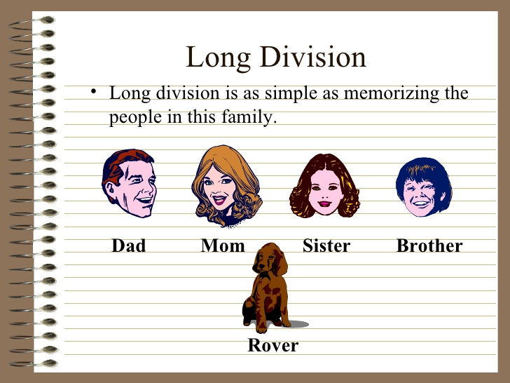

Slide 4
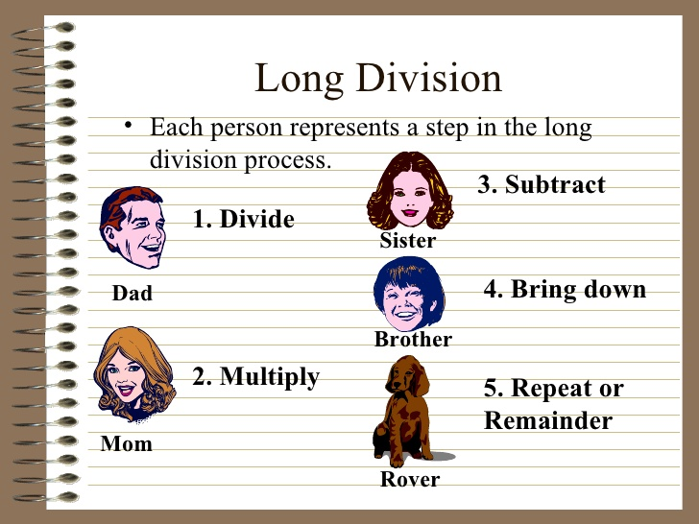

Slide 5
EXERCISE 5 ( C )
3. The product of numbers is 3,14,48,895. If one of the numbers is 6491,find the
other number.
? × 6491 = 3,14,48,895
Ans:
The product of two numbers = 3,14,48,895
One of the number = 6491
The other number is = 3,14,48,895 ÷ 6491
= 4,845
Thus, the other number is 4,845.

Slide 6

EXERCISE 5 ( C )
4. A library has 56,700 books. If each shelf has 105 books, find out the number of shelves in the library.
Ans:
Number of books in a library = 56,700
Number of books in each selves = 105
The number of shelves in the library = 56,700 ÷ 105
= 540
Thus, the number of shelves in the library is 540.

Slide 7


EXERCISE 5 ( C )
5. A state government has distributed 2,26,87,875 among 3,015 farmers. Find the share of each farmer.
Ans:
Total amount distributed by the government = 2,26,87,875
Number of farmers = 3,015
The share of each farmer = 2,26,87,875 ÷ 3,015
= 7,525
Thus, The share of each farmer 7,525 .

Slide 8
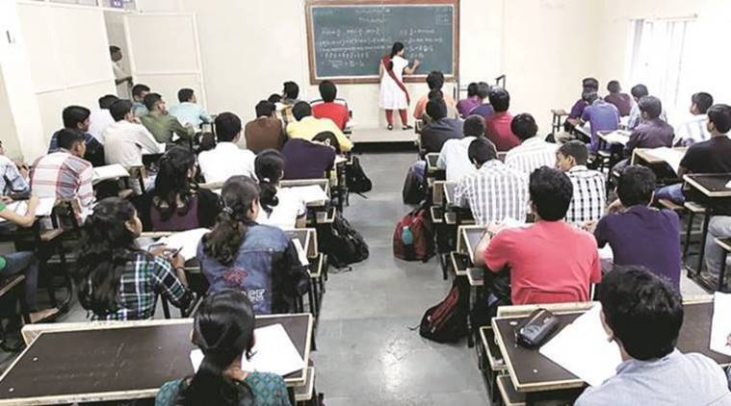
EXERCISE 5 ( C )
6. Mrs. Sharma gets an annual income of 2,98,494 by taking science tutions of 63 students. Find the amount of fees charged by her per student.
Ans:
Mrs. Sharma’s annual income = 2,98,494
Number of students = 63
The amount of fees charged by her per student = 2,98,494 ÷ 63
= 4,738
Thus, The amount of fees charged by her per student is 4,738.

Slide 9

EXERCISE 5 ( C )
7. The government distributes a scholarship of 11,47,500 for 255 meritorious university students annually. Calculate the scholarship amount given to each.
Ans:
Total scholarship amount = 11,47,500
Number of meritorious students = 255
The scholarship amount of each student = 111,47,500 ÷ 255
= 4,500
Thus, The scholarship amount given to each student is 4,500.

Slide 10
LEARNING OUTCOME
# Students are relating the story sums based on division to their real life and solve them.

Slide 11
HOME WORK
Complete exercise - 5 C Q.No. 3 to 7 in the notebook.

Slide 12
THANKING YOU
ODM EDUCATIONAL GROUP

