Slide 1


SESSION : 2
CLASS : V
SUBJECT : MATHEMATICS
CHAPTER NUMBER : 5
CHAPTER NAME : OPERATIONS ON LARGER NUMBERS
SUBTOPIC : Long division
Exercise - 5 C Q.No 2

Slide 2
DIVISION OF LARGE NUMBERS

Slide 3
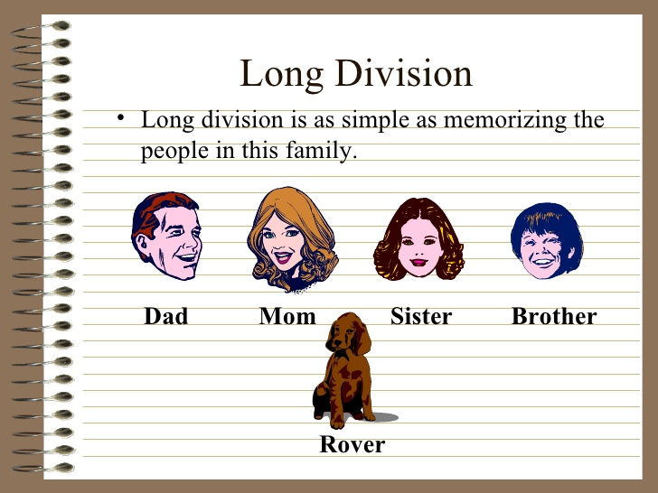

Slide 4
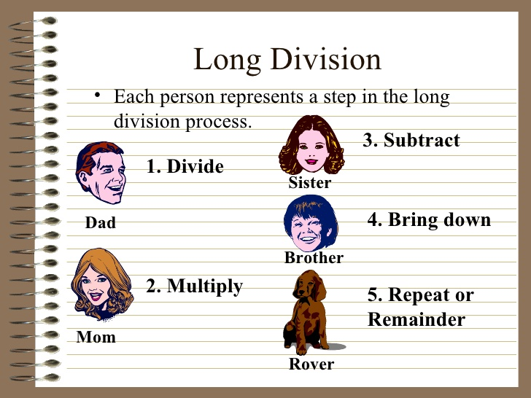

Slide 5
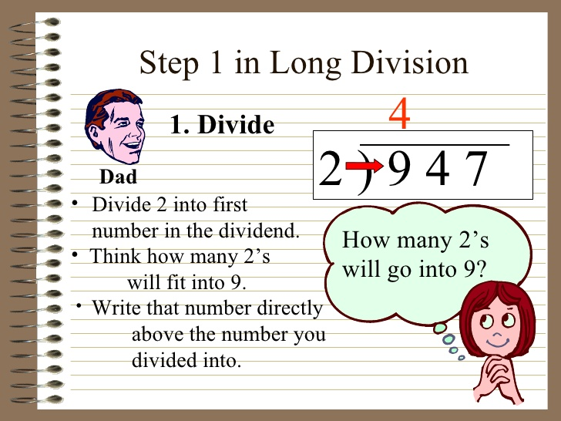

Slide 6
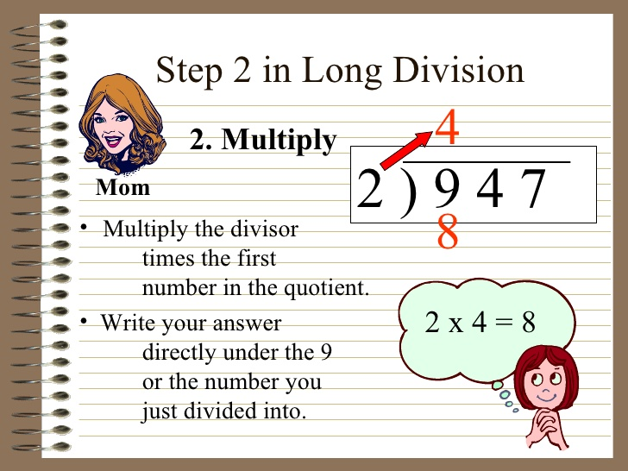

Slide 7
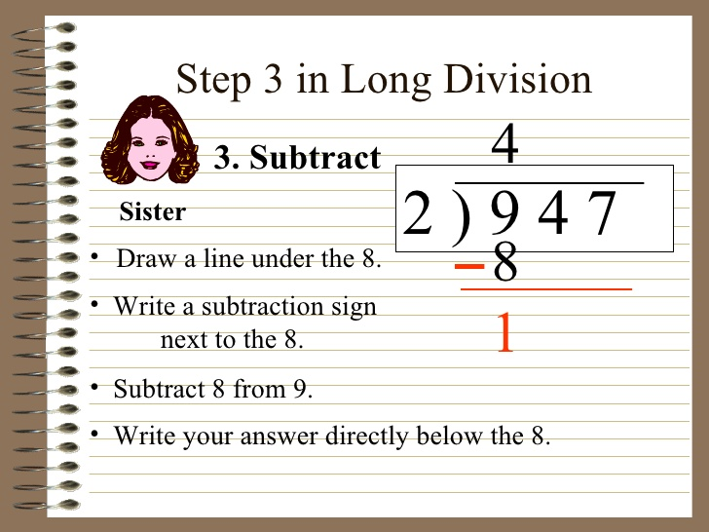

Slide 8
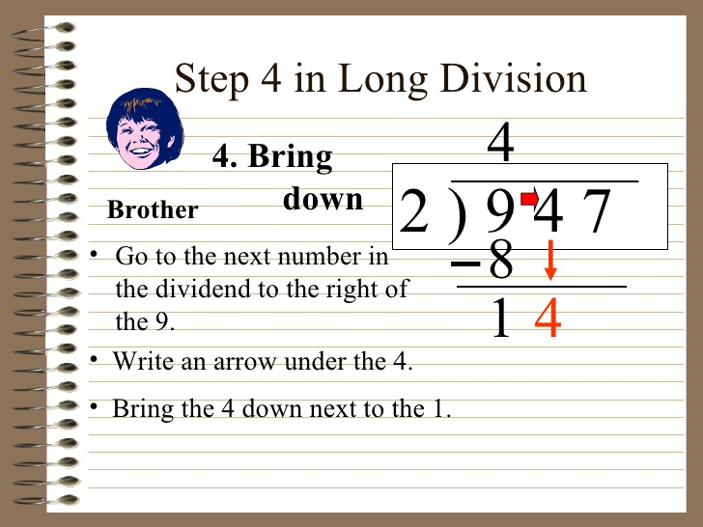

Slide 9
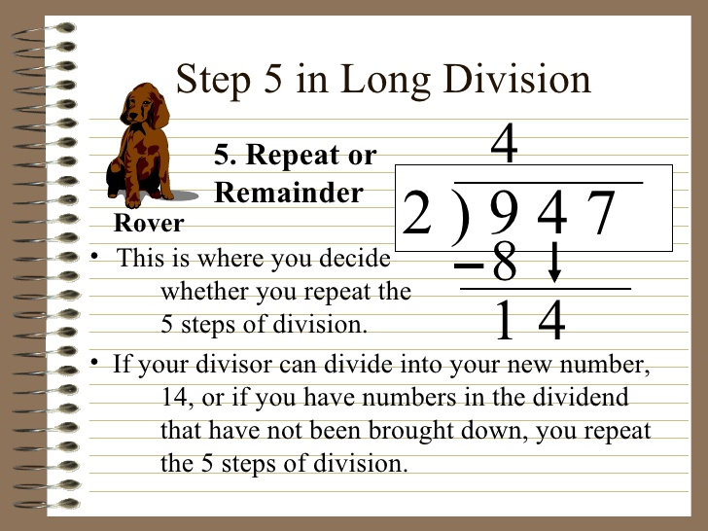

Slide 10
EXAMPLE-1
419634 ÷ 38
1
1
0
4
3
3 8
4 1 9 6 3 4
3 8
Ans:
Quotient = 11043
Remainder=0
3
9
3 8
1
6
3
1 5 2
1
1
4
1 1 4
0

Slide 11
EXAMPLE-2
364865 ÷ 57
6
4
0
1
57
3 6 4 8 6 5
3 4 2
Ans:
Quotient = 6401
Remainder= 8
2
2
8
2 2 8
0
6
5
5 7
8

Slide 12
EXAMPLE-3
36648067 ÷ 943
38863
57
36648067
2829
Ans:
Quotient = 38863
Remainder= 258
8358
7544
8140
7544
5966
5658
3087
2829
258

Slide 13
EXERCISE 5 ( C )
2. Divide and find the quotient and the remainder. Check your answer using the relationship: Dividend = Divisor × Quotient + Remainder
a) 62643 ÷ 56 =
Ans:
Quotient = 1118
Remainder = 35
Checking :
Divisor × Quotient + Remainder
= 56 × 1118 + 35 = 62643 = Dividend

Slide 14
EXERCISE 5 ( C )
2. Divide and find the quotient and the remainder. Check your answer using the relationship: Dividend = Divisor × Quotient + Remainder
b) 342616 ÷ 47 =
Ans:
Quotient = 7289
Remainder = 33
Checking :
Quotient × Divisor + Remainder
= 7289 × 47 + 33 = 342616 = Dividend

Slide 15
EXERCISE 5 ( C )
2. Divide and find the quotient and the remainder. Check your answer using the relationship: Dividend = Divisor × Quotient + Remainder
c) 5177365 ÷ 63 =
Ans:
Quotient = 82180
Remainder = 25
Checking :
Quotient × Divisor + Remainder
= 82180 × 63 + 25 = 5177365 = Dividend

Slide 16
EXERCISE 5 ( C )
2. Divide and find the quotient and the remainder. Check your answer using the relationship: Dividend = Divisor × Quotient + Remainder
d) 4810348 ÷ 75 =
Ans:
Quotient = 64137
Remainder = 73
Checking :
Quotient × Divisor + Remainder
= 64137 × 75 + 73 = 4810348 = Dividend

Slide 17
EXERCISE 5 ( C )
2. Divide and find the quotient and the remainder. Check your answer using the relationship: Dividend = Divisor × Quotient + Remainder
e) 51693 ÷ 483 =
Ans:
Quotient = 107
Remainder = 12
Checking :
Quotient × Divisor + Remainder
= 107 × 483 + 12 = 51693 = Dividend

Slide 18
EXERCISE 5 ( C )
2. Divide and find the quotient and the remainder. Check your answer using the relationship: Dividend = Divisor × Quotient + Remainder
f) 68085 ÷ 583 =
Ans:
Quotient = 116
Remainder = 457
Checking :
Quotient × Divisor + Remainder
= 116 × 583 + 457 = 68085 = Dividend

Slide 19
LEARNING OUTCOME
# Students are able to do the division using long division method.

Slide 20
HOME WORK
Complete exercise - 5 C Q.No. 2 in the notebook.

Slide 21
THANKING YOU
ODM EDUCATIONAL GROUP

