Slide 1


SESSION : 1
CLASS : V
SUBJECT : MATHEMATICS
CHAPTER NUMBER : 5
CHAPTER NAME : OPERATIONS ON LARGER NUMBERS
SUBTOPIC : Division facts and properties of division
Exercise - 5 C Q.No 1

Slide 2
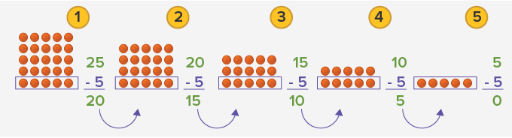
Points to Recall :
Division means repeated subtraction.
Example: 25 ÷ 5 = 5 , remainder = 0
It means 5 is subtracted from 25 five times and remainder is 0.

Slide 3
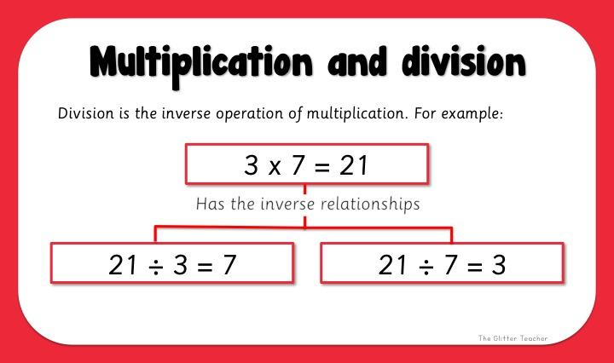
Points to Recall :
Division is the inverse of multiplication.
In division we break up a given number into equal parts or groups.
But when we divide 21 by 3, we break 21 into 7 equal parts or groups .
Similarly, if we divide 21 by 7, we break 21 into 3 equal parts or groups.

Slide 4
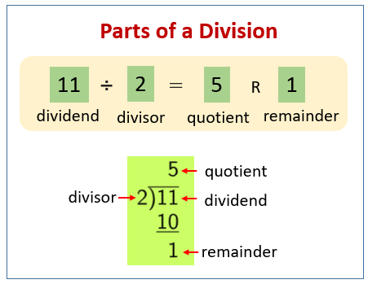
Points to Remember :
The number to be divided is called the dividend.
The number by which dividend is divided is called the divisor.
The result obtained by the process of division is called the quotient.
The number which is left over after finding the quotient is called the remainder.
Remainder is always smaller than the divisor.

Slide 5
Points to Remember :
The dividend, divisor, quotient and remainder are related with one another by the following relationship
Dividend = Divisor × Quotient + Remainder
When we divide a number by 10, 100, 1000, 10000 etc., we get the number
formed by as many digits from the right of the dividend add there are zeroes in
the divisor as remainder and the number formed by the remaining digits of the
dividend as quotient
Example-1
13566 ÷ 100
Quotient =
Remainder =
Example-2
ii) 46483 ÷ 1000
Quotient =
Remainder =
Example-3
iii) 368345 ÷ 10000
Quotient =
Remainder =
135
46
36
66
483
8345

Slide 6
Properties of division
5. When we divide a number by1, the quotient is the number itself.
Example: 7384 ÷ 1 = 7384
6. When we divide a numbers by the number itself, (except 0) we get the quotient as 1 .
Example: 4965 ÷ 4965 = 1
7. A division by zero has no meaning.
Example: 358 ÷ 0 has no meaning
8. “0” divided by a number other than 0 gives “0” as the quotient.
Example: 0 ÷ 8497 = 0 ; 0 ÷ 9 = 0 ; 0 ÷ 0 is not defined.

Slide 7
EXERCISE 5 ( C )
Divide the following numbers by i) 100 ii) 1000 iii) 10000.(Do by short method).
Write the quotient and the remainder.
Number | By 100 |  | By 1000 |  | By 10000
 | Quotient | Remainder | Quotient | Remainder | Quotient | Remainder
a) 85400
b) 821600
c) 974800
d) 96000
e) 486000
f) 770000
g) 3360000
h) 9876450
854
0
85
400
8
5400
8216
0
821
600
82
1600
9748
0
974
800
97
4800
960
0
96
0
9
6000
4860
0
486
0
48
6000
7700
0
770
0
77
0
33600
0
3360
0
336
0
98764
50
9876
450
987
6450

Slide 8
LEARNING OUTCOME
Students recalled the division facts and properties of division and could able to answer the related questions.

Slide 9
HOME WORK
Complete exercise - 5 C Q.No. 1 in the notebook.

Slide 10
THANKING YOU
ODM EDUCATIONAL GROUP

