Slide 1

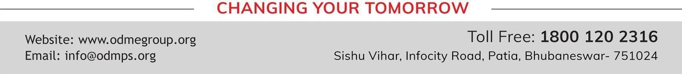
SESSION : 2
CLASS : 5
SUBJECT : SOCIAL SCIENCE
CHAPTER NUMBER: 6 and 7
CHAPTER NAME : GREENLAND – THE LAND OF ICE AND SNOW, SAUDI ARABIA – THE LAND OF HOT SANDS
SUBTOPIC : REVISION 2, MAP SKILL

Slide 2
LEARNING OBJECTIVES
Enable the learner to know about:
A clear understanding of where they are headed.
Well-written learning objectives.

Slide 3
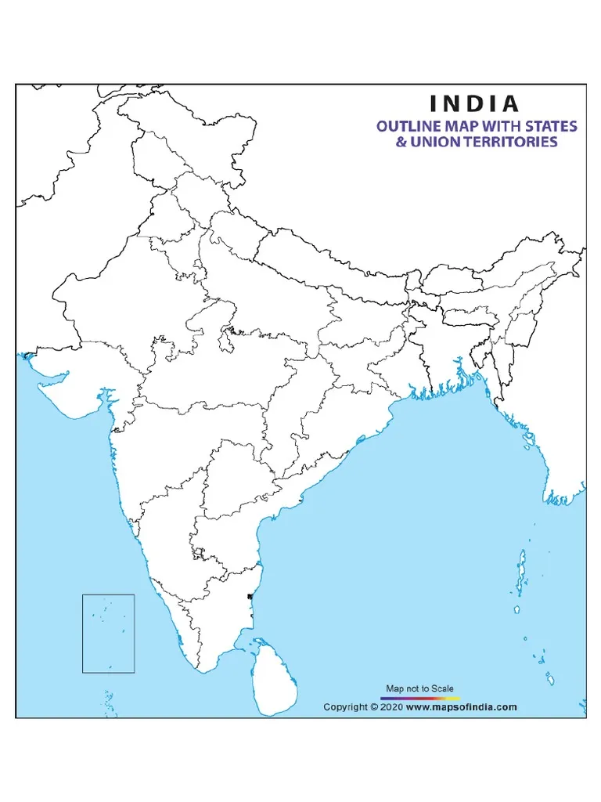
Locate the following on the outline map f India:
a. The state where Konark temple is located.
b. The smallest state.
c. The state where garden city of India is located.
a
b
c

Slide 4
A. Correct the sentences by changing the underlined words .
A large flat area of frozen land lying around the north pole is called iceberg.
2. Kayaks are used for boat racing.
3. Greenland is also known as Land of magic.
4. The capital of Saudi Arabia is Nuuk.
Ans. Tundra
Ans. Fishing
Ans. Midnight Sun
Ans. Riyadh

Slide 5
B. Give answer in one word.
Liquid Gold
The other name of petroleum. ___________
Greenland is a part of which country? _____________
Most of DRC is covered with _______________ forests.
The _______ river flows through the DRC.
Denmark
Tropical rain
congo
C. Answer the following questions.
Define – a) Bedouins b) Thobe c) Peninsula d) Oasis
Ans. a) Bedouins – The nomadic Arabs living in the desert in tents are called Bedouins.
b) Thobe – The men and boys of Saudi Arabia wear the traditional loose fitting white robes called Thobe.
c) Peninsula - A peninsula is a piece of land jutting out into the sea. It is surrounded by water on three sides.
d) Oasis – Fertile area formed in the desert by underground water that comes to the surface is called an oasis.

Slide 6
D. Read the paragraph and answer the following questions.
The Arabian Peninsula is the largest peninsula in the world. Saudi Arabia is a large country situated in the Arabian Peninsula. The capital of Saudi Arabia is Riyadh.
What is the capital of Saudi Arabia?
Ans. Riyadh is the capital of Saudi Arabia.
2. Which is the largest peninsula in the world?
Ans. The Arabian Peninsula is the largest peninsula in the world.
3. Where is Saudi Arabia?
Ans. Saudi Arabia is a large country situated in the Arabian Peninsula.

Slide 7
HOMEWORK
Learn Q/A of Ch 4,5,6 & 7 for Revision Test - 1

Slide 8
LEARNING OUTCOME
By the end of the class, learners will be able to know:
A clear understanding of where they are headed.
Well-written learning objectives.

Slide 9
THANKING YOU
ODM EDUCATIONAL GROUP

