Slide 1


SESSION : 1
CLASS : 03
SUBJECT- SOCIAL SCIENCE
CHAPTER NUMBER: 07
CHAPTER NAME :THE CLOTHES WE WEAR
SUBTOPIC : INTRODUCTION, MEN WEAR CLOTHES AND NEW WORDS

Slide 2


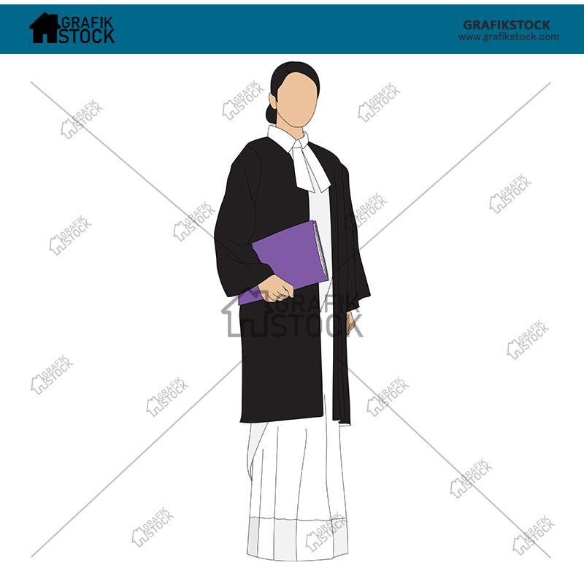
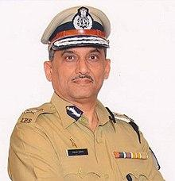

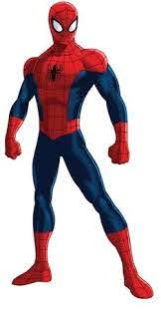
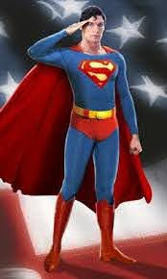

Slide 3

Introduction
Why do we wear clothes?
To protect our body from rough weather
To maintain decency
To be safe from germs and diseases
To display occupation
To display religion and tradition

Slide 4
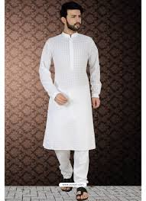
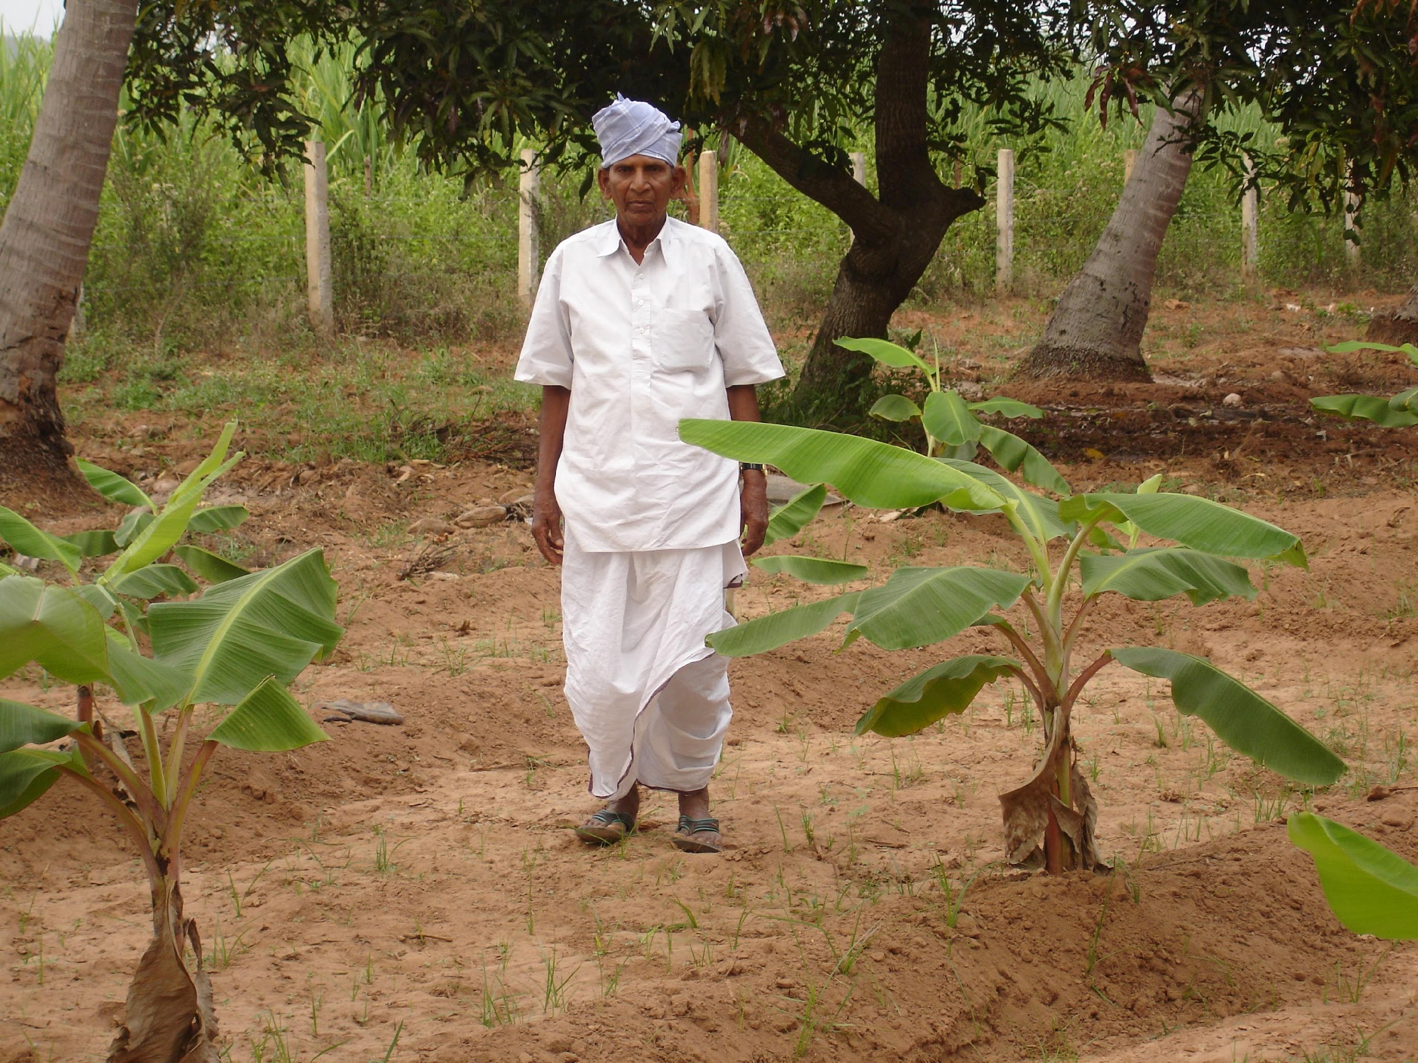
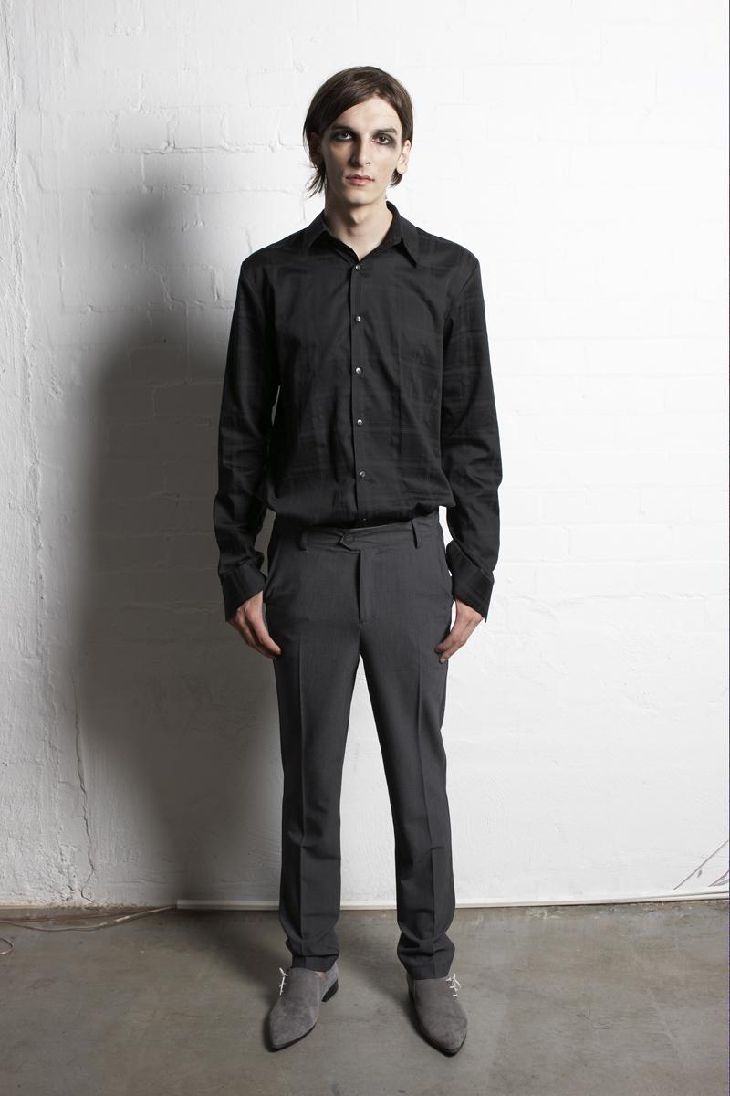
What Our Men Wear
Men wear different clothes indifferent states.
Kurtas worn with dhotis, pyjamas, churidars or lung is are popular in most of the northern and eastern states, as well as in the states of Central India.

Slide 5
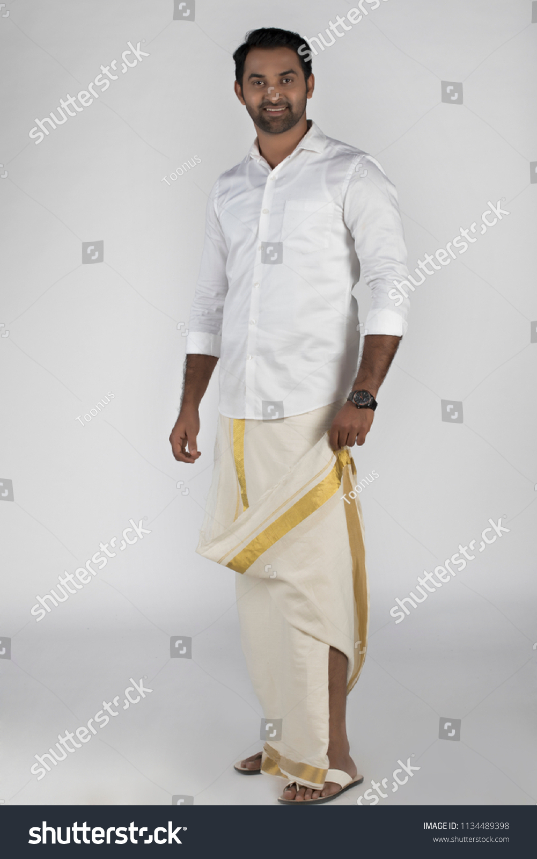
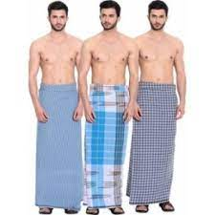
A lungi is a cloth tied around the waist by men.
Lungi-kurta or lungi with a shirt is commonly worn in the southern states.
The lungi is called mundu in Kerala and veshti in Tamil Nadu.

Slide 6
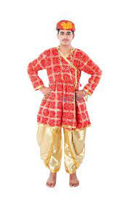
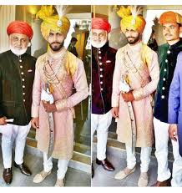
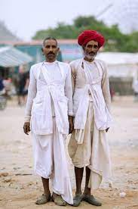
In Rajasthan, a pyjama or dhoti is worn as the lower garment and angrakha as upper garment.

Slide 7
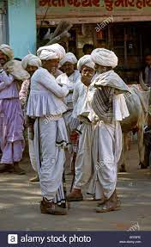
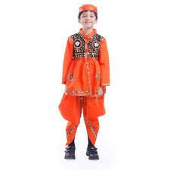
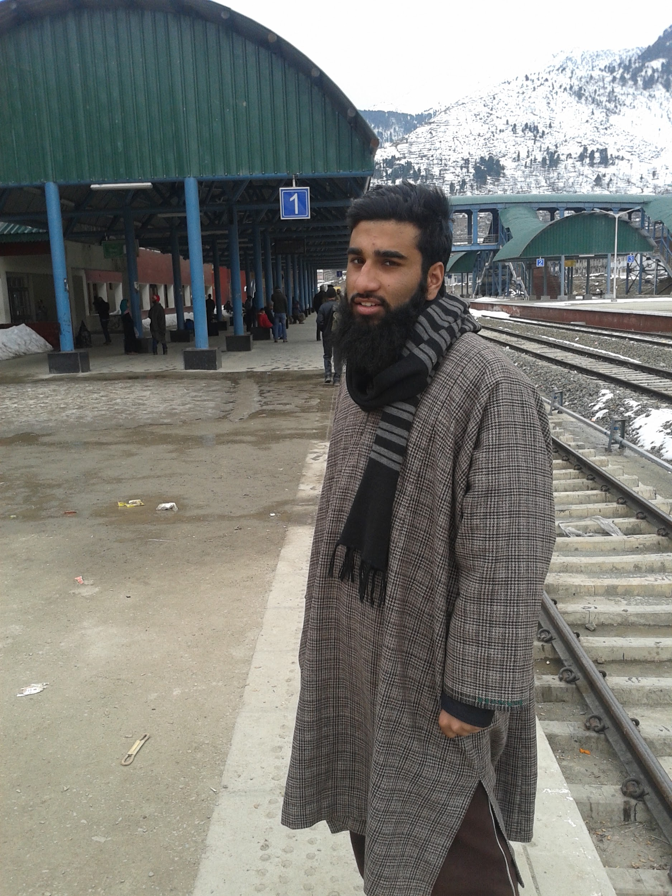
In Gujarat, men wear a short frilled white angrakha over white pyjamas or dhoti and jacket.
Man in Kashmir wearing a phiran.

Slide 8
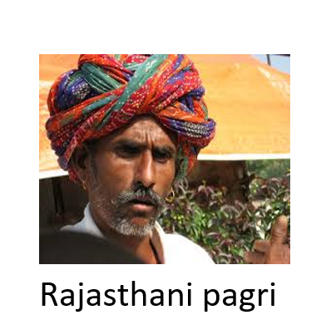
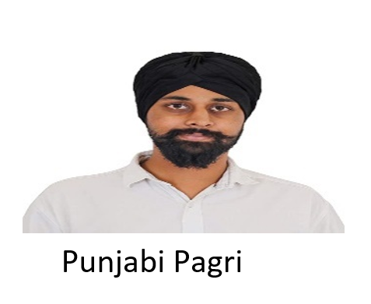
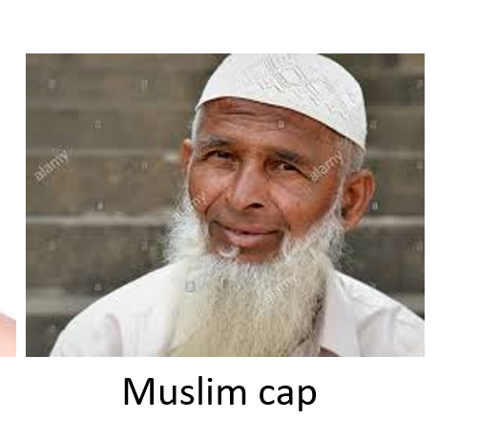
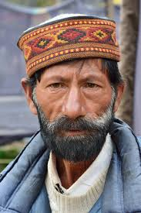
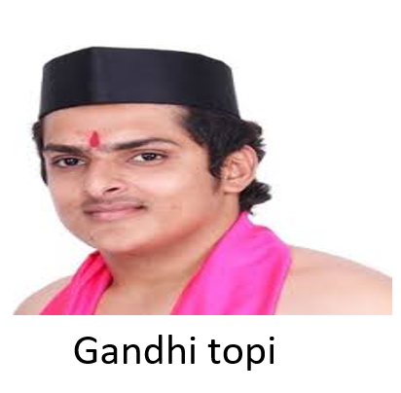
PAGRI AND TOPI
Indian men often cover their heads with turbans or pagris, and traditional caps or topis.
The way these are worn varies from region to region.

Slide 9
Word meanings
lungi/dhoti/mundu: a cloth worn around the waist by men
angrakha: short jacket like shirt worn over dhoti by men of Gujarat and Rajasthan
turban: a head dress for men made by winding a length of cloth tightly around the head
ghaghra/lehenga/pavada: long skirts worn by women
kanchli/kurta/choli/kameez: blouse or shirt worn by women
salwar/pyjama/churidar: trouser-like garment worn by women
odhni/dupatta: cloth draped over the chest or head by women

Slide 10
Home Assignment
Make a list of women wear clothes in project record.

Slide 11
LEARNING OUTCOME :
Learner will be able to know:
Students will be know about the diversity in Clothes of India

Slide 12
THANKING YOU
ODM EDUCATIONAL GROUP

