Slide 1


SESSION : 2
CLASS : 03
SUBJECT- SOCIAL SCIENCE
CHAPTER NUMBER: 07
CHAPTER NAME :THE CLOTHES WE WEAR
SUBTOPIC : WOMEN WEAR CLOTHES AND SHORT Q/A

Slide 2

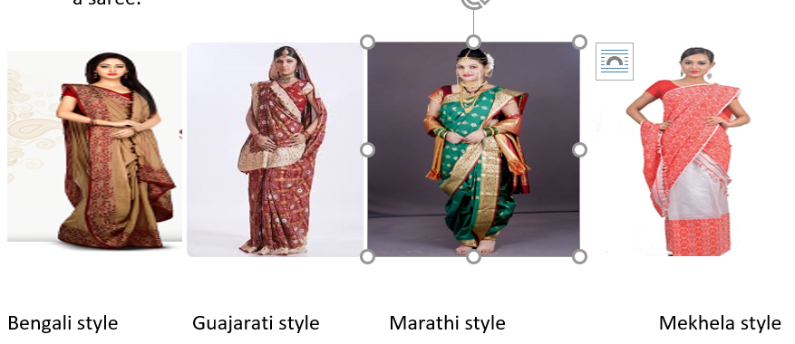
Saree
The saree is one of the oldest traditional costumes worn by Indian women.
It is worn all over India.
But women in different parts of India wear different sarees in different style.
The Mekhela Chador worn in Assam consist of two pieces of cloth draped like a saree.

Slide 3
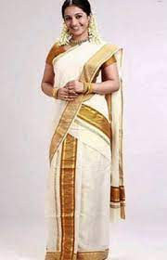
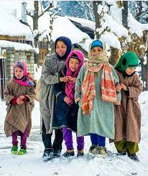
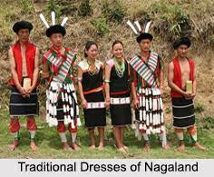
MUNDU of KERALA
SALWAR-PHIRAN of Kashmir

Slide 4
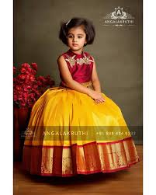
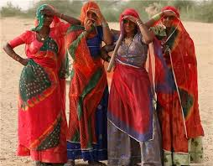
GHAGRA-CHOLI
The ghagra-choli is also known as lehenga-choli.
A ghagra is a long skirt which is worn with a blouse (choli) and a dupatta.
This is the traditional dress of the women of Rajasthan and some parts of Gujarat.
Girls in southern India wear a similar dress called pavadai-chattai, or langa-davani.

Slide 5
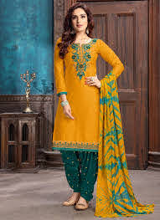
SALWAR-KAMEEZ
The salwar-kameez is the traditional dress of the women of Punjab, Haryana and Himachal Pradesh.
The salwar is like a pyjama.
It is worn with a long top called kameez or kurta.
The salwar-kameez is usually worn along with a dupatta or chunni.
These days, the salwar-kameez is worn by women all over India as it is easy to wear.

Slide 6
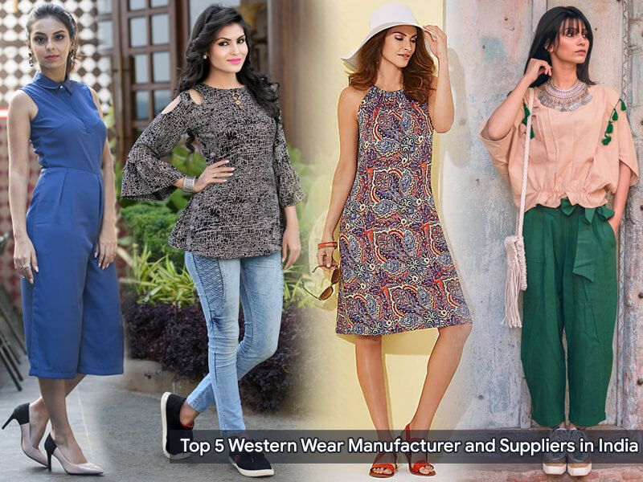
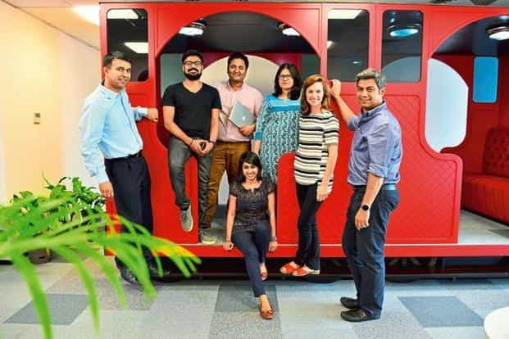
Western Clothes
Western clothes such as trouser, shirts. Jeans, T-shirt, skirts and jacket have also become popular among both man and women.

Slide 7
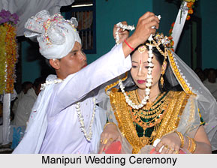
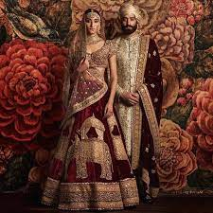
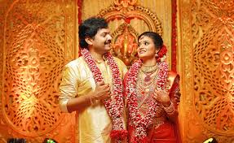
WEDDING CLOTHES

Slide 8
Circle the odd one
1. turban dhoti lungi pyjama
2. sari lungi dhoti trouser
3. salwar angrakha mundu veshti
4. mekhla lehenga ghagra kanchli
5. pyjama kameez churidar trouser
turban
Sari
angrakha
mekhla
kameez

Slide 9
Match the following
1. Salwar – phiran a. Haryana
2. Ghaghra- kurta b. Kerala
3. Mundu- blouse c. Assam
4. Mekhla-chadar d. Kashmir

Slide 10
Multiple choice questions
The clothes that people wear is influenced by the ___________ of the place.
climate b)food c)wind
2. Men’s _________________ in Tamil Nadu is called veshti
Lungi b. pyjama c. churidar
3. The ________ is the most common piece of clothing for women in India.
a. Ghagra b. churidar c. sari
4. In several states of India, men cover their heads with a ___________ .
a.hat b. hanky c. turban
5.A phiran is a long ___________.
a.kurta b. blouse c. skirt
climate
. Lungi
. sari.
. turban
kurta

Slide 11
LEARNING OBJECTIVE :
Learner will be able to know:
to enable the children to know about different women clothes of india

Slide 12

THANKING YOU
ODM EDUCATIONAL GROUP

