Slide 1


SESSION : 5
CLASS : III
SUBJECT : SCIENCE
CHAPTER NUMBER : 8
CHAPTER NAME : MAN:THE LIVING MACHINE
SUB-TOPIC : THE EXCRETORY SYSTEM, THE REPRODUCTIVE
SYSTEM, NEW WORDS AND WORD MEANINGS

Slide 2
LEARNING OBJECTIVE :
To enable the learners to know –
about the excretory system, the reproductive system and
new words and word meanings.

Slide 3

LET’S RECAPITULATE
Please assist Chintu to organise the following activities under correct heads.
1.Hearing 2. give shape to body 3. helps the body to move 4. walking 5. learning 6.seeing
Nervous system | Skeletal system | Muscular system
hearing
Give shape to body
Helps the body to move
walking
learning
seeing

Slide 4

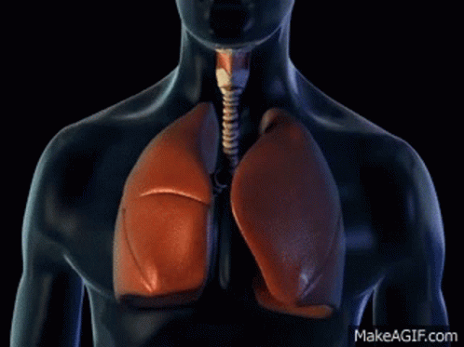
THE EXCRETORY SYSTEM
The main function of excretory system is to remove the waste from the body through its organs.
The kidneys remove urine.
The skin removes sweat.
The lungs throw out carbon dioxide.
Sweating
Breathing

Slide 5
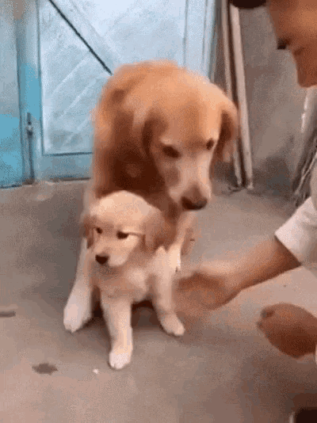
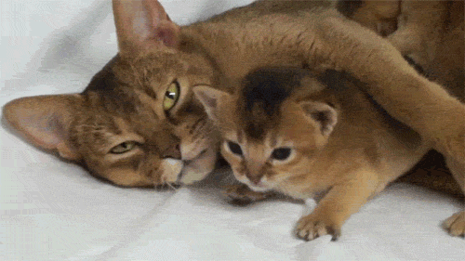
THE REPRODUCTIVE SYSTEM
The organs of this system help to produce
babies.
Because of this system life on earth goes on.

Slide 6
THE NEW WORDS AND MEANING
S.NO | NEW WORD | WORD MEANING
1 | Sense | Feeling
2 | Grinder | A machine for grinding spices
3 | System | Team
4 | Purifies | Removing dirt
5 | Saliva | Liquid that is produced in mouth
6 | Pumps | Sends
7 | Digestion | Process of changing of food into a simple form
8 | Nutrients | Substance that is needed to keep a living thing alive
9 | Blood vessel | Tubes in the body through which blood flows
10 | Nerve | Long thin thread which carry messages to and from brain.

Slide 7
LEARNING OUTCOME:
The learners will be able to know -
about the excretory system and the reproductive system.

Slide 8
THANKING YOU
ODM EDUCATIONAL GROUP

