Slide 1


SESSION : 4
CLASS : III
SUBJECT : SCIENCE
CHAPTER NUMBER : 8
CHAPTER NAME : MAN:THE LIVING MACHINE
SUB-TOPIC : THE NERVOUS SYSTEM,THE SKELETAL SYSTEM, THE MUSCULAR SYSTEM.

Slide 2
LEARNING OBJECTIVE :
To enable the learners to know -
about the nervous system, the skeletal system and the muscular system.

Slide 3



LET’S RECAPITULATE:
David and Twinkle are differ in the following statements. Tell them who is right.
When we smell food, our mouth starts watering.
The food that we chew, mixes with saliva and becomes hard.
From the stomach the food first goes into the large intestine.
Digested food is taken in by the blood are carried to the other parts of the body .
The heart pumps the blood to different parts of the body through small and big blood vessels.
When we smell food our eyes start watering.
The food that we chew, mixes with saliva and becomes soft.
From the stomach the food first goes into the small intestine.
The undigested food goes to the large intestine and it is thrown out.
The brain pumps the blood into the different parts of the blood.

Slide 4
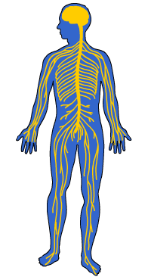
THE NERVOUS SYSTEM
The nervous system consists of the brain, the spinal cord and the nerves.
The nervous system controls all our actions like seeing, hearing, walking and learning.

Slide 5
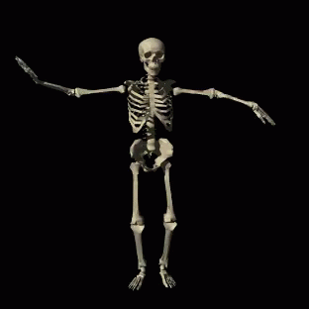
THE SKELETAL SYSTEM
Our body is made up of 206 bones.
These bones together make up the skeletal system.
The bones give shape and support to the body.
We can stand, walk and move because of our bones.

Slide 6
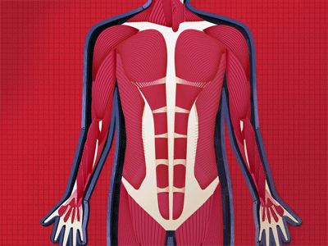
THE MUSCULAR SYSTEM
Our muscles along with the bones help the body and its parts to move.

Slide 7
Summary
The nervous system consists of the brain, the spinal cord and the nerves.
Our body is made up of 206 bones.
The bones give shape and support to the body.
Muscular system helps in moving body parts.

Slide 8
Tick the correct answer:
1. Which body system provides protection for the body system and its
organs?
a. muscular b. circulatory c. skeletal d. digestive
2. Which system works with he skeletal system to move the body?
a. muscular b. circulatory c. nervous d. respiratory
3. Which system has the brain as the main organ?
a. skeletal b. muscular c. nervous d. respiratory
4. Which of these organs controls all the systems in the body?
a. heart b. kidney c. brain d. lung
5. The _________ system carries digested food and oxygen to all parts of the body.
a. excretory b. respiratory c. circulatory d. none of the above

Slide 9
Circle the odd one in each set.
Head stomach brain think
Lung head breathe chest
Stomach food pump eat
Swallow heart blood pump
stomach
head
pump
Swallow

Slide 10
LEARNING OUTCOME:
The learners will be able to know –
about the nervous systems, skeletal system and muscular system.

Slide 11
HOME ASSIGNMENTS
Do oral questions of book page -71.

Slide 12
THANKING YOU
ODM EDUCATIONAL GROUP

