Slide 1


SESSION : 3
CLASS : III
SUBJECT : SCIENCE
CHAPTER NUMBER : 8
CHAPTER NAME : MAN:THE LIVING MACHINE
SUB-TOPIC : THE DIGESTIVE SYSTEM, THE CIRCULATORY
SYSTEM

Slide 2
LEARNING OBJECTIVE :
To enable the learners to know about –
the digestive system and circulatory system.

Slide 3


LET’S RECAPITULATE:
A cute boy is after he got scolding from his mummy.
He has given the following answers. Please try to help him.
We breathe out oxygen.
Ans: carbon dioxide
We should breathe through our mouth.
Ans: nose
We should keep our windows closed.
Ans: open
We should cover our face while sleeping.
Ans: We should not
Breathing pollutes our blood.
Ans: Breathing purifies

Slide 4
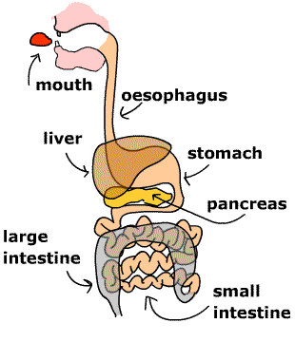
THE DIGESTIVE SYSTEM
Digestion is the process of changing of food into a simple form so that it can be used by the body.
The food that we chew, mixes with saliva and becomes soft.
Then it goes to the stomach.
In the stomach the food mixes with the digestive juices.

Slide 5
THE DIGESTIVE SYSTEM
After four hours of eating the food goes into the small intestine.
Here the digested food is taken in by the blood and carried to the other parts of the body.
The undigested food goes to the large intestine and from there it is thrown out through anus.

Slide 6
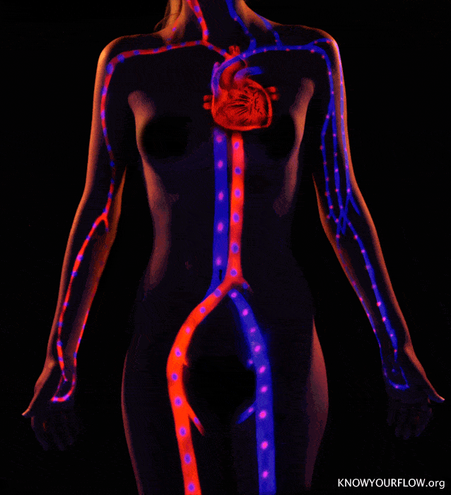
THE CIRCULATORY SYSTEM
The heart, the blood and the blood vessels make up the circulatory system.
The heart pumps the blood to different parts of the body through small and big blood vessels.

Slide 7
Summary
Digestion is the process of changing of food into a simple form so that it can be used by the body.
The undigested food goes to the large intestine and from there it is thrown out through anus.
The heart pumps the blood to different parts of the body through small and big blood vessels.

Slide 8
A. Answer the following:
What is the main function of the digestive system ?
Ans. The digestive system breaks down food into simple substances that can be absorbed by the body.
2. List the organs that make up the digestive system.
Ans. It consists of the mouth, food pipe, stomach, small intestine and large intestine.
3. What is the function of blood?
Ans. The blood carries oxygen and digested food to all parts of the body. It also collects waste from all parts of the body.
4. List the organs that make up the circulatory system.
Ans. The heart, the blood and the blood vessels make up the circulatory system.

Slide 9
B. DEFINE THE FOLLOWING:
Saliva - The watery fluid in the mouth made by the salivary glands. It moistens food to help digestion and it helps protect the mouth against infections.
Small intestine – A long tube like organ that connects the stomach and the large intestine. It folds many times to fit inside the abdomen.
Blood vessels – The blood vessels are a system of tubes that carry the blood throughout the body.

Slide 10
LEARNING OUTCOME:
The learners will be able to –
know about the digestive system and the circulatory system.

Slide 11
HOME ASSIGNMENTS
Write the name of the organs that made up the digestive system and the circulatory systems in the notebook.

Slide 12
THANKING YOU
ODM EDUCATIONAL GROUP

