Slide 1


SESSION : 2
CLASS : III
SUBJECT : SCIENCE
CHAPTER NUMBER : 8
CHAPTER NAME : MAN:THE LIVING MACHINE
SUB-TOPIC : THE RESPIRATORY SYSTEM, BREATHE
CORRECTLY

Slide 2
LEARNING OBJECTIVE :
To enable the learners to –
know about the respiratory system and how to breathe correctly.

Slide 3
LET’S RECAPITULATE:
Choose the correct word and fill in the blanks.
Chandini opened her whatsApp to _____ (see, hear, smell) the message.
Arunitha love to _____ (hear, see, feel) classical music.
Devesh could not bear the _____ (smell , touch, music) of the rotten egg.
I ____ (feel, seeing, thinking) cold in AC room.
Anjali went to a restaurant with her friends to ______(taste, smell, touch) Idly, sambar and chutney.
see
hear
smell
feel
taste

Slide 4
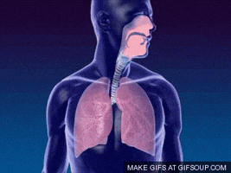
THE RESPIRATORY SYSTEM
The respiratory system supplies oxygen to various parts of our body.
The air goes through our nose.
The air that we breathe in has a gas called oxygen.
Oxygen which burns up the food we eat and give energy.
The air which is breathe out is impure and has carbon dioxide.
Breathing purifies the blood.

Slide 5
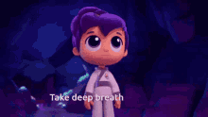
BREATHE CORRECTLY
We should -
breathe in fresh air.
breathe through our nose not our mouth.
keep the windows of our rooms open.
not cover our face while sleeping.

Slide 6
RESPIRATORY SYSTEM
NOTES
The respiratory system supplies oxygen to various parts of our body.
The air that we breathe in has a gas called oxygen.
It burns the food and gives us energy.
We should breathe in fresh air through our nose.

Slide 7
Answer the following questions.
1. What is an organ system?
Ans:- A group of organs in the body working together to do an important job is called an organ system.
2. What is the role of oxygen in our body?
Ans:- We need energy to live and oxygen is used by the body to get energy from the food we eat.

Slide 8
Write T for true and F for false.
We take in oxygen through our nose.
The air we breathe out is called oxygen.
We should always breathe through our mouth.
We should not cover our face while sleeping.
The hair in the nose prevent dust and germs from entering our body.
True
False
False
True
True

Slide 9
LEARNING OUTCOME:
The learners will be able to –
know about the respiratory system and how to breathe correctly.

Slide 10
THANKING YOU
ODM EDUCATIONAL GROUP

