Slide 1


SESSION : 1
CLASS : III
SUBJECT : SCIENCE
CHAPTER NUMBER : 8
CHAPTER NAME : MAN:THE LIVING MACHINE
SUB-TOPIC : INTRODUCTION, OUR SENSE ORGAN

Slide 2
LEARNING OBJECTIVE :
To enable the learners to –
know about the human body and sense organs.

Slide 3



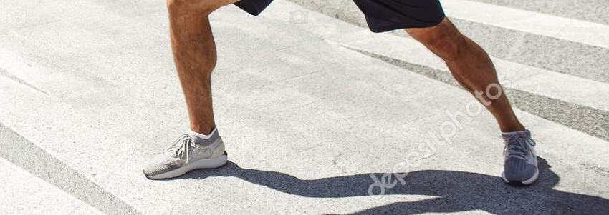
INTRODUCTION
Fill in the blanks selecting the words from the box.
1. We run using our _______.
2. Old people have grey ____.
3. The food that we eat goes into _______.
4. We write by using our _______.
5. We hear with our _____.
All these are parts of a human body.
hair, ears , hands, stomach, legs
legs
hair
stomach
hands
ears

Slide 4
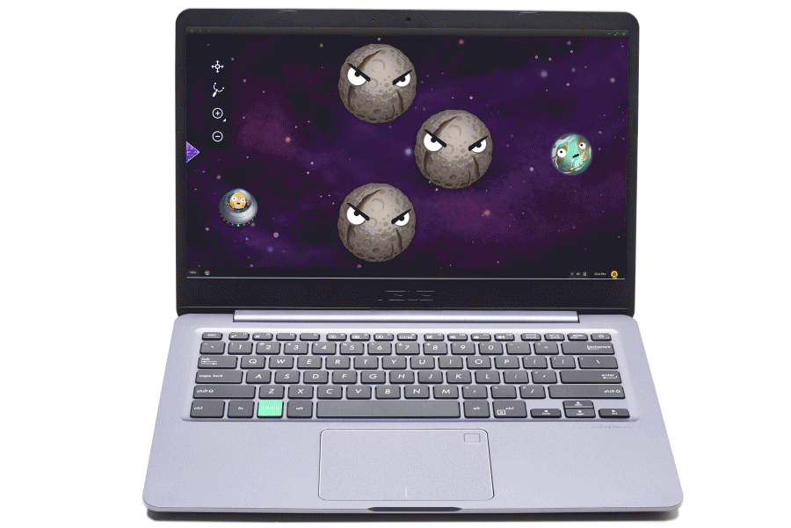
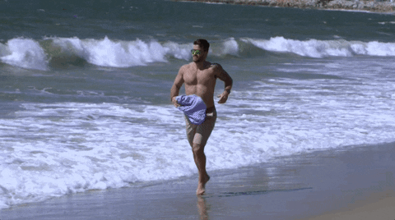
MAN: THE LIVING MACHINE
The human body is a living machine like a computer. It is a better machine than any other machine.
It can see, hear, smell, taste and feel.
It can also move, grow, breathe and reproduce.
The human body is made up of cells.
Cells of the same kind join together to make a tissue.
Tissues join together to make an organ.
Many organs together form an organ system.

Slide 5

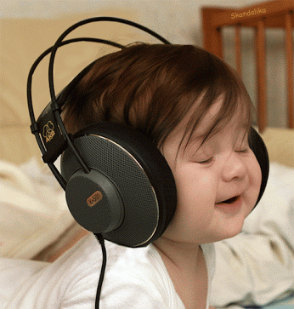
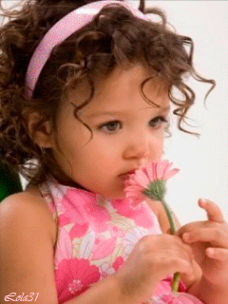
OUR SENSE ORGANS
Let’s try to answer the following questions.
How do we see the wonderful things in the world?
Ans: We see the wonderful things in the world
through our eyes.
Which part of our body help us listen to the music ?
Ans: Ears help us listen to the music.
How can we smell the fragrance of a flower ?
Ans: We smell the fragrance of a flower through
our nose.

Slide 6
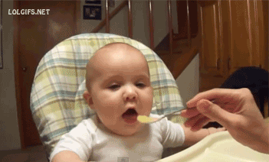

OUR SENSE ORGANS
Let’s try to answer the following questions.
4. How do we know a fruit is sweet or sour?
Ans: We know a fruit is sweet or sour through our
tongue.
How do we feel something is smooth or rough,
hot or cold?
Ans: Our skin help us to feel something smooth
or rough, hot or cold.

Slide 7
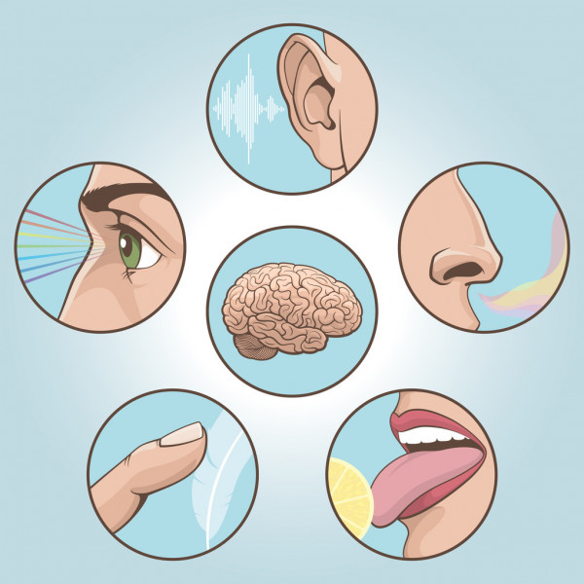
OUR SENSE ORGANS
We have five sense organs - the eyes , the ears, the nose, the tongue and the skin.
All these sense organs are connected to the brain through the nerves.
The sense organs send messages to the brain. The brain makes us understand pictures, sounds, smells, tastes and feelings.

Slide 8
NOTES
The human body works like a machine.
The human body is made up of cells, tissues, organs and organ systems.
Our sense organs tell us about the world.
Our sense organs work together with the brain.

Slide 9

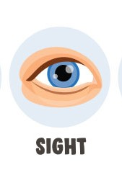
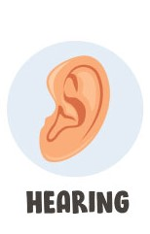


Match with the correct option.
Pizza is very tasty
The pillow is very soft.
The sound is very loud
The cartoon is very interesting
The fragrance of rose is very nice.

Slide 10
LEARNING OUTCOME:
The learners will be able to –
Know about the human body and sense organs.

Slide 11
HOME ASSIGNMENT
Do Get Set! of the page no 68 in the notebook.

Slide 12
THANKING YOU
ODM EDUCATIONAL GROUP

