Slide 1


SESSION : 2
CLASS : III
SUBJECT : SCIENCE
CHAPTER NUMBER : 10
CHAPTER NAME : LIGHT, SOUND AND FORCE
SUB-TOPIC : SOUND, FORCE, NEW WORDS, SHORT Q/A

Slide 2
LEARNING OBJECTIVE :
Learners will be able to know -
about the various types of sounds and force,
new words and meanings, can solve short Q/A

Slide 3
LET’S RECAPITULATE :
Rewrite the sentences by correcting the underlined words.
Light travels in a curved line.
Ans: Light travels in a straight line.
The Moon is the natural source of light.
Ans: The Sun is the natural source of light.
Shadow is created when something goes in the way of light.
Ans: Shadow is created when something comes in the way of light.
The mountain is a luminous object.
Ans: The mountain is a non luminous object.
The earth revolves around the moon.
Ans: The earth revolves around the sun.

Slide 4

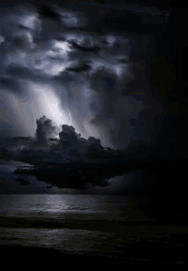
SOUND
We hear various types of sounds everyday.
The ringing of door bells, the chirping of birds, the honking of horns, thunders are some of the sounds.
When we speak or laugh we produce sound.

Slide 5
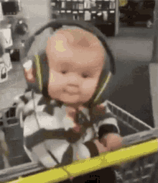


SOUND
Some sounds are pleasant which make us feel happy.
Some sounds which everyone gets disturbed are unpleasant also called as noise.
We should
avoid the use of horn as far as possible,
should speak softly,
play music and TV at a low volume.

Slide 6
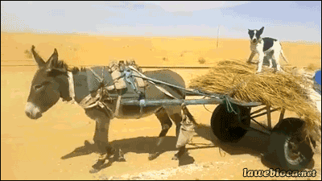
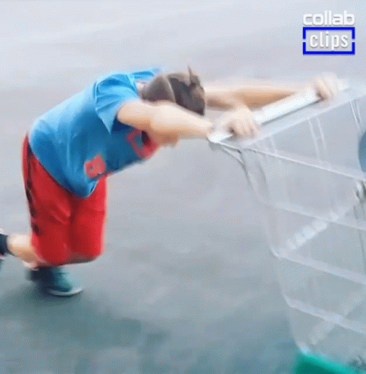
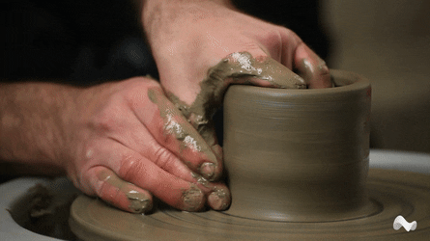
FORCE
When we push or pull something what we apply is called force.
Force can -
move an object
stop a moving object
change the shape of an object

Slide 7
NEW WORDS AND MEANINGS
SL.NO | NEW WORD | WORD MEANING
1 | SOURCE | From where some thing starts
2 | REVOLVES | Moves around
3 | LUMINIOUS | That shines in the dark
4 | REFLECTS | Throw back of light
5 | CHIRPING | Short sharp high pitched sound
6 | NOISE | A loud and unpleasant sound
7 | HONKING | Sound the horn
8 | FORCE | Physical strength or power
9 | VOLUME | A measure of how loud or soft something sounds

Slide 8

Short Q/A
A. Tick ( ) the correct answer
1. This is the main source of light on earth.
Candle b. Sun c.Moon
2. Loud and unpleasant sounds
make us feel happy b. irritate us c. have no effect on us
3. When we push or pull something we apply force and
Sleep b.do work c. do nothing
4. Force can do
a. Nothing b. one thing c. many things

Slide 9
Short Q/A
B. Name the following
Light travels as thin beams of these ________
This is formed when an object blocks the path of light _________
This is caused by an unpleasant sound. ________
Rays
Shadow
Noise

Slide 10
LEARNING OUTCOME:
Learners will able to know -
about the various types of sounds and force,
new words and meanings, can solve short Q/A

Slide 11
HOME ASSIGNMENTS
Do oral questions of book page 85 and 86.

Slide 12
THANKING YOU
ODM EDUCATIONAL GROUP

