Slide 1

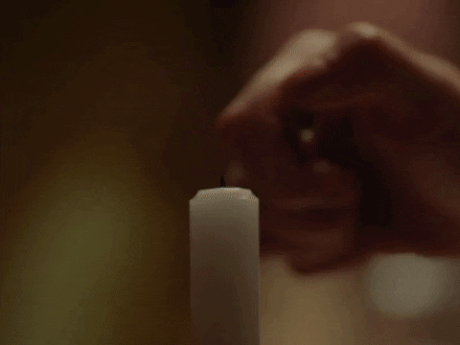


Observe the picture carefully and describe the activity.
Lighting a candle
Switching a bulb
Switching a torchlight
Question : Why we need to do all ?
Answer : To get light which removes dark ness

Slide 2

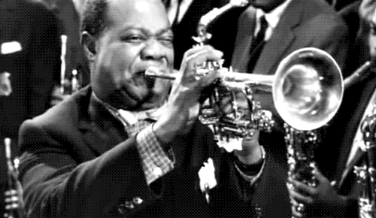
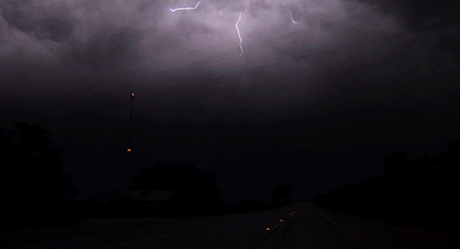
Observe the picture carefully and describe the activity.
Ringing Alarm
Blowing a Trumpet
Thunder with lightning
Question: What is resulted from each Picture?
Answer: Sound

Slide 3



Observe the picture carefully and describe the activity.
Pushing a grocery cart
Pushing a car
Pulling a loaded trolley
Question: What is required to do all these?
Answer: Apply Force

Slide 4

SESSION : 1
CLASS : III
SUBJECT : SCIENCE
CHAPTER NUMBER : 10
CHAPTER NAME : LIGHT,SOUND AND FORCE
SUB-TOPIC : INTRODUCTION, LIGHT AND SHADOW

Slide 5
LEARNING OBJECTIVE :
Learners will be able to know –
about the sources of light and how shadow is formed.

Slide 6
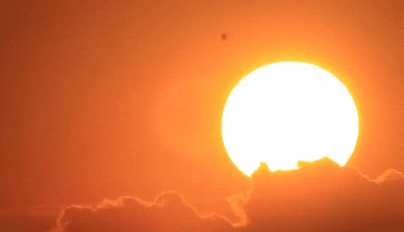
LIGHT
Light helps us to see objects around us.
The sun is the main source of light on the earth.

Slide 7
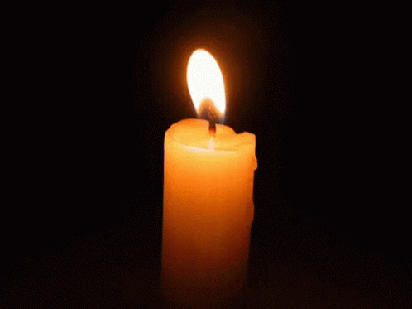

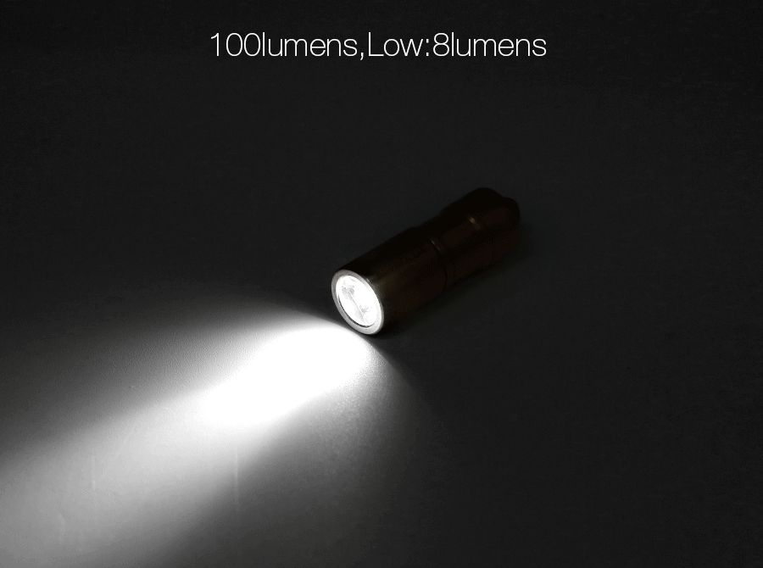
LIGHT
Objects which give us light are called luminous objects. Ex. candles, lamps, torches, bulbs etc.
Objects which do not give light are called non-luminous objects. Ex. table, chair, ball, teddy bear etc.

Slide 8


SHADOW
Light travels in a straight line.
When something comes in the way of light, a shadow is formed.

Slide 9
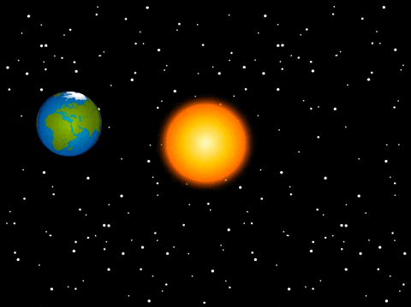
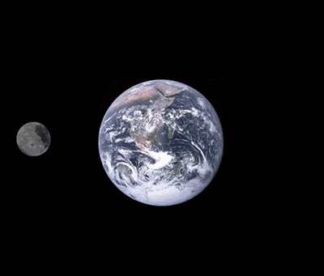
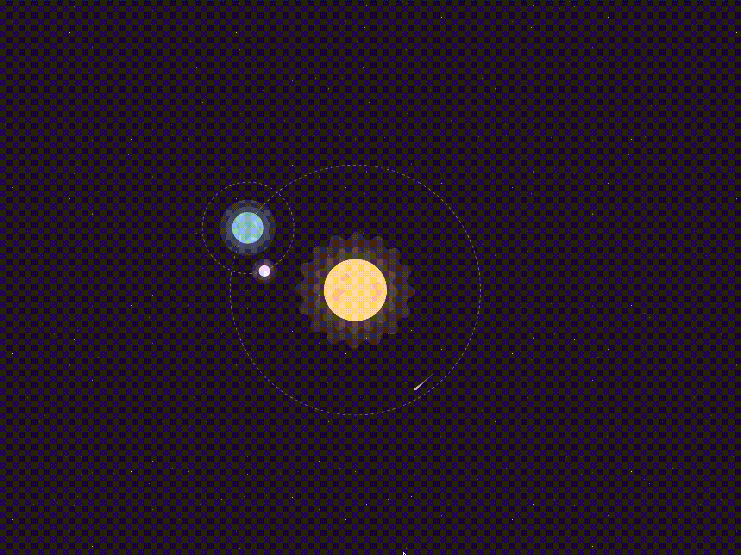
SHADOW
The earth revolves round the sun. The sun’s light falls on the earth.
The moon revolves round the earth. The moon reflects the light of the sun.

Slide 10
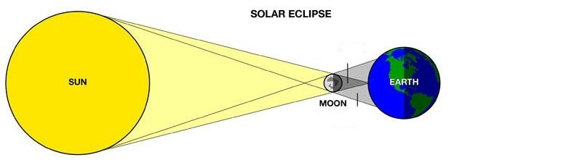
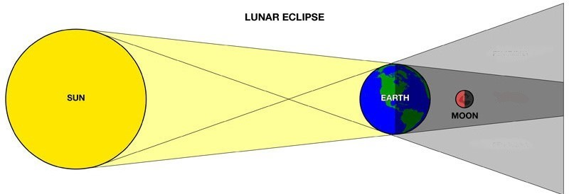
SHADOW
A Solar eclipse occurs when the moon blocks the light of the sun. The shadow of the moon falls on the earth and the sun cannot seen or partially hidden
A lunar eclipse occurs when the earth blocks the light of the sun. The shadow of the earth falls on the moon and the moon cannot be seen.
Solar eclipse
Lunar eclipse

Slide 11
A. ARRANGE THE WORDS UNDER THE CORRECT
COLUMN:
Luminous Objects Non-Luminous Objects
Table, Sun, Moon, Chair, Bulb, Lamp, Candle, Bed, Ball, Torch
Sun
Table
1
2
3
4
5
1
2
3
4
5
Bulb
Moon
Lamp
Chair
Candle
Bed
Torch
Ball

Slide 12
Let’s Answer:
B. Answer the following :
1. What is the main source of light on the Earth?
Ans. The main source of light on the Earth is the Sun.
2. How shadows are formed?
Ans. Shadows are formed when something blocks the path of light.

Slide 13
LEARNING OUTCOME:
Learners will able to know -
about the sources of light and how shadow is formed.

Slide 14
HOME ASSIGNMENTS
List out the Luminous and non luminous objects in note book.

Slide 15
THANKING YOU
ODM EDUCATIONAL GROUP

