Slide 1


SESSION : 4
CLASS : III
SUBJECT : SCIENCE
CHAPTER NUMBER : 4
CHAPTER NAME : LIVING AND NON LIVING
SUB-TOPIC : NEW WORDS AND WORD MEANINGS

Slide 2
LEARNING OBJECTIVE:
To enable the learner to:
know new words and their meanings.

Slide 3
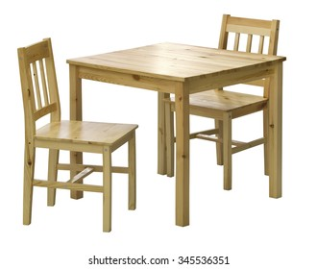
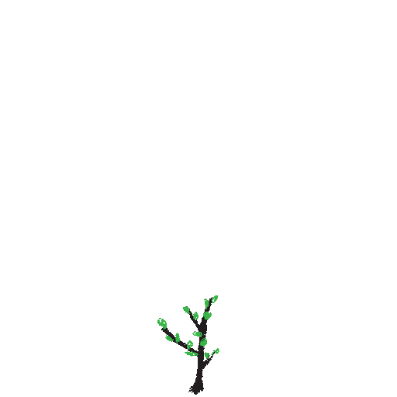
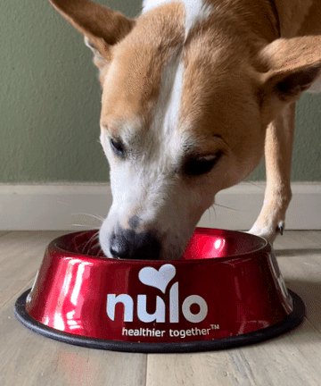
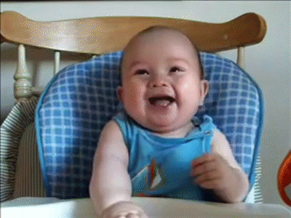
LET’S RECAPITULATE:
See the pictures and say True or False.
Chairs and Table move of their own.
A baby plant grows into a tree.
All living things need food.
Living things cannot feel.
False
True
True
False

Slide 4
NEW WORDS AND MEANING
SL.NO | NEW WORDS | WORD MEANING
1 | Wonderful
2 | Natural
3 | Movement
4 | Stranger
5 | Stroke
beautiful
derived from nature
an act of moving
a person whom one does not know
gently moving hand over

Slide 5
NEW WORDS AND MEANING
SL.NO | NEW WORDS | WORD MEANING
6 | LUNGS
7 | ADULT
8 | PURR
9 | REPRODUCE
10 | BREATHING
a pair of
a person or an animal that is fully grown
to make a continuous low sound that shows pleasure
to produce a copy of some thing
to take in oxygen

Slide 6
Fill in the blanks.
Our Earth is made up of _________ and ________ things.
Plants, Rocks, the sun, the moon and ______ are natural things.
A human baby grows into an _________ .
Living things need food to _________ .
Plants grow towards the ________ .
Human beings cannot live without ___________ .
A bird lays ________ but cats and cows give birth to ________ .
living
non-living
stars
adult
grow
light
breathing
eggs
babies

Slide 7
LET’s SUMMARISE:
Our earth is made up of living and non-living things.
The sun, the moon, rocks, the stars and plants are given to us by the nature are called natural things.
Things made by humans are called man-made things.
Living things include humans, animals and plants.
Living things can move, grow, eat, feel, breathe and reproduce.

Slide 8
HOME ASSIGNMENT :
Write all the new words in your rough note book.

Slide 9
LEARNING OUTCOME :
The learner will be able to:
know new words and their meanings.

Slide 10
THANKING YOU
ODM EDUCATIONAL GROUP

