Slide 1


SESSION : 3
CLASS : III
SUBJECT : SCIENCE
CHAPTER NUMBER : 4
CHAPTER NAME : LIVING AND NON LIVING
SUB-TOPIC : LIVING THINGS BREATHE , LIVING THINGS REPRODUCE

Slide 2
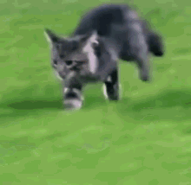
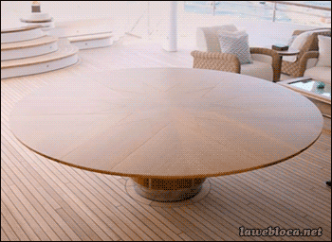
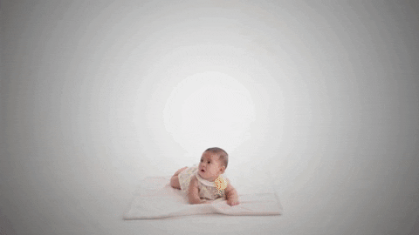
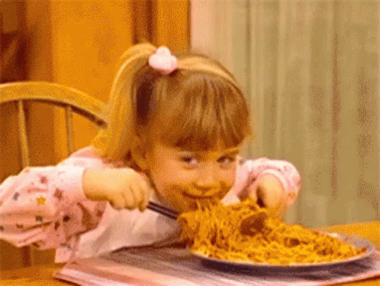
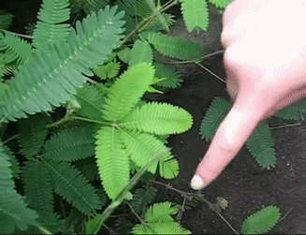
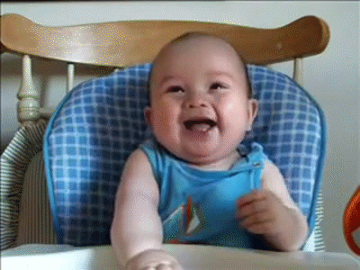
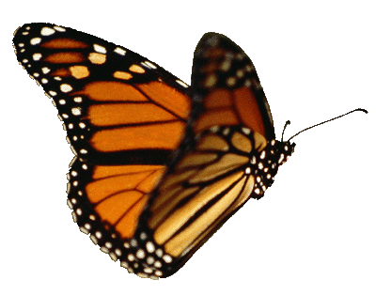
LET’S RECAPITULATE:
Match the picture with the correct statements given in the box:
I can walk ( B ) When touched, I move ( C ) I can’t live without food ( D ) I can grow (E) I am happy and laughing. (F) I can’t move of my own. (G) I can fly
(A) I can walk
(F) I can’t move of my own
(D) I can grow
( C ) I can’t live without food
(B) When touched, I move
(E) I am happy & laughing
(G) I can fly

Slide 3
LEARNING OBJECTIVE :
To enable the learner to:
know how living things breathe and reproduce.

Slide 4
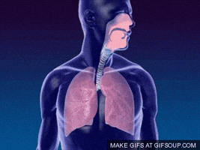
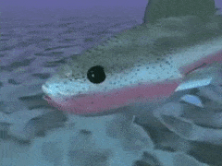
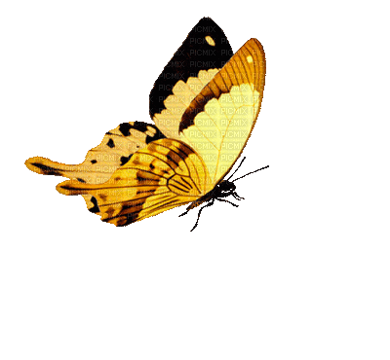
LIVING THINGS BREATHE
Animals and human beings cannot stay without breathing.
They need air to breathe.
Animals have lungs, gills, or air holes to breathe.
Only living things breathe.
Whereas things like teddy bear which are called non living do not breathe.
Human being breathe through lungs
Fish breathe through its gills
Butterfly breathe through air holes

Slide 5
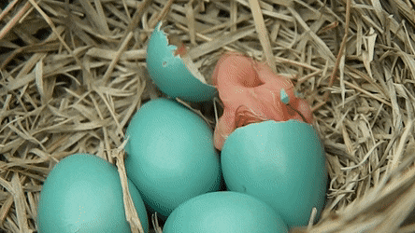
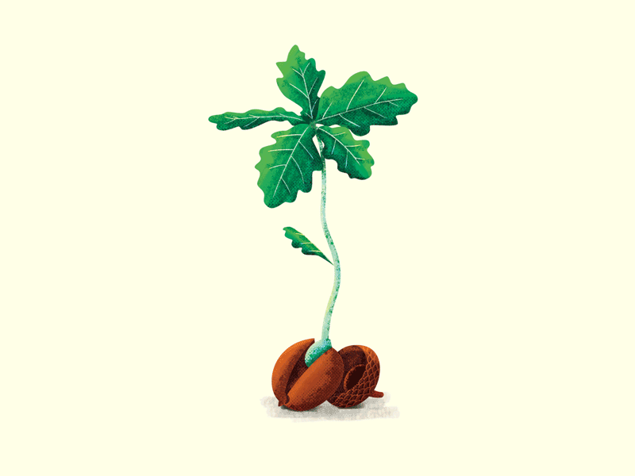
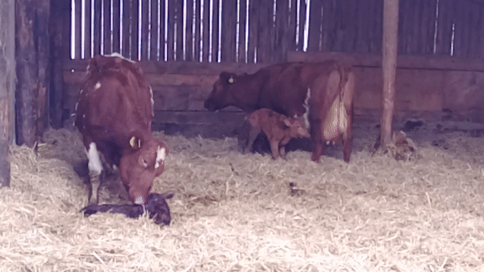
LIVING THINGS REPRODUCE
All living things like human and animals reproduce.
A bird lays eggs. Baby birds come out of the eggs
New plants grow from seeds.
Human beings and animals like cow and cats give birth to babies.
Only living things reproduce.
Where as non-living things cannot reproduce.
Baby bird comes out of eggs
Plants grow from seeds
Cow with calf

Slide 6
ANSWER THE FOLLOWING:
Q.1. How living things are different from non-living things?
Ans. Living things are different from non-living things in many ways.
Living things move
They grow.
They need food
They feel
They breathe and
They reproduce.

Slide 7
ANSWER THE FOLLOWING:
2. Why do living things need food?
Ans. Living things need energy to grow, move and keep their bodies fit and
healthy. They get energy from food.
Plants make their own food by using air, water and sunlight.
Animals move from place to place in search food and shelter.
3. How do animals reproduce?
Ans:- Animals reproduce by giving birth to young ones or by laying eggs from which young ones hatch.
Plants mainly reproduce from seeds. Some plants also reproduce through body parts such as stems, roots and leaves.

Slide 8
Let’s Summarise
Our earth is made up of living and non-living things.
Living things can move on their own but non-living cannot move.
Living things grow but non-living things cannot.
Living things need food but non-living do not .
Living things can feel but non-living things cannot.
Living things cannot live without breathing.
Living things reproduce but non-living things cannot.

Slide 9
HOME ASSIGNMENT:
Draw an animal that breathe through gills/lungs/air holes in your note book.

Slide 10
LEARNING OUTCOME :
The learner will be able to:
know how living things breathe and reproduce.

Slide 11
THANKING YOU
ODM EDUCATIONAL GROUP

