Slide 1


SESSION : 2
CLASS : III
SUBJECT : SCIENCE
CHAPTER NUMBER : 4
CHAPTER NAME : LIVING AND NON LIVING
SUB-TOPIC : LIVING THINGS GROW, LIVING THINGS NEED FOOD AND LIVING THINGS FEEL, ORAL QUESTIONS

Slide 2
LEARNING OBJECTIVE
To enable the learners to:
know living things grow, need food and feel.

Slide 3
Let’s Recapitulate:
1. What are natural things?
Ans:- Things given to us by the nature are called natural things. They are not made by humans. Like animals, rocks, the sun, stars etc.
2. What are man-made things?
Ans:- Things made by humans are called man-made things. Ex.Car, aeroplane, buildings, roads etc.
3. What are living things?
Ans:- Humans, animals and plants are living things.

Slide 4
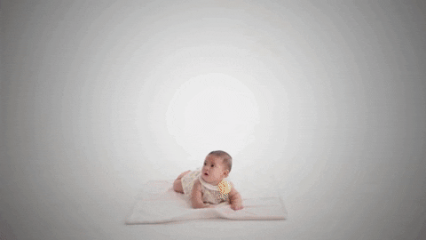

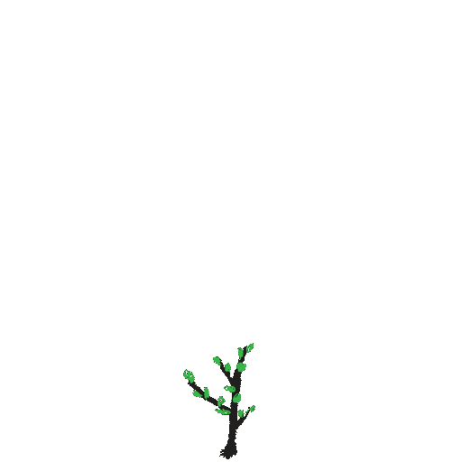
LIVING THINGS GROW
A human baby grows into an adult.
A chick grows into a hen.
A baby plant grows into a tree.
All living things grow and change.
Whereas computers, dolls, rocks, air and water do not grow as they are non-living things.
Baby grows into an adult
Chick grows into hen
Plant grows into tree

Slide 5
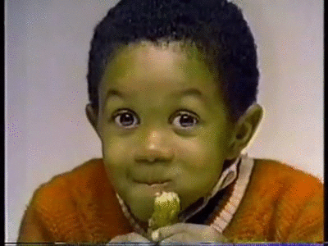
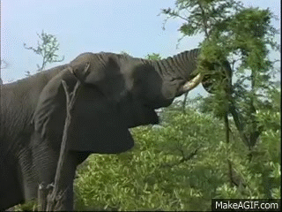
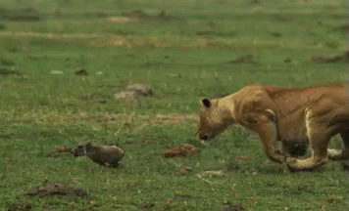

LIVING THINGS NEED FOOD
Human beings and animals need food to live. Food helps them to grow.
Animals get their food from plants or other animals.
Plants make their food with the help of air, water and sunlight.
Non-living things like doll never need food.
Only living things need food.
Kid eating food
Elephant eating leaves
Tiger catching a small animal
Plant making food

Slide 6
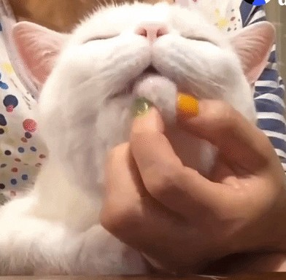
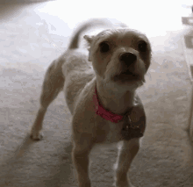
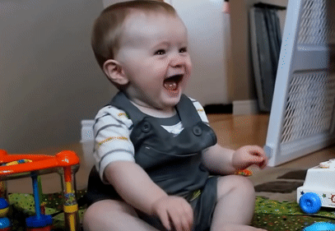
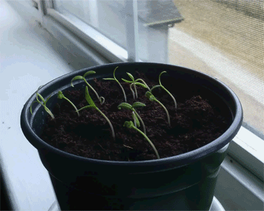
LIVING THINGS FEEL
Animals and human beings feel.
Cat purrs when it stroked.
Dog barks at stranger.
Human being laughs, cry, gets angry or feel pain.
Plants grows towards light.
Only living things can feel.
However, the toys do not cry if you throw them on the floor as they are non-living thing.
Cat purrs
Dog barks
Kid Laughs
Plants grow towards light

Slide 7
ORAL QUESTIONS:
CHOOSE THE CORRECT ANSWER
1. Things like cars and bridges are (living/man-made/natural) things.
Ans : man-made
2. A (fish/boys/chairs) cannot move by themselves.
Ans : chairs
3. When you are (happy/angry/feel pain) you laugh.
Ans : happy

Slide 8
SUMMARY:
All living things grow and change.
Only living things need food.
Living things animals and human beings can feel.
Animals and human beings feel.

Slide 9
HOME ASSIGNMENT :
Do all oral questions in the note book.

Slide 10

Let’s watch a video:

Slide 11
LEARNING OUTCOME :
Learners will be able to:
know living things grow, need food and feel.

Slide 12
THANKING YOU
ODM EDUCATIONAL GROUP

