Slide 1

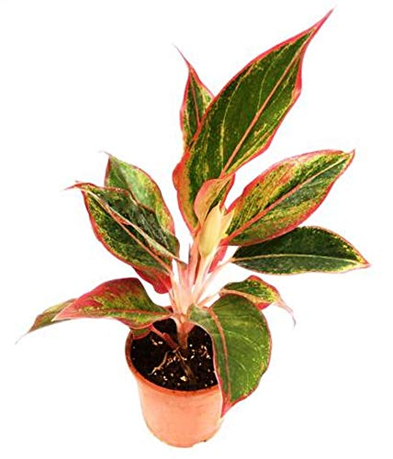
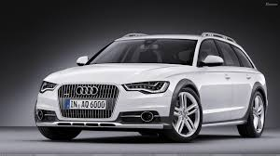
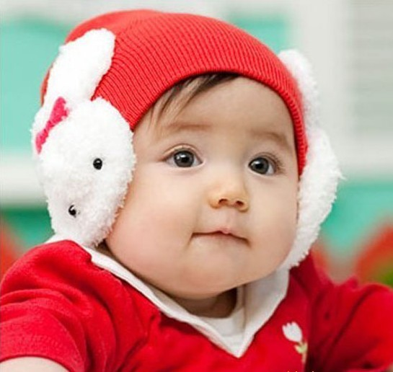
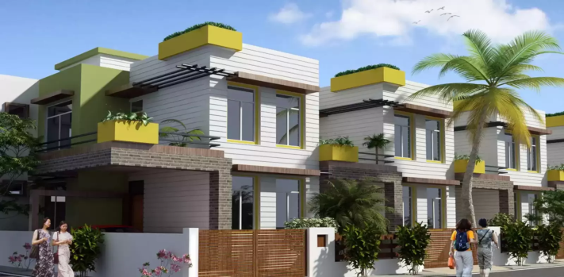
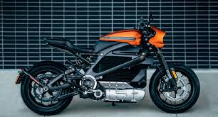
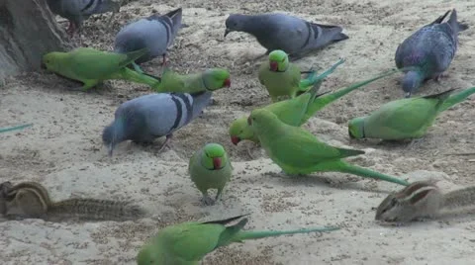
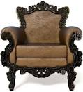
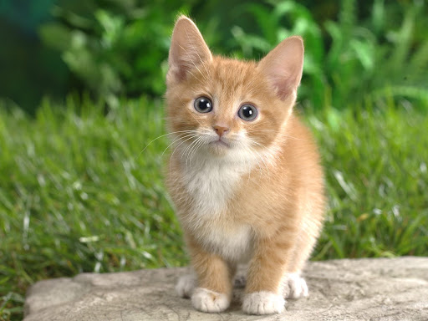
The things we see around us

Slide 2

SESSION : 1
CLASS : III
SUBJECT : SCIENCE
CHAPTER NUMBER : 4
CHAPTER NAME : LIVING AND NON LIVING
SUB-TOPIC : INTRODUCTION, LIVING THINGS MOVE

Slide 3
LEARNING OBJECTIVE :
To enable the learners to –
know what are living and non-living things.
How the living things move?

Slide 4
Get set !
Circle the names of living things and underline the names of non-living things.
1. Sachin hit the ball for a six.
Ans : ball
2. Ruskin Bond has written many books for children.
Ans : books
3. We stopped the car to look at the lovely trees.
Ans : car
4. From the boat Salim saw a flock of birds flying away.
Ans: boat
Sachin
Ruskin Bond
children
Trees
Salim
Birds

Slide 5
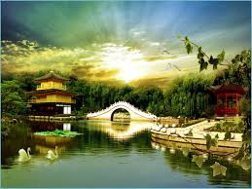
INTRODUCTION :
Our earth is full of wonderful things.
Things like car, buildings, roads and bridges are made by humans are called man made things.
Things like animals, plants rocks, clouds, the sun, the moon and the stars given by nature to us are called natural things.
Humans, animals and plants are living things.
Living things differ from non-living things in many ways.

Slide 6
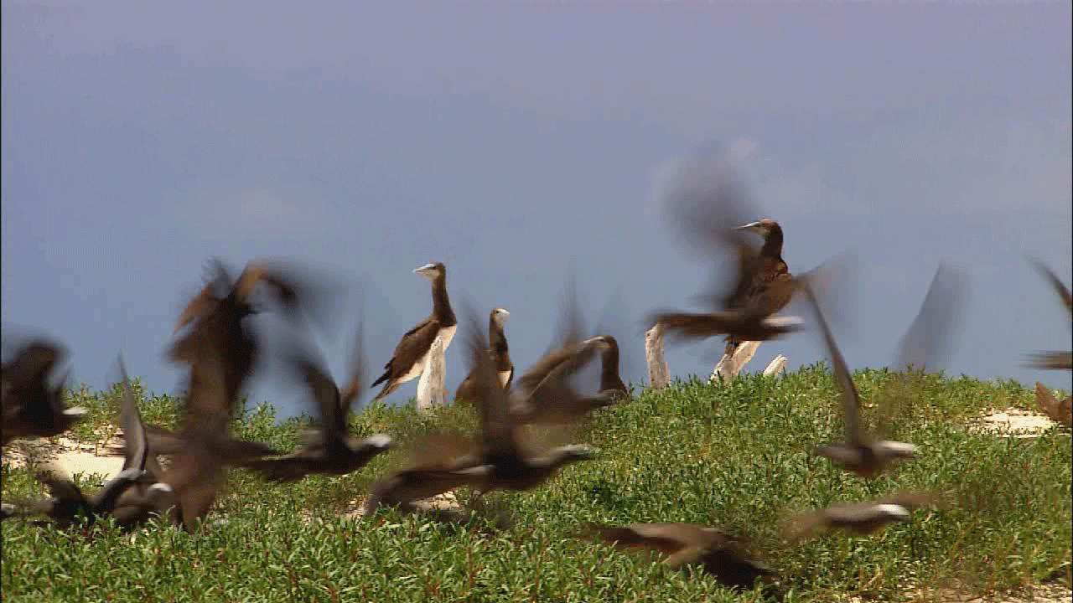
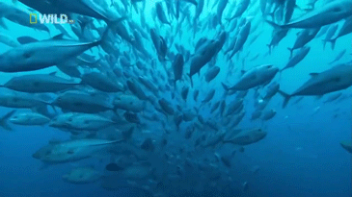
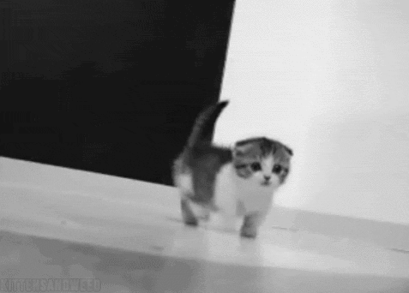
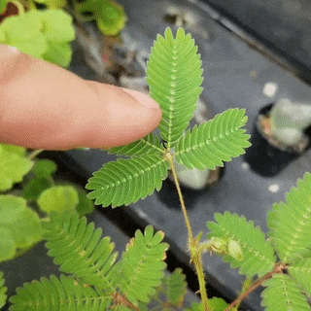
Living things move
The movements of living things show that they are alive.
Birds and insects fly, Dogs and cat walk, Fish swim. These animals move because they have life
The plants like the touch-me-not show slow movement. The sunflower turns towards the sun.
Birds flying
Fish swimming
Cat walking
Touch me not plant

Slide 7
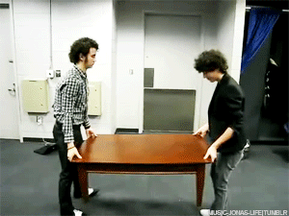
Living things move
However does a table which is a non- living thing cannot move by itself.
We can say that only living things move on their own, non living things cannot.
Table is moving not by itself

Slide 8
Arrange the words under the correct columns:
The Sun, The Moon, Buildings, Roads, Rocks, Planets, Cars, Computer
NATURAL THINGS | MAN-MADE THINGS
The Sun
Buildings
The Moon
Roads
Rocks
Cars
Planets
Computer

Slide 9

Let’s watch a video:

Slide 10
SUMMARY:
Our earth is made up of living and non-living things.
Things made by man are called man-made things.
Things given by the nature to us are called natural things.
Living things move on their own.

Slide 11
LEARNING OUTCOME :
The learner will be able to:
know what are living and non-living things.
How the living things move?

Slide 12
THANKING YOU
ODM EDUCATIONAL GROUP

