Slide 1


SESSION : 4
CLASS : 3
SUBJECT : SCIENCE
CHAPTER NUMBER : 13
CHAPTER NAME : WATER AND WEATHER
SUB-TOPIC : NEW WORDS AND SHORT Q/A

Slide 2
LET’S RECAPTILUATE:
Fill in the blanks choosing the correct option.
When the water is heated it changes into __________ (ice/vapour)
b. The cloud is a mixture of tiny ___________ (water/gas) drops.
c. Water is found in _________ (two/three) forms.
d. When you put water in freezer it changes into ___________(gas/ice)
e. The rain water flows into _________ (river/desert),ponds, lakes and ocean.
vapour
water
three
ice
river

Slide 3
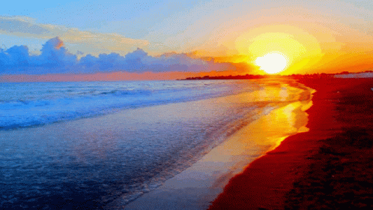
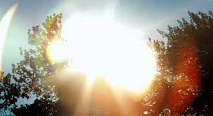
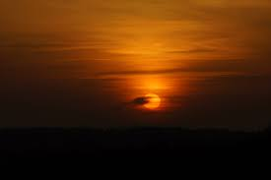
CHANGING WEATHER
The sun, the wind, the clouds and the rain decides the weather.
In India, three main seasons are winter, summer and monsoon. The weather changes from day to day sometimes from hour to hour.
The sun affects the weather.
During mornings and evenings the rays of the sun are slanting. The sun is not so hot during this time.
At noon the sun is overhead and the rays fall straight. The noon is the hottest part of the day.

Slide 4
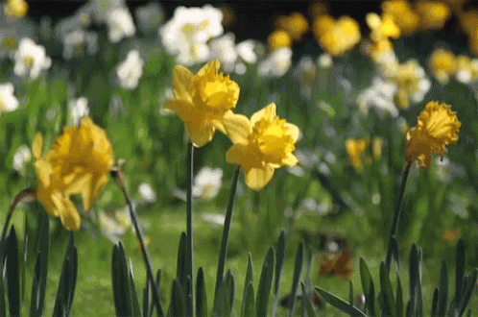
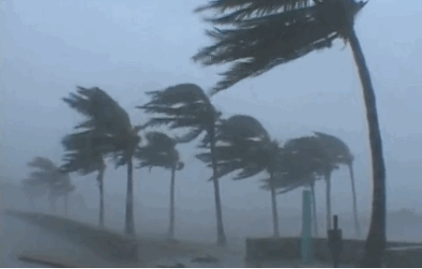
CHANGING WEATHER
The wind affects the weather.
When the wind blows gently, it is called breeze.
When the wind moves with great speed and there is heavy rain, it is called a storm.
It causes lot of damage to trees and buildings.

Slide 5
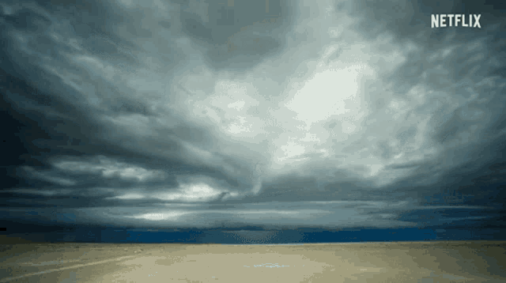
CHANGING WEATHER
The clouds affect the weather.
On cloudy days, clouds block the sun rays and rays cannot reach us.
Cloudy nights are warmer because clouds do not allow the heat to escape into the atmosphere. Some clouds bring rain.

Slide 6
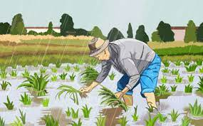
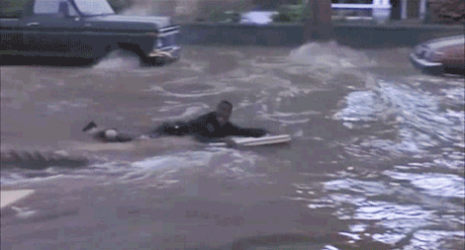
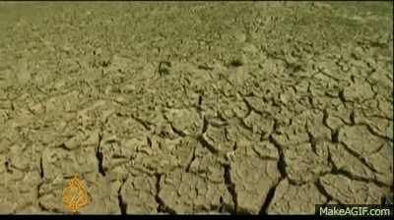
CHANGING WEATHER
The rain affects the weather.
The part of earth on which the rain falls becomes cool.
Farmers welcome the rain as it is good for the crops.
Too much of rain causes damage to crops, building and roads and even harm living things.
The places where there is no rain experience drought. Plants, animals and human beings may die due to lack of food and water.

Slide 7
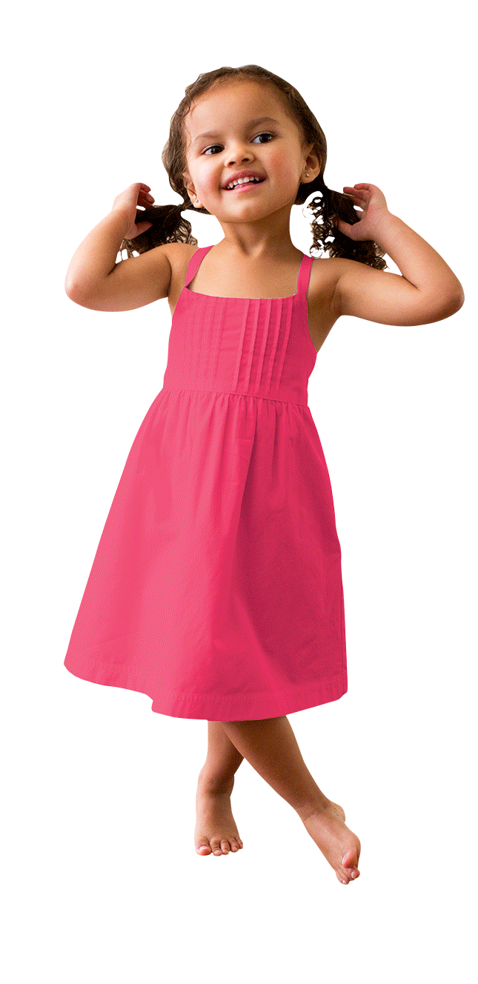
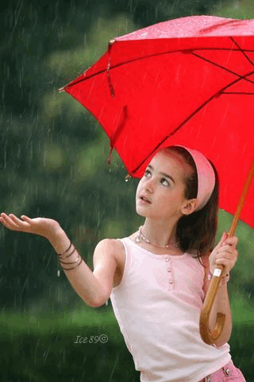
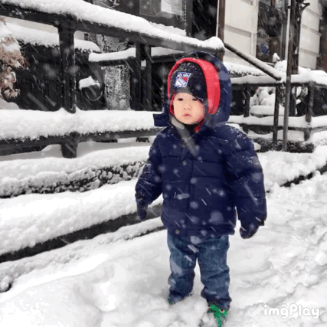
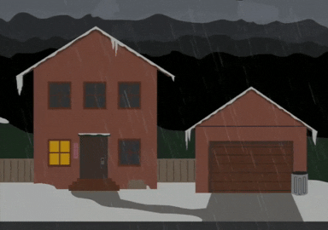
CHANGING WEATHER
Weather affects our lives
What we wear , eat and enjoy depends on the weather.
Foggy and stormy weather can cause accidents.
In very cold places with heavy rain on snowfall, people build houses with sloping roofs.
In places where it rains a lot, people grow and eat rice because a crop of rice needs a lot of water.

Slide 8
FILL IN THE BLANKS:
1. _________ time is the hottest part of the day.
2. In winter, we like the heat of the __________ .
3. Too much rain can cause _________.
4. Accidents can occur on __________ days.
5. __________ is experienced due to lack of rain.
Noon
sun
floods
foggy
Drought

Slide 9
LEARNING OUTCOME:
The learner will be able to -
know about changing weather and its affects,
new words and meanings

Slide 10
THANKING YOU
ODM EDUCATIONAL GROUP

