Slide 1


SESSION : 4
CLASS : 3
SUBJECT : SCIENCE
CHAPTER NUMBER : 13
CHAPTER NAME : WATER AND WEATHER
SUB-TOPIC : NEW WORDS AND SHORT Q/A

Slide 2
LET’S RECAPTILUATE:
Fill in the blanks choosing the correct option.
When the water is heated it changes into __________ (ice/vapour)
b. The cloud is a mixture of tiny ___________ (water/gas) drops.
c. Water is found in _________ (two/three) forms.
d. When you put water in freezer it changes into ___________(gas/ice)
e. The rain water flows into _________ (river/desert),ponds, lakes and ocean.
vapour
water
three
ice
river

Slide 3
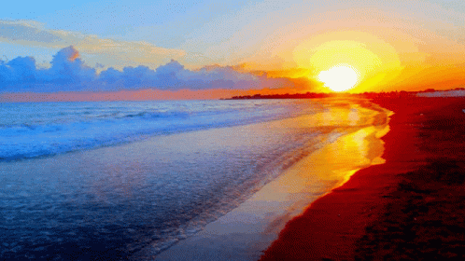
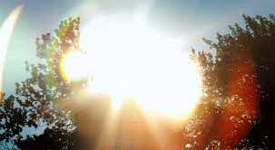
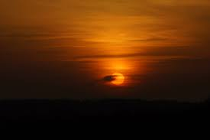
CHANGING WEATHER
The sun, the wind, the clouds and the rain decides the weather.
In India, three main seasons are winter, summer and monsoon. The weather changes from day to day sometimes from hour to hour.
The sun affects the weather.
During mornings and evenings the rays of the sun are slanting. The sun is not so hot during this time.
At noon the sun is overhead and the rays fall straight. The noon is the hottest part of the day.

Slide 4
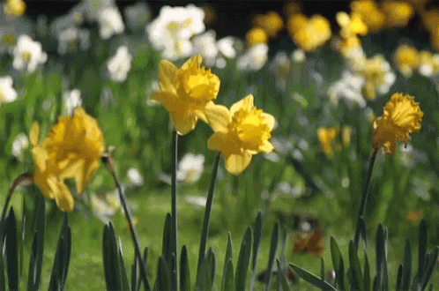
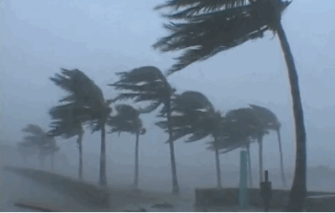
CHANGING WEATHER
The wind affects the weather.
When the wind blows gently, it is called breeze.
When the wind moves with great speed and there is heavy rain, it is called a storm.
It causes lot of damage to trees and buildings.

Slide 5
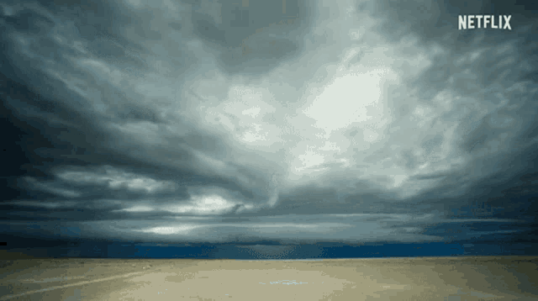
CHANGING WEATHER
The clouds affect the weather.
On cloudy days, clouds block the sun rays and rays cannot reach us.
Cloudy nights are warmer because clouds do not allow the heat to escape into the atmosphere. Some clouds bring rain.

Slide 6
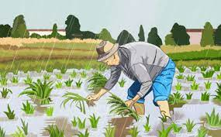
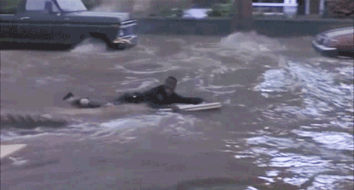
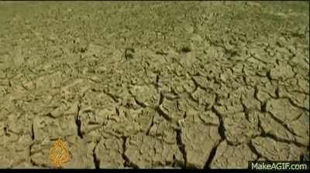
CHANGING WEATHER
The rain affects the weather.
The part of earth on which the rain falls becomes cool.
Farmers welcome the rain as it is good for the crops.
Too much of rain causes damage to crops, building and roads and even harm living things.
The places where there is no rain experience drought. Plants, animals and human beings may die due to lack of food and water.

Slide 7

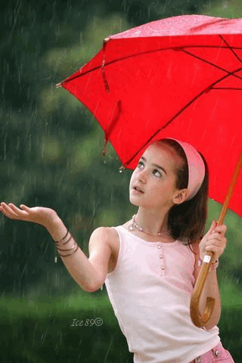
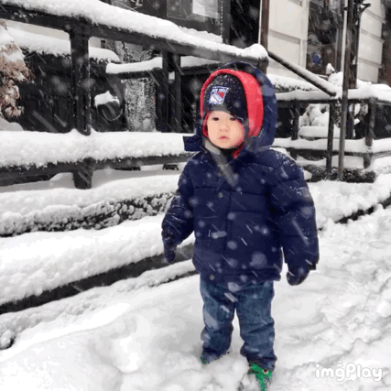
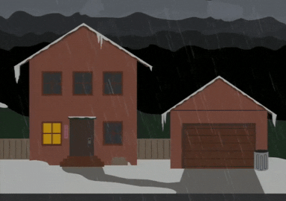
CHANGING WEATHER
Weather affects our lives
What we wear , eat and enjoy depends on the weather.
Foggy and stormy weather can cause accidents.
In very cold places with heavy rain on snowfall, people build houses with sloping roofs.
In places where it rains a lot, people grow and eat rice because a crop of rice needs a lot of water.

Slide 8
NEW WORDS
NO | NEW WORD | WORD MEANING
1 | Form | Shape
2 | Vapour | Steam
3 | Drought | Lack of rain
4 | Flood | Overflow of large amount of water
5 | Storm | cyclone

Slide 9
NEW WORDS
1. Weather 7. Clouds
2. Vapour 8. Affects
3. Drought 9. Breeze
4. Flood 10. Foggy
5. Storm 11. Sloping
6. Form 12. Clouds

Slide 10

SHORT Q/A
TICK ( ) THE CORRECT ANSWER.
1. This is a form of water.
a.ice boat b.ice berg c.ice cream
2. The changing form of water in nature is called the water.
Truck b.cycle c . Bus
3.In India, winter, summer and monsoon are the three main
a. Weather b.states of water c. seasons

Slide 11
SHORT Q/A
4. Storms may occur when the wind is not blowing.
gently but strongly b.strongly but gently c. at all
5. Foggy and stormy weather are not suitable for
a. Staying in the house b. playing indoors c.going out to play

Slide 12
LEARNING OUTCOME:
The learner will be able to -
know about changing weather and its affects,
new words and meanings

Slide 13
HOME ASSIGNMENTS
Do oral questions of book page 113 in notebook.

Slide 14
THANKING YOU
ODM EDUCATIONAL GROUP

