Slide 1


SESSION : 2
CLASS : 3
SUBJECT : SCIENCE
CHAPTER NUMBER : 13
CHAPTER NAME : WATER AND WEATHER
SUB-TOPIC : CHANGING WEATHER

Slide 2
LET’S RECAPTILUATE:
Fill in the blanks choosing the correct option.
When the water is heated it changes into __________ (ice/vapour)
b. The cloud is a mixture of tiny ___________ (water/gas) drops.
c. Water is found in _________ (two/three) forms.
d. When you put water in freezer it changes into ___________(gas/ice)
e. The rain water flows into _________ (river/desert),ponds, lakes and ocean.
vapour
water
three
ice
river

Slide 3

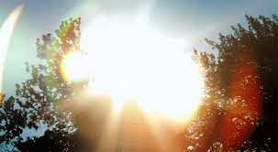
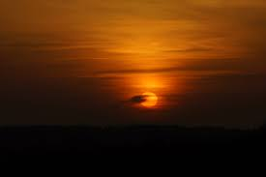
CHANGING WEATHER
The sun, the wind, the clouds and the rain decides the weather.
In India, three main seasons are winter, summer and monsoon. The weather changes from day to day sometimes from hour to hour.
The sun affects the weather.
During mornings and evenings the rays of the sun are slanting. The sun is not so hot during this time.
At noon the sun is overhead and the rays fall straight. The noon is the hottest part of the day.

Slide 4
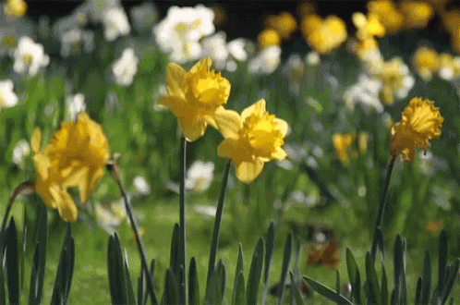
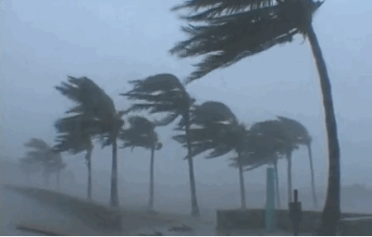
CHANGING WEATHER
The wind affects the weather.
When the wind blows gently, it is called breeze.
When the wind moves with great speed and there is heavy rain, it is called a storm.
It causes lot of damage to trees and buildings.

Slide 5
LEARNING OUTCOME:
The learner will be able to -
know about changing weather and its affects,

Slide 6
HOME ASSIGNMENTS
Do oral questions of book page 113 and do Q.No.E label the diagram.

Slide 7
THANKING YOU
ODM EDUCATIONAL GROUP

