Slide 1

OBSERVE THE STATEMENTS AND UNDERLINED WORDS.
1. Sunita: “ Mom it is too cold can you give me a cup of hot tea ?
2. Rajan : “ Dad can you switch on the geyser ! I will take bath with warm water.
3. Mother: Bunny do not forget to take rain coat while going out, it is raining.

Slide 2
OBSERVE THE STATEMENTS AND UNDERLINED WORDS.
4. Teacher: Children do not drink cool water you may get cold.
5. Visitors visit the hill stations during hot summer.
6. Now can you guess,what the underlined words relating to ?
Ans: water and weather

Slide 3

SESSION : 1
CLASS : 3
SUBJECT : SCIENCE
CHAPTER NUMBER : 13
CHAPTER NAME : WATER AND WEATHER
SUB-TOPIC : INTRODUCTION, The Water Cycle

Slide 4
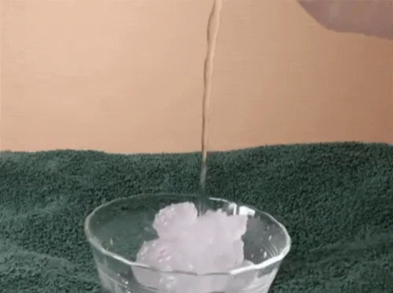
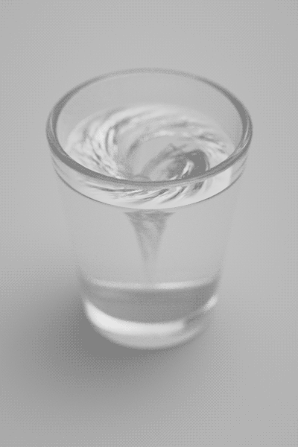
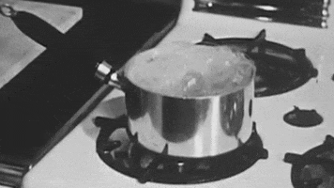
FORMS OF WATER
The water has three forms.
They are Ice, water and water vapour.
When the water is cooled it changes into ice.
When the water is heated it changes into water vapour.

Slide 5
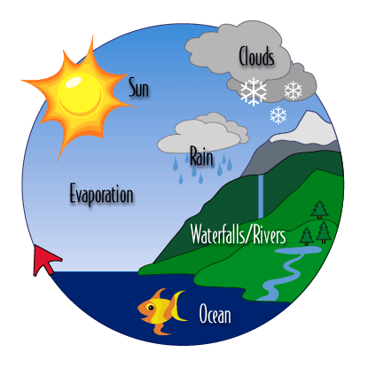
THE WATER CYCLE
When the sun shines, water from the rivers, ponds, lakes and oceans heats up and rises in the form of water vapour.
High up in the sky, this water vapour comes in contact with cold air. It cools down to form tiny drops of water. The tiny drops cling together to form clouds.
On cooling further, these tiny drops become heavy and fall as rain. The rainwater flows backs to the rivers,ponds,lakes and ocean.
This cycle of change is called the water cycle.

Slide 6

Let’s Answer
A. Multiple choice questions.
1. In which of these forms can water be present in nature?
a. Solid b. liquid c. gas d. all of these
2. Which of these forms of water can mix easily with air?
a. Liquid water b. ice c. water vapour d. all of these
3. Water in the form of ice is a ________.
a. Liquid b. solid c. gas d. all of these
4. When water is ______, it changes into water vapour.
a. cooled b. heated c. boiled d. none of these

Slide 7
SUMMARY
Water exists in three forms – liquid (water), gas (water vapour) and solid (ice).
When the water is cooled it changes into ice.
When the water is heated it changes into water vapour.
Ice changes into water or in liquid form if it is heated.
This cycle of change is called the water cycle.

Slide 8
LEARNING OUTCOME:
The learner will be able to –
know about different forms of water and water cycle

Slide 9
HOME ASSIGNMENTS
Draw and label the water cycle in the project record.

Slide 10
THANKING YOU
ODM EDUCATIONAL GROUP

