Slide 1


SESSION : 6
CLASS : III
SUBJECT : SCIENCE
CHAPTER NUMBER : 7
CHAPTER NAME : BIRDS:FOOD AND MORE
SUB-TOPIC : SHORT Q & A, TICK THE CORRECT ANSWER,
MATCH THE COLUMNS, NAME THE FOLLOWING

Slide 2
LEARNING OBJECTIVE :
To enable the learners to –
solve the short questions and answers.

Slide 3
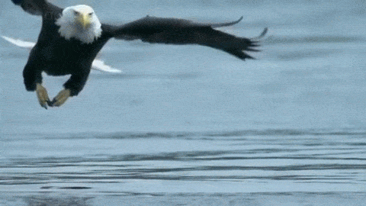
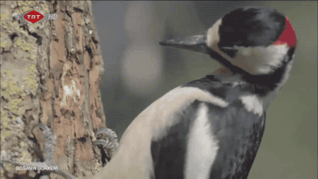
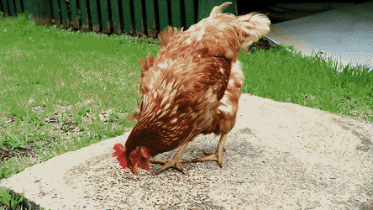
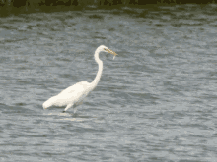
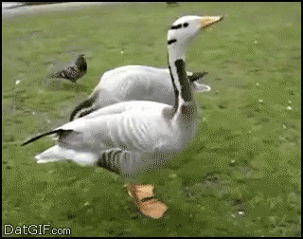
LET’S RECAPITULATE: The picture wants to tell some thing. Match with the correct statement.
a. I catch the birds with my talons b. I do have a webbed feet c. I can scratch the ground d. I can cling on the tree with my toes. e. I can wade through water without getting wet.
I catch the birds with my talons
I can cling on the tree with my toes
1
I can scratch the ground
4
3
I can wade through water without getting wet.
I do have a webbed feet
2
5

Slide 4

15.11.21 A. Tick ( √ ) the correct answer.
1. These birds of prey have strong , sharp and hooked beaks.
a. Eagles, vultures, and sparrows b. Vultures, kites and pigeons.
c. Eagles, vultures and kites.
2. Feet with two toes upwards and two toes downwards help birds to
a. hold on to a branch. b. dig the ground c. climb trees.

Slide 5
A. Tick ( √ ) the correct answer.
3.A bird’s body is covered with
a. down feathers b. up feathers c. flight feathers.
4.The bird uses its beak like a needle to sew leaves with materials like thread and wool.
a. the weaver bird. b. the tailor bird c. the woodpecker.

Slide 6
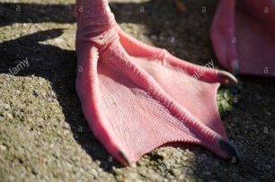
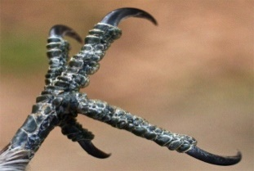
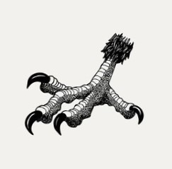
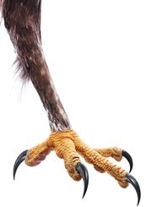
B.MATCH THE COLUMNS.
1. |  | a. help birds to climb trees
2. |  | b. help birds to dig out ground
3. |  | c. help birds in swimming
4. |  | d. help birds to catch small birds

Slide 7
C. NAME THE BIRD:-
1. weaves grass in and out to make its nest.
Ans: weaver bird
2. collects a few sticks to make a cup – shaped nest.
Ans: eagle
3. its front toes are joined by a skin.
Ans: duck
4. collects pebbles and stones to make a nest .
Ans:penguin
5. makes its nest in the hollow of a tree.
Ans:woodpecker

Slide 8
Summary:
Birds of prey have strong, sharp and hooked beaks.
Birds with two toes upwards and two toes downwards help birds to climb trees.
Tailor bird uses its beak like a needle to sew leaves with materials like thread and wool.
The weaver bird makes a beautiful and strong nest with twigs and grass.
The swimming birds have webbed feet, they have three toes in front and one toe at the back.
The penguin collects a few pebbles and stones to make a nest on the ground.

Slide 9
LEARNING OUTCOME:
The learners will able to –
solve the short questions and answers.

Slide 10
THANKING YOU
ODM EDUCATIONAL GROUP

