Slide 1


SESSION : 5
CLASS : III
SUBJECT : SCIENCE
CHAPTER NUMBER : 7
CHAPTER NAME : BIRDS:FOOD AND MORE
SUB-TOPIC : CARING FOR THE YOUNG
NEW WORDS AND MEANINGS

Slide 2
LEARNING OBJECTIVE :
To enable the learners to know about –
how do birds care for the young?
the new words and word meanings.

Slide 3
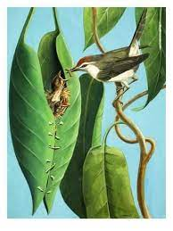
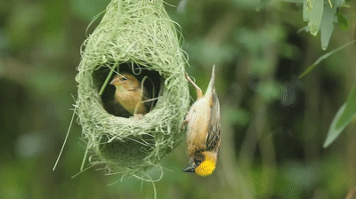
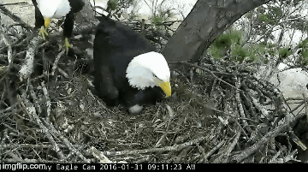
NESTING HABITS
The tailor bird
The weaver bird
The eagle
The tailor bird uses its beak like a needle to sew leaves with material like thread and wool. The nest is made cozy with cotton, wool, hair or dry grass
The weaver bird makes a beautiful and strong nest with twigs and grass. It weaves the grass in and out rapidly. The nest hangs from the branch of a tree. The bird enters its home through a tunnel like opening at the bottom of the nest
The eagle make nests by gathering a few sticks and simply putting them together in the shape of a shallow cup.

Slide 4
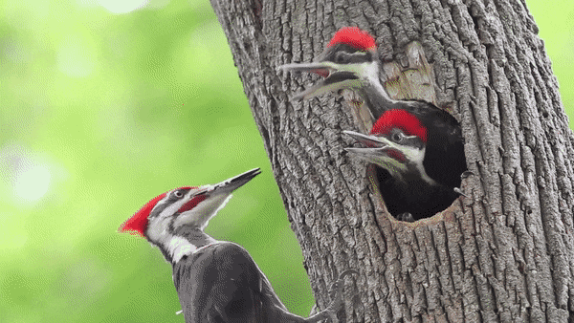
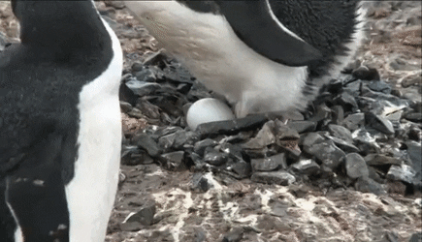
NESTING HABITS
The woodpecker
The penguin
The woodpecker pecks a tree trunk with its beak to make a hole. To make its nest cosy, it lines the hole with chips of wood
The penguin collects a few pebbles and stones to make a nest on the ground.

Slide 5
Choose the correct answer.
1. A wood pecker has a ________ shaped beak.
curve b. chisel c. hook Ans :
2. Water birds have _________ feet.
Long- legged b. webbed c. short legged Ans:
3. Birds built _________ to lay eggs.
house b. building c. nests Ans:
4. The wings have ___________ types of movements.
three b. four c. two Ans :
The tailor bird uses its beak like a needle to __________ leaves with material like thread and wool
a. cut b. sew c. Fix Ans :
chisel
webbed
nests
two
sew

Slide 6
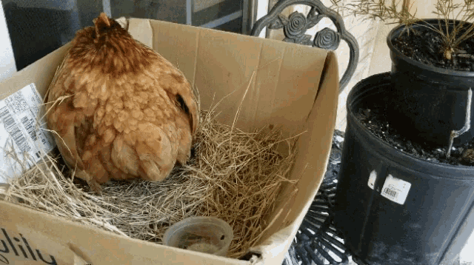
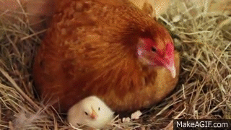
CARING FOR THE YOUNG
The mother bird after laying eggs sits on them to keep them warm.
When the babies come out, they are weak featherless.
The parents feed them and keep them warm and protect the babies from enemies and bad weather.
.

Slide 7
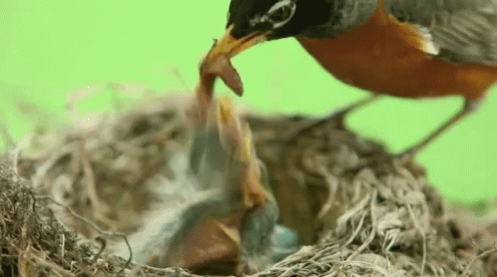
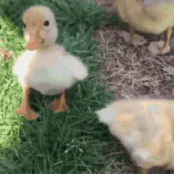
CARING FOR THE YOUNG
The parents look after the babies till their feathers grow and they learn to fly and look for food on their own.
Always watch birds quietly and from a distance so as not to disturb the.

Slide 8
NEW WORDS AND MEANING
SL.NO | NEW WORD | WORD MEANING
1 | Chisel | A carpenter’s tool
2 | Slender | Thin
3 | Wade | Walk through water
4 | Shallow | Not deep
5 | Fluffy | Soft
6 | Cosy | Feeling of comfort
7 | Tunnel | An underpass
8 | Perch | Resting place
9 | Peck | A stroke by a bird

Slide 9
Summary:
The bird has a very light body made up of hollow bones which help them to fly.
The bird’s wings have two types of movement - upward movement and downward movement.
Birds build nest to lay eggs. Different birds make different types of nests.

Slide 10
LEARNING OUTCOME:
The learners will be able to know–
how do birds care for the young?
new words and word meanings.

Slide 11
THANKING YOU
ODM EDUCATIONAL GROUP

