Slide 1


SESSION : 4
CLASS : III
SUBJECT : SCIENCE
CHAPTER NUMBER : 7
CHAPTER NAME : BIRDS:FOOD AND MORE
SUB-TOPIC : HOW DOES A BIRD FLY? NESTING HABITS

Slide 2
LEARNING OBJECTIVE :
To enable the learners to –
describe the body of a bird and the types of feathers they have.
describe the different kinds of nests that birds build.

Slide 3
LET’S RECAPITULATE: Arrange the birds given in the box
under the correct column.
sparrow, crow, crane, heron, duck, woodpecker, parakeet, mynah, hen , eagle and hawk
Flesh eating birds | Perching birds | Scratching birds | Climbing birds | Swimming birds | Wading birds
eagle
sparrow
hen
woodpecker
duck
crane
hawk
mynah
parakeet
heron
crow

Slide 4
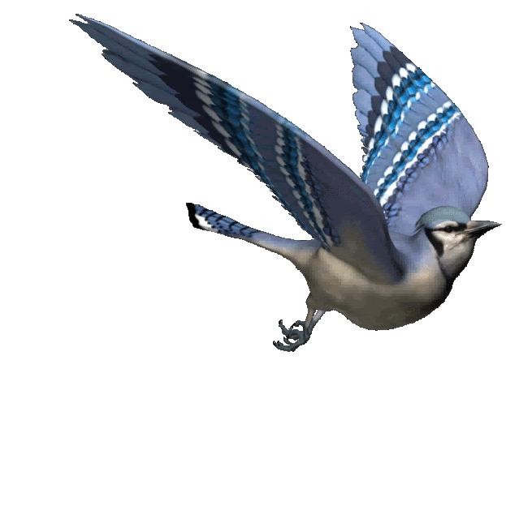
HOW DOES A BIRD FLY ?
The bird has a very light body made up hollow bones with thin plates.
The body has a strong framework of bones.
Most of the bones have a special shape.
The body is shaped like a boat.
Birds have strong muscles which help the bird to move the wings up and down or forward and backward.
Bird’s tail help to change the direction while flying.

Slide 5
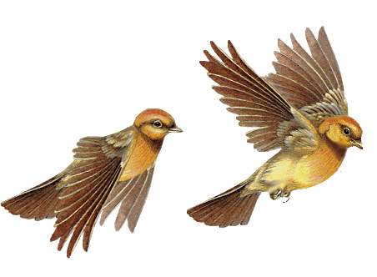
HOW DOES A BIRD FLY?
Wing movement.
The birds wings have two types of movements.
Upstroke: The wings move upward and backward.
Downstroke: The wings move downward and forward
UPSTROKE
DOWNSTROKE

Slide 6
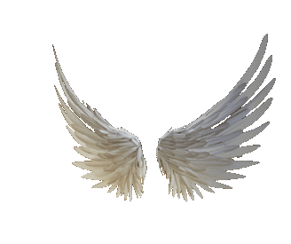
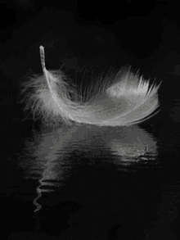
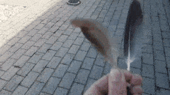
HOW DOES A BIRD FLY?
Feathers of birds
Small fluffy feathers called down feathers keep the bird’s
body warm.
The long, flat feathers attached to the wings and tail
Help the birds to fly. These are called flight feathers.
WINGS
DOWN FEATHER
FLIGHT FEATHER

Slide 7
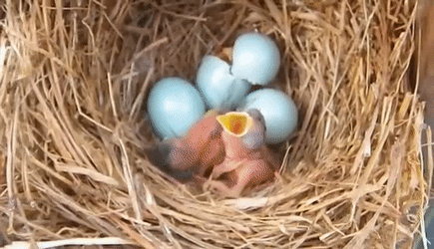
NESTING HABITS
Birds build nest to lay eggs.
Birds use material like twigs, dry leaves, cotton, thread
wool, feather, hair, pieces of cloth, paper and pebbles
to build their nests.
The eggs are laid in the nests.
When the baby birds are big enough, they fly away.
Most parent birds leave the nests.

Slide 8
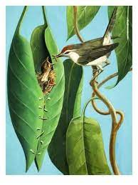
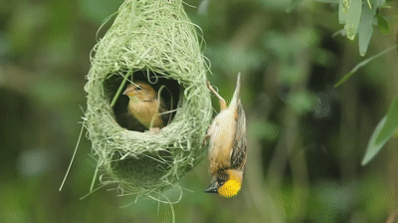
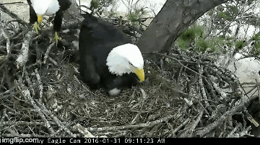
NESTING HABITS
The tailor bird
The weaver bird
The eagle
The tailor bird uses its beak like a needle to sew leaves with material like thread and wool. The nest is made cozy with cotton, wool, hair or dry grass
The weaver bird makes a beautiful and strong nest with twigs and grass. It weaves the grass in and out rapidly. The nest hangs from the branch of a tree. The bird enters its home through a tunnel like opening at the bottom of the nest
The eagle make nests by gathering a few sticks and simply putting them together in the shape of a shallow cup.

Slide 9
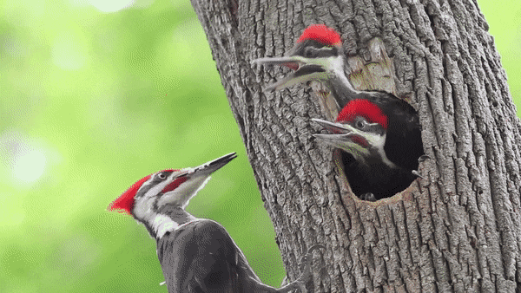
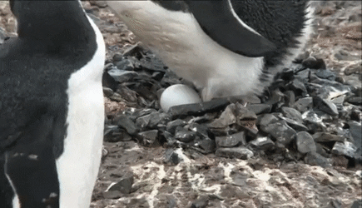
NESTING HABITS
The woodpecker
The penguin
The woodpecker pecks a tree trunk with its beak to make a hole. To make its nest cosy, it lines the hole with chips of wood
The penguin collects a few pebbles and stones to make a nest on the ground.

Slide 10
Summary:
The bird has a very light body made up of hollow bones which help them to fly.
The bird’s wings have two types of movement - upward movement and downward movement.
Birds build nest to lay eggs. Different birds make different types of nests.

Slide 11
LEARNING OUTCOME:
Learners will be able to –
describe the body of a bird and the types of feathers they have.
describe the different kinds of nests that birds build.

Slide 12
HOME ASSIGNMENT:
Do oral questions of page no 61 and 62.

Slide 13
THANKING YOU
ODM EDUCATIONAL GROUP

