Slide 1


SESSION : 3
CLASS : III
SUBJECT : SCIENCE
CHAPTER NUMBER : 7
CHAPTER NAME : BIRDS: FOOD AND MORE
SUB-TOPIC : FEET AND CLAWS

Slide 2
LEARNING OBJECTIVE :
To enable the learners to –
know about different feet and claws of the birds.

Slide 3
LETS RECAPTULATE.
Fill in the blanks selecting the answers from the STAR.
I am having a strong , sharp and hooked beak to tear flesh. _________
I can crack nuts and hard fruits._________
I do have a long and slender beak._______
I can crush grain and seeds with my beak.___________
My beak is broad and flat with tiny holes on the sides. ________
OWL
PARAKEET
HOOPOE
HOOPOE
DUCK
OWL
SPARROW
SPRAOOW
DUCK
PARAKEET

Slide 4
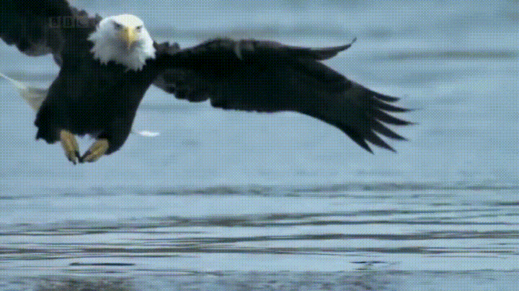
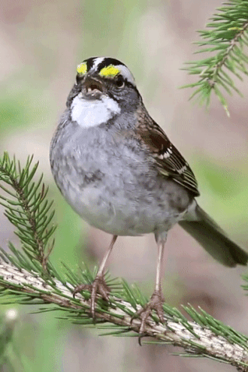
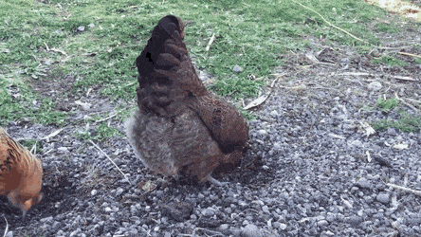
FEET AND CLAWS
FLESH EATING BIRDS PERCHING BIRDS SCRATCHING BIRDS
The flesh eating birds have strong and sharp claws called talons.
These claws help them to catch live prey like toads, rats and small birds.
Example: hawks and eagles
The perching birds have three toes in front and one at the back.
These type of feet help the birds to hold on to a branch
and can even sleep while they perch.
Example: sparrow , mynahs and crows
The scratching birds have strong legs with three toes in front and one toe at the back.
These toes have sharp, hard claws to help them to dig the ground and bring out insects and buried seeds.
Example: hen

Slide 5
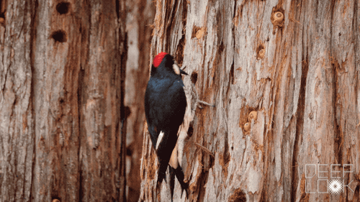
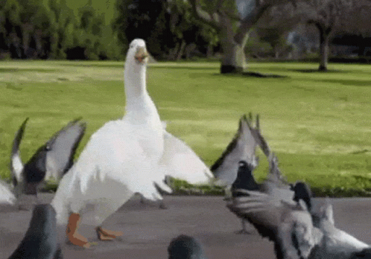
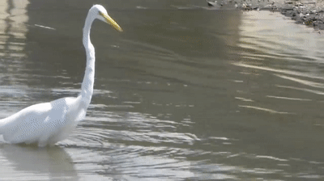
FEET AND CLAWS
CLIMBING BIRDS SWIMMING BIRDS WADING BIRDS
The climbing birds have two toes which point upwards and two which point downwards.
These toes help them to climb trees and to cling on them.
Example: woodpecker and parakeet
Water birds have webbed feet. They have three toes in front and one toe at the back.
The three toes are joined by skin which is called web.
This skin helps them to push water back while swimming.
Example: duck
These birds are long legged with spread out toes.
They can wade through muddy water without getting wet.
Example: crane and heron

Slide 6
SUMMARY:
Flesh eating birds have strong and sharp claws called talons.
Perching birds like sparrows, mynas and crows have three toes in front and one at the back which help them to hold on to a branch even while sleeping.
Scratching birds have strong legs with sharp and hard claws to help them to dig the ground.
Climbing birds have two toes which point towards and two which points downwards which help them to climb trees.
Birds like ducks and geese have webbed feet which help them to swim.
Cranes and herons are wading birds with long leg and spread out toes.

Slide 7
Give two examples of each:
1. Climbing birds.
Ans. Woodpeckers, Parakeets
2. Perching birds.
Ans. Sparrow, Crows
3. Flesh eating birds.
Ans. Hawks, Eagles
4. Wading birds.
Ans. Cranes, Herons
5. Climbing birds.
Ans. Woodpeckers, Parrots

Slide 8
LEARNING OUTCOME:
Learners will be able to–
get knowledge regarding feet and claws of different birds.

Slide 9
HOME ASSIGNMENT:
Draw any 3 claws in Project Record.

Slide 10
THANKING YOU
ODM EDUCATIONAL GROUP

