Slide 1


SESSION : 2
CLASS : III
SUBJECT : SCIENCE
CHAPTER NUMBER : 7
CHAPTER NAME : BIRDS:FOOD AND MORE
SUB-TOPIC : DIFFERENT KINDS OF BEAKS…. CONTD.

Slide 2
LEARNING OBJECTIVE :
Learners will be able to know –
get knowledge about the nature and types of beaks.

Slide 3
LET’S RECAPITULATE:
Give two examples of following.
a. Birds having strong , sharp and hooked beak.
Ans:
b. Birds having short , hard and horny beak.
Ans:
c. Birds having curved beak.
Ans:
EAGLE
VULTURE
SPARROW
PEACOCK
PARROT
PARAKEET

Slide 4
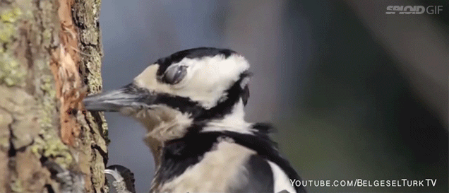
DIFFERENT KINDS OF BEAKS
Strong and chisel-shaped beak:
A woodpecker has a strong and
chisel-shaped beak.
This helps it to tap the bark of trees
and take out insects.
WOOD PECKER

Slide 5
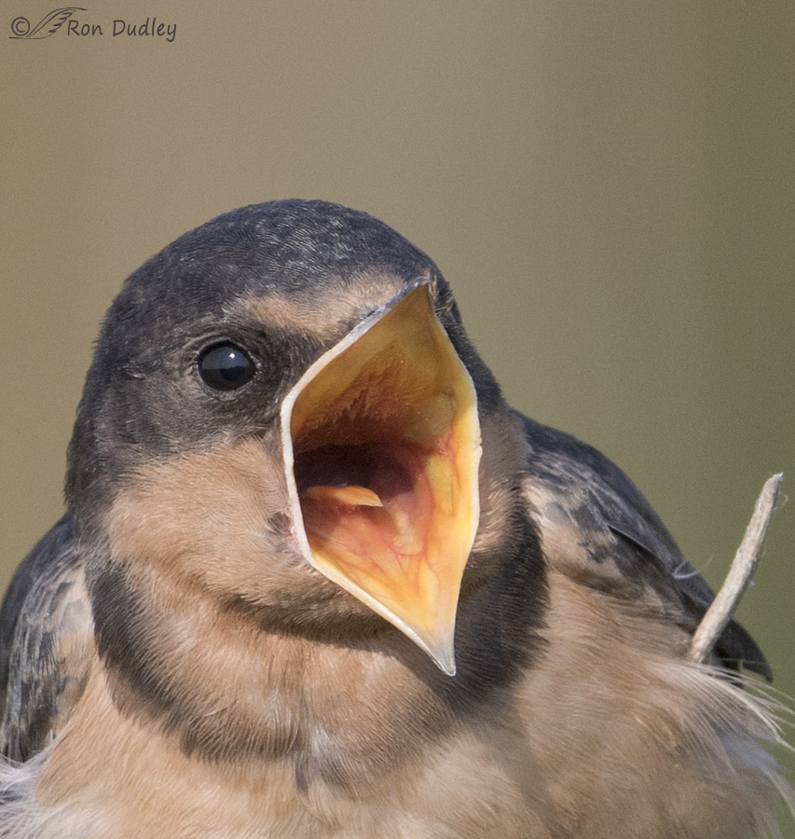
DIFFERENT KINDS OF BEAKS
Broad and short beak:
The swallow has a broad and short beak
which is sticky on the inside.
The bird open its beak while flying and tiny
flying insects get stuck inside.
SWALLOW

Slide 6
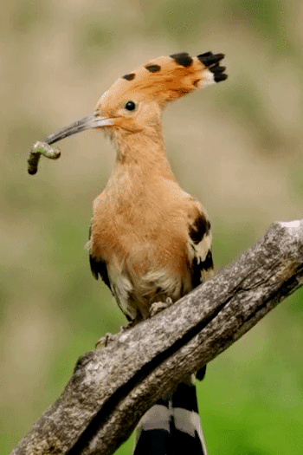
DIFFERENT KINDS OF BEAKS
Long and slender beak:
The bird hoopoe is having long and slender
beak.
It is able to pull out insects from holes in the
ground.
HOOPOE

Slide 7
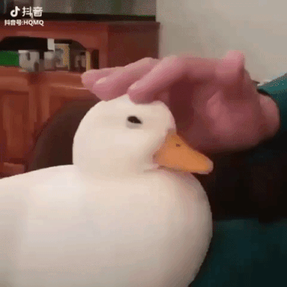
DIFFERENT KINDS OF BEAKS
Broad and flat beak:
The duck has a broad and flat beak with
tiny holes on the sides.
The duck takes in muddy water with
Insects , worms and water plants.
The mud and water flow out through the tiny
holes leaving the plants and insects inside the beak.
DUCK

Slide 8
Summary:
A woodpecker tap the bark of trees and take out insects with its strong and chisel shaped beak.
The swallow has a broad and short beak. While flying it opens its beak and tiny flying insects get stuck inside.
The bird hoopoe is having long and slender beak.
The duck has a broad and flat beak with tiny holes on the sides.

Slide 9
Complete the table.
TYPE OF BEAK | EXAMPLES | TYPE OF FOOD
Short hard and horny beak |  | grains and seeds
 | Eagles, vultures, kites | Small animals like chicks, mice, frogs
Broad and flat beak with tiny holes on the sides. | Duck
 | woodpecker | insects
Sparrows, pigeons, peacocks
Strong, sharp and hooked beak
Insects, water plants, worms
Strong and chisel-shaped beak

Slide 10
HOME ASSIGNMENT:
Draw any 3 beaks in Project Record.

Slide 11
LEARNING OUTCOME:
Learners will be able to–
get knowledge about the nature and types of beaks.

Slide 12
THANKING YOU
ODM EDUCATIONAL GROUP

