Slide 1


SESSION : 1
CLASS : III
SUBJECT : SCIENCE
CHAPTER NUMBER : 7
CHAPTER NAME : BIRDS:FOOD AND MORE
SUB-TOPIC : INTRODUCTION - DIFFERENT KINDS OF BEAKS

Slide 2
LEARNING OBJECTIVE :
Learners will be able to –
get knowledge about the types of beaks.

Slide 3

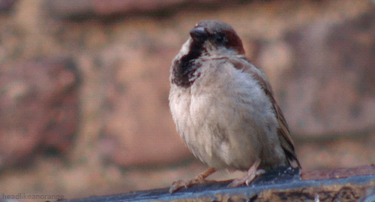
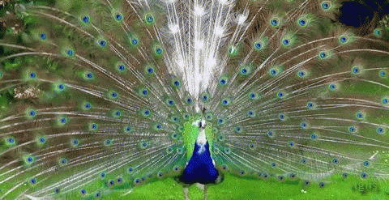
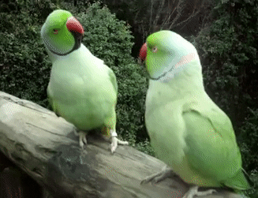
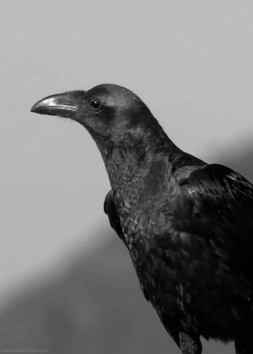
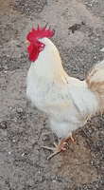
INTRODUCTION: Listen carefully and then
identify me through sound.

Slide 4
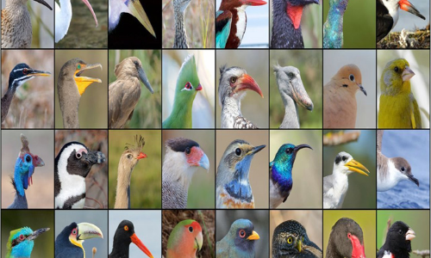
Beaks:
Birds are living things and they need food to survive.
The beak is the bird’s mouth.
The shape of the bird’s beak is suited to the type of food it eats.

Slide 5
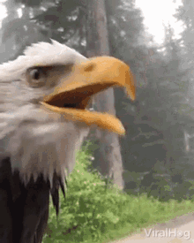
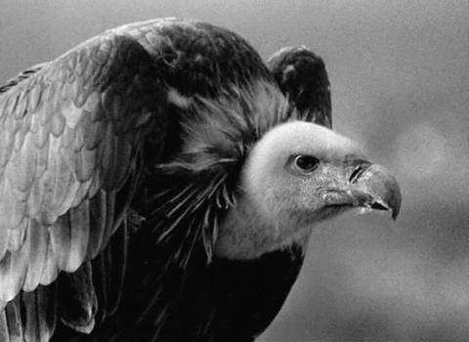
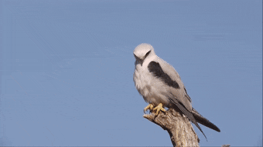
DIFFERENT KINDS OF BEAKS
Strong, sharp and hooked beak:
Eagles, vultures and kites are birds of prey.
They eat small animals like chicks, mice,
frogs and snakes.
They have strong sharp and hooked beak
to tear flesh.
EAGLE
VULTURE
KITE

Slide 6
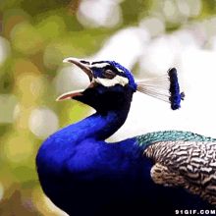
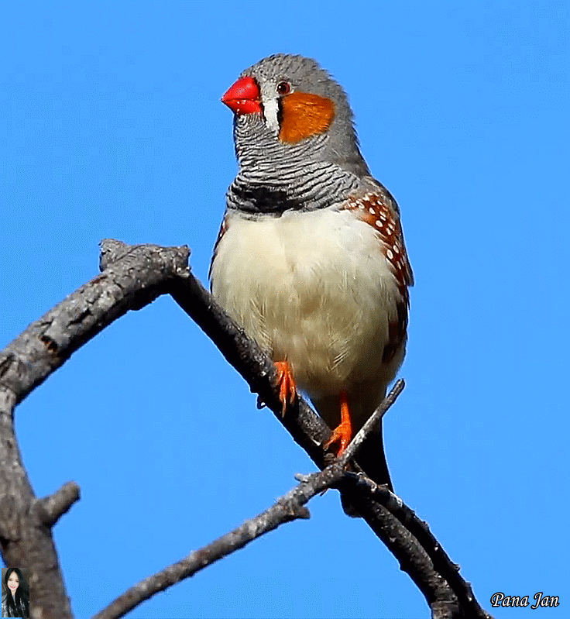
DIFFERENT KINDS OF BEAKS
Short, hard and horny beak :
Sparrows, pigeons, peacocks and finches
have short, hard and horny beak.
They crush grains and seeds with the
beaks.
SPARROW
PEACOCK
FLINCH

Slide 7
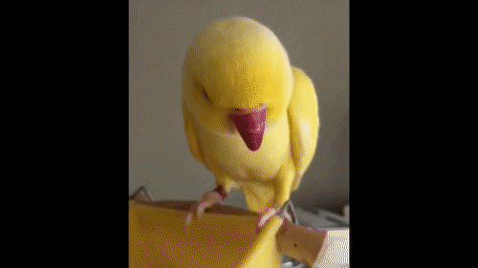
DIFFERENT KINDS OF BEAKS
Curved beak:
The curved beak of a parakeet helps it
to crack nuts and hard fruits.
And also helps it to climb trees.
PARAKEET

Slide 8
SUMMARY:
Eagles, vultures and kites are birds of prey. They have strong, sharp and hooked beak.
Sparrows, pigeons, peacocks have short hard and horny beaks.
Parakeet have curved beak to crack nuts and hard fruits.

Slide 9
LEARNING OUTCOME:
Learners will be able to–
get knowledge about the types of beaks.

Slide 10
THANKING YOU
ODM EDUCATIONAL GROUP

