Slide 1


SESSION : 9
CLASS : III
SUBJECT : SCIENCE
CHAPTER NUMBER : 3
CHAPTER NAME : PRECIOUS SOIL
SUBTOPIC : ACTIVITY BASED ON THE SOIL,
CLASS TEST.

Slide 2
LEARNING OBJECTIVE :
To enable the learner to -
revise the chapter and assess.

Slide 3
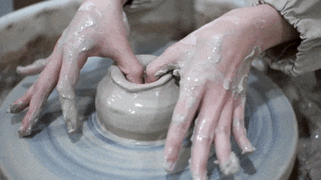
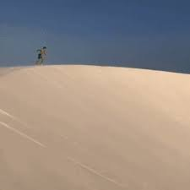
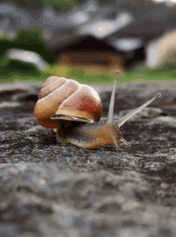
Activity
Identify the picture:
Clayey soil is used by the potter
Sandy soil found in desert/sea shore
Snails live in the soil

Slide 4
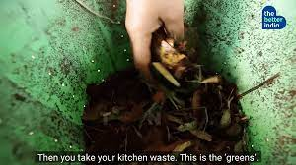
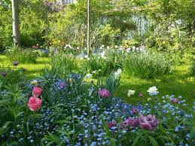
Manure makes the soil fertile
Loam is the best soil for plants

Slide 5

CLASS TEST
A. Multiple choice questions.
1.The action of sun, wind and rain break up rocks to form _______.
Table b. chair c. soil
2. Which soil is used to make pots?
Sandy soil b. loamy soil c. clayey soil
3. Which of these animals lives in soil?
a. Elephant b. snails d. lion

Slide 6
4. What do we add to soil to make it more fertile?
a. Water b. clay c. manure d. gravel
5. Which is the best soil for growing plants?
a. Sandy b. loam c. clayey d. mud

Slide 7
Write ‘True’ or ‘False’ for the given statements.
The making of soil take ten years.
Manure contains cow dung and decaying leaves.
The parts of dead plants and animals are called humus.
Sandy soil is best for the plants.
Soil contains humus, clay, sand and stones.
False
True
True
False
True

Slide 8
HOME ASSIGNMENT :
Learn Chapter – 1 and 2

Slide 9
LEARNING OUTCOME
The learner will be able -
revise the chapter and assess.

Slide 10
THANKING YOU
ODM EDUCATIONAL GROUP

