Slide 1


SESSION : 3
CLASS : III
SUBJECT : SCIENCE
CHAPTER NUMBER : 3
CHAPTER NAME : PRECIOUS SOIL
SUBTOPIC : TYPES OF SOIL, ORAL QUESTIONS

Slide 2
LEARNING OBJECTIVE :
Learners will be able to know -
Different types of soil and
Different uses of the soil.

Slide 3
LETS RECAPITULATE
Millions years before, the earth was a hard rock. The sun heated, the rain cooled the rocks then the wind over blew resulting the rock to broken into pieces.
The pieces further rubbed against each other till they became tiny particles of soil.
Different soils have different colours.
Soil contains stones, sand, clay, humus and also water and air.

Slide 4
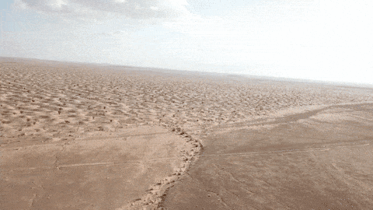
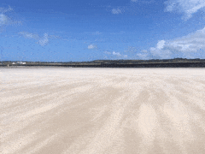
Dt.24.06.21 TYPES OF SOIL ( Sandy soil)
Sandy soil is mostly found in the desert and on the seashore.
Sand particles are big.
There is a lot of air in the space between these particles.
It does not hold much water.
SANDY SOIL IN DESERT
SANDY SOIL IN SEASHORE

Slide 5
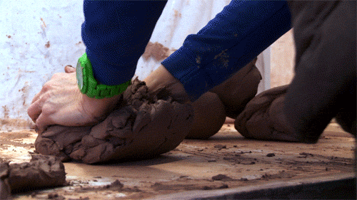
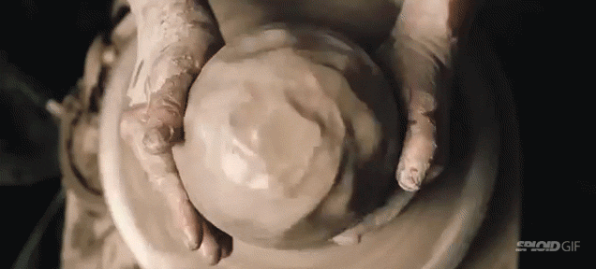
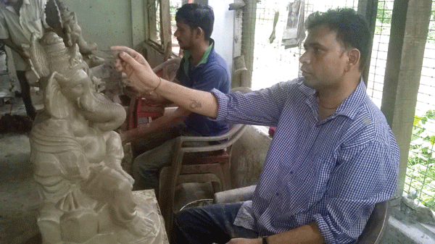
TYPES OF SOIL (Clayey soil)
Clayey soil is sticky.
It is mostly used for making pots and toys.
Clay particles are very fine.
There is no space for air between the particles.
It can hold a lot of water.
Clayey soil with fine particles
Clayey soil used in pot making
Clayey soil used in idol making

Slide 6
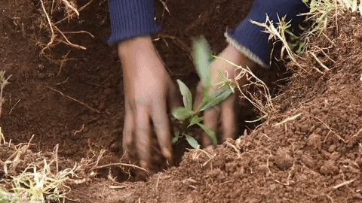
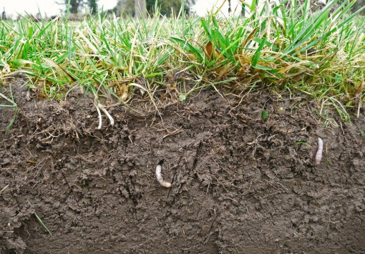
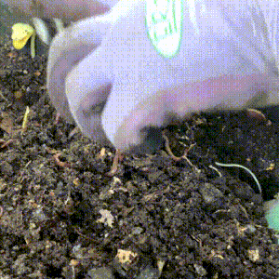
TYPES OF SOIL (Loam)
Loam is a mixture of sand and clay.
It can hold both air and water.
It has lot of humus.
Loam is the best soil for plants because it contains air, water and humus.
Humus makes the soil fertile.
Planting in loam soil
Grass in loam soil
Humus

Slide 7
ORAL QUESTIONS:
Choose the correct answer.
1. The making of soil took (hundreds/thousands/millions) of years.
ANS: millions
2. The soil is home to (birds/insects/elephants)
ANS: insects
3. (Humus/Sand/Clay) is the parts of dead plants and animals found in the soil.
ANS: Humus

Slide 8
LEARNING OUTCOME :
The learner will be able to -
Identify and describe different types of soil and their uses.

Slide 9
HOME ASSIGNMENT:
If you want to grow wheat, write the kind of soil would you need?

Slide 10
THANKING YOU
ODM EDUCATIONAL GROUP

